Slide 1
Argonne Leadership Computing Facility Getting Started Videoconference
Welcome! We will begin soon.
Please set your microphone to ‘mute’ unless you are asking a question.
Please leave your camera ON so our speakers can better interact with you.
This videoconference is meant to be interactive. If you have a question for the presenter, please ask. You may also hold your question for the end of the topic, or email it to the moderator at chel@alcf.anl.gov and it will be forwarded to the presenter.
Sessions are being recorded for future playback online.
Conference software support: please email chel@alcf.anl.gov
CRYPTOCard token or ALCF resource support: please email support@alcf.anl.gov
We will use Cetus or Vesta for the hands-on. Please make sure you can log in: > ssh username@cetus.alcf.anl.gov or > ssh username@vesta.alcf.anl.gov

Slide 2
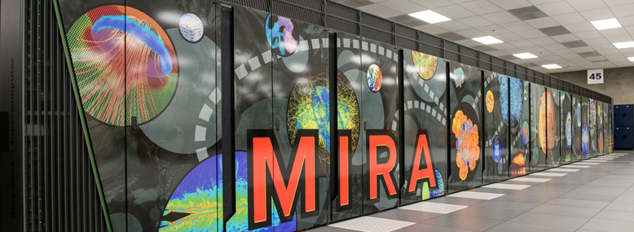
Welcome to Getting Started at the ALCF

Slide 3
Agenda
Part I
Blue Gene/Q hardware overview
Building your code
Considerations before you run
Queuing and running
Part II
After your job is submitted
Potential problems
Performance tuning
Backups and tape archiving
Hands-on session

Slide 4
Part I

Slide 5
Section: Blue Gene/Q hardware overview

Slide 6
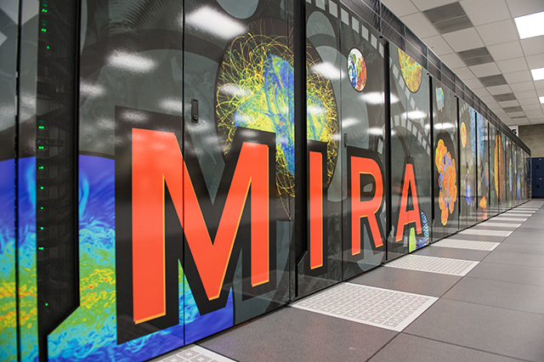
ALCF resources
Mira (Production) – IBM Blue Gene/Q
49,152 nodes / 786,432 cores
768 TB of memory
Peak flop rate: 10 PF
Linpack flop rate: 8.1 PF
Cetus (Test & Devel.) – IBM Blue Gene/Q
1,024 nodes / 16,384 cores
16 TB of memory
210 TF peak flop rate
Vesta (Test & Devel.) – IBM Blue Gene/Q
2,048 nodes / 32,768 cores
32 TB of memory
419 TF peak flop rate
Tukey (Visualization) – NVIDIA
96 nodes / 1536 x86 cores / 192 M2070 GPUs
6.1 TB x86 memory / 1.1 TB GPU memory
220 TF peak flop rate
Storage
Scratch: 28.8 PB raw capacity, 240 GB/s bw (GPFS)
Home: 1.8 PB raw capacity,
45 GB/s bw (GPFS)
Storage upgrade planned in 2015

Slide 7
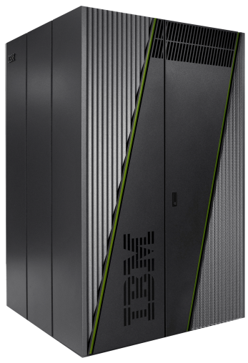
ALCF resources
(16) DDN 12Ke couplets – Scratch – 28 PB (raw), 240 GB/s
Mira
48 racks / 768K cores
10 PF
Infiniband Switch Complex
I/O
(3) DDN 12Ke couplets – Home – 1.8 PB (raw), 45 GB/s
Cetus (T&D)
1 rack / 16K cores
210 TF
I/O
Tukey (Visualization)
96 nodes / 1536 cores
192 NVIDIA GPUs
6.1 TB / 1.1 TB GPU
Tape Library – 16 PB (raw)
Networks – 100Gb
(via ESnet, internet2
UltraScienceNet, )
IB Switch
(1) DDN 12Ke – 600 TB (raw), 15 GB/s
Vesta (T&D)
2 racks / 32K cores
419 TF
I/O

Slide 8
Blue Gene Features
Low speed, low power
Embedded PowerPC core with custom SIMD floating point extensions
Low frequency: 1.6 GHz on Blue Gene/Q
Massive parallelism
Many cores: 786,432 on Mira
Fast communication network(s)
5D Torus network on Blue Gene/Q
Balance
Processor, network, and memory speeds are well balanced
Minimal system overhead
Simple lightweight OS (CNK) minimizes noise
Standard programming models
Fortran, C, C++ & Python languages supported
Provides MPI, OpenMP, and Pthreads parallel programming models
System-on-a-Chip (SoC) & Custom designed ASIC (Application Specific Integrated Circuit)
All node components on one chip, except for memory
Reduces system complexity and power, improves price / performance
High reliability
Sophisticated RAS (Reliability, Availability, and Serviceability)
Dense packaging
1024 nodes per rack

Slide 9
Blue Gene/Q evolution from Blue Gene/P
Design Parameters | Blue Gene/P | Blue Gene/Q | Difference
Cores / Node | 4 | 16 | 4x
Hardware Threads / Core | 1 | 4 | 4x
Concurrency / Rack | 4,096 | 65,536 | 16x
Clock Speed (GHz) | 0.85 | 1.6 | 1.9x
Flop / Clock / Core | 4 | 8 | 2x
Flop / Node (GF) | 13.6 | 204.8 | 15x
RAM / core (GB) | 0.5 or 1 | 1 | 2x or 1x
Mem. BW/Node (GB/sec) | 13.6 | 42.6 | 3x
Latency (MPI zero-length, nearest-neighbor node) | 2.6 ms | 2.2 ms | ~15% less
Bisection BW (32 racks) | 1.39TB/s | 13.1TB/s | 9.42x
Network | 3D Torus + collectives | 5D Torus | smaller diameter
GFlops/Watt | 0.77 | 2.10 | 3x
Instruction Set | 32 bit PowerPC + DH | 64 bit PowerPC + QPX | new vector instructions
Programming Models | MPI + OpenMP | MPI + OpenMP
Cooling | air | water

Slide 10
Blue Gene/Q
Compute card
One single chip module
16 GB DDR3 Memory
Heat Spreader for H₂O Cooling
Node board
32 compute cards,
optical Modules,
link chips; 5D Torus
Chip
16+2 cores
Module
Single chip
Rack
1 or 2 midplanes
0, 1, 2, or 4 I/O drawers
Multi-rack system Mira: 48 racks, 10 PF/s
I/O drawer
8 I/O cards w/16 GB
8 PCIe Gen2 x8 slots
3D I/O Torus
Midplane 16 node boards

Slide 11
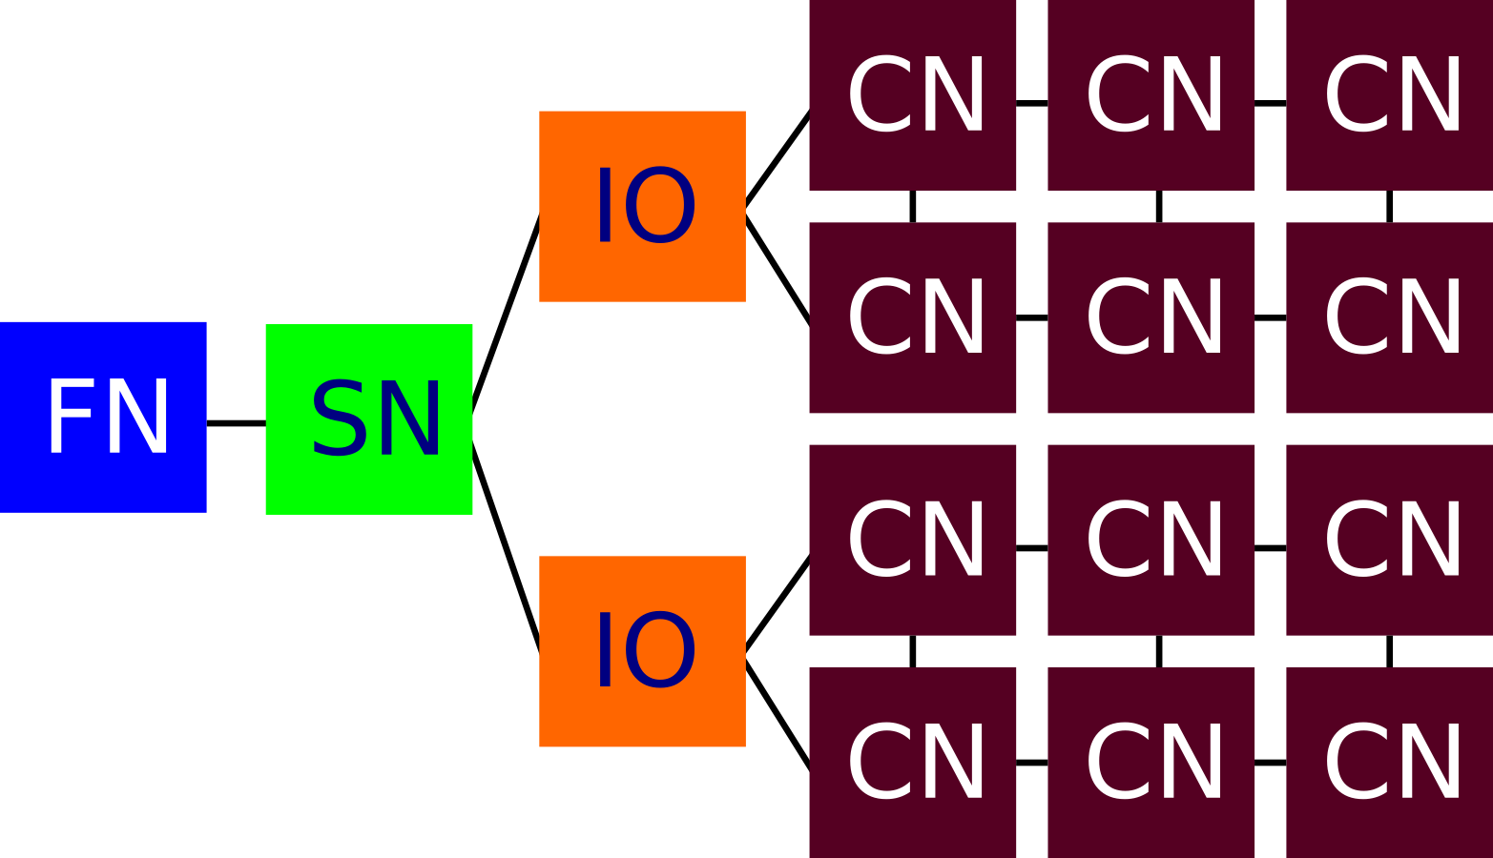
Blue Gene/Q system components
Front-end nodes – dedicated for user’s to login, compile programs, submit jobs, query job status, debug applications. RedHat Linux OS.
Service nodes – perform partitioning, monitoring, synchronization and other system management services. Users do not run on service nodes directly.
I/O nodes – provide a number of Linux/Unix typical services, such as files, sockets, process launching, signals, debugging; run Linux.
Compute nodes – run user applications, use simple compute node kernel (CNK) operating system, ships I/O-related system calls to I/O nodes.
Notes:
11

Slide 12
Partition dimensions on Blue Gene/Q systems
Mira
Cetus
Nodes | A | B | C | D | E
512 | 4 | 4 | 4 | 4 | 2
1024 | 4 | 4 | 4 | 8 | 2
2048 | 4 | 4 | 4 | 16 | 2
4096 | 4/8 | 4 | 8/4 | 16 | 2
8192 | 4 | 4 | 16 | 16 | 2
12288 | 8 | 4 | 12 | 16 | 2
16384 | 4/8 | 8/4 | 16 | 16 | 2
24576 | 4 | 12 | 16 | 16 | 2
32768 | 8 | 8 | 16 | 16 | 2
49152 | 8 | 12 | 16 | 16 | 2
Nodes | A | B | C | D | E
128 | 2 | 2 | 4 | 4 | 2
256 | 4 | 2 | 4 | 4 | 2
512 | 4 | 4 | 4 | 4 | 2
1024 | 4 | 4 | 4 | 8 | 2
Vesta
Nodes | A | B | C | D | E
32 | 2 | 2 | 2 | 2 | 2
64 | 2 | 2 | 4 | 2 | 2
128 | 2 | 2 | 4 | 4 | 2
256 | 4 | 2 | 4 | 4 | 2
512 | 4 | 4 | 4 | 4 | 2
1024 | 4 | 4 | 4/8 | 8/4 | 2
2048^{(*)} | 4 | 4 | 8 | 8 | 2
Command: partlist
http://www.alcf.anl.gov/user-guides/machine-partitions
(*) Partition not active.

Slide 13
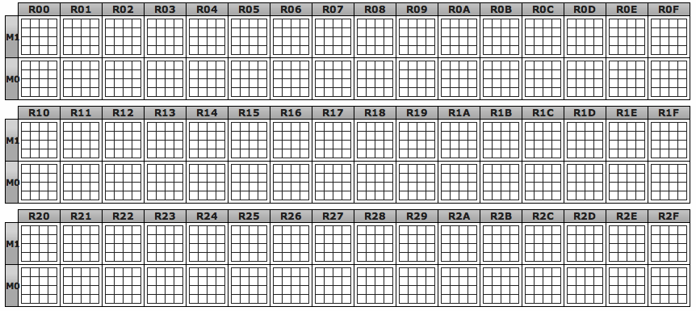
Mira multiple rack partitions (“blocks”)
512 nodes
1024
2048
4096
The number of large block sizes possible is:
# of nodes | # of blocks
49152 | 1
32768 | 3
24576 | 2
16384 | 9
12288 | 12
8192 | 6
4096 | 12
2048 | 24
1024 | 64
512 | 96
Row 0
Row 1
Row 2
8192
16384
http://status.alcf.anl.gov/mira/activity (beta, a.k.a. The Gronkulator)
partlist will show you if a large free block is busy due to a wiring dependency

Slide 14
Minimum partition sizes on Blue Gene/Q systems
512 nodes = minimum partition size on Mira
Mira
48 racks
128 nodes = minimum partition size on Cetus
Cetus
1 rack
32 nodes = minimum partition size on Vesta
Vesta
2 racks

Slide 15
Questions?

Slide 16
Section: Building your code

Slide 17
SoftEnv
A tool for managing a user’s environment
Sets your PATH to access desired front-end tools
Your compiler version can be changed here
Settings:
Maintained in the file ~/.soft
Add/remove keywords from ~/.soft to change environment
Make sure @default is at the very end
Commands:
softenv
A list of all keywords defined on the systems
resoft
Reloads initial environment from ~/.soft file
soft add|remove keyword
Temporarily modify environment by adding/removing keywords
http://www.mcs.anl.gov/hs/software/systems/softenv/softenv-intro.html

Slide 18
Using compiler wrappers
IBM XL cross-compilers:
SoftEnv key: +mpiwrapper-xl
Non-thread-safe: mpixlc, mpixlcxx, mpixlf77, mpixlf90, mpixlf95, mpixlf2003, etc.
Thread-safe (add _r suffix): mpixlc_r, mpixlcxx_r, mpixlf77_r, etc.
“-show” option: shows complete command used to invoke compiler. E.g.: > mpixlc -show
GNU cross-compilers:
SoftEnv key: +mpiwrapper-gcc
mpicc, mpicxx, mpif77, mpif90
CLANG cross-compilers:
SoftEnv key: +mpiwrapper-bgclang
mpiclang, mpiclang++, mpiclang++11
http://www.alcf.anl.gov/user-guides/software-and-libraries

Slide 19
IBM XL Optimization Settings Options
Level | Implies | Description
-O0 | -qstrict -qfloat=nofltint:norsqrt:rngchk -qstrict_induction | Preserves program semantics, minimal optimization. Best for debugging
-O2 (or -O) | -qstrict -qfloat=nofltint:norsqrt:rngchk -qnostrict_induction -qmaxmem=8192 | Preserves program semantics, eliminates redundant code, basic loop optimization. Good for correctness check, baseline performance
-O3 | -qnostrict -qfloat=fltint:rsqrt:norngchk -qnostrict_induction -qmaxmem=-1 -qhot=level=0 | High order loop analysis and transformations, better loop scheduling, inlining, in depth memory access analysis. Can alter program semantics unless used with -qstrict
-O4 | All -O3 options plus -qhot=level=1 -qhot=vector -qipa=level=1 | Additional loop analysis, basic interprocedural optimization.
-O5 | All -O4 options plus -qipa=level=2 | Advanced interprocedural analysis (IPA).

Slide 20
IBM XL Optimization Tips
Tips:
-qlistopt generates a listing with all flags used in compilation
-qreport produces a listing, shows how code was optimized
Performance can decrease at higher levels of optimization, especially at -O4 or -O5
May specify different optimization levels for different routines/files
The compiler option ‘-g’ must be used to resolve the code line numbers
in the debugger.

Slide 21
Sample Blue Gene/Q makefile
CC = mpixlc
CXX = mpixlcxx
FC = mpixlf90
OPTFLAGS = -O3
CFLAGS = $(OPTFLAGS) -qlist -qsource -qreport -g
FFLAGS = $(OPTFLAGS) -qlist -qsource -qreport -g
myprog: myprog.c
$(CC) $(CFLAGS) –o myprog myprog.c

Slide 22
Threading
OpenMP is supported
IBM XL compilers: -qsmp=omp:noauto
GNU: -fopenmp
BGCLANG: -fopenmp
Pthreads is supported
NPTL Pthreads implementation in glibc requires no modifications
Compiler auto thread parallelization is available
Use -qsmp=auto
Not always effective
The runjob mode will determine maximum total number of threads (including the master thread)
runjob --ranks-per-node (or for non-script jobs, qsub --mode)
Maximum 4 threads per core
Each core needs at least 2 (possibly more) threads for peak efficiency

Slide 23
OpenMP
Shared-memory parallelism is supported within a single node
Hybrid programming model
MPI at outer level, across compute nodes
OpenMP at inner level, within a compute node
For XL compilers, thread-safe compiler version should be used (mpixlc_r etc.) with any threaded application (either OMP or Pthreads)
OpenMP standard directives are supported (version 3.1):
parallel, for, parallel for, sections, parallel sections, critical, single
#pragma omp <rest of pragma> for C/C++
!$OMP <rest of directive> for Fortran
Compiler functions
omp_get_num_procs, omp_get_num_threads omp_get_thread_num, omp_set_num_threads
Number of OpenMP threads
set using environment variable OMP_NUM_THREADS
must be exported to the compute nodes using runjob --envs (or for non-script jobs, qsub --env)

Slide 24
Software & libraries on Blue Gene/Q systems
ALCF supports two sets of libraries:
IBM system and provided libraries: /bgsys/drivers/ppcfloor
glibc
mpi
PAMI (Parallel Active Messaging Interface)
Site supported libraries and programs: /soft/libraries
ESSL, PETSc, HDF5, netCDF, Parallel netCDF, Boost
ESSL is IBM’s optimized Engineering and Scientific Subroutine library for BG/Q: BLAS, LAPACK, FFT, sort/search, interpolation, quadrature, random numbers, BLACS
Additional tuned libraries in /soft/libraries/alcf subdirectory
BLAS, CBLAS, FFTW2, FFTW3, LAPACK, METIS, PARMETIS, PARPACK, SCALAPACK, SILO, SZIP, ZLIB
For a complete list visit:
http://www.alcf.anl.gov/user-guides/software-and-libraries

Slide 25
Questions?

Slide 26
Section: Considerations before you run

Slide 27
Allocations, accounts, projects, & such at ALCF
ALCF Account
Login username
/home/username
Access to at least one machine
CRYPTOCard token for authentication
PIN
Must call ALCF help desk to activate
Project
Corresponds to allocation of core-hours on at least one machine
User can be member of one or more projects
/projects/ProjectName
Logging in
ssh -Y username@mira.alcf.anl.gov
Click button on CRYPTOCard
Password: PIN + CRYPTOCard display
http://www.alcf.anl.gov/user-guides/accounts-access

Slide 28
Allocations, accounts, projects, & such at ALCF
ALCF Account
Login username
/home/username
Access to at least one machine
CRYPTOCard token for authentication
PIN
Must call ALCF help desk to activate
Project
Corresponds to allocation of core-hours on at least one machine
User can be member of one or more projects
/projects/ProjectName
Logging in
ssh -Y username@mira.alcf.anl.gov
Click button on CRYPTOCard
Password: PIN + CRYPTOCard display
Manage your account at
http://accounts.alcf.anl.gov
(password needed)
http://www.alcf.anl.gov/user-guides/accounts-access

Slide 29
Allocation Management
Every user must be assigned to at least one Project:
Use ‘projects’ command to query.
Projects are then given allocations:
Allocations have an amount, start, and end date, and are tracked separately; Charges will cross allocations automatically. The allocation with the earliest end date will be charged first, until it runs out, then the next, and so on.
Use ‘cbank’ command to query allocation, balance:
cbank charges -p <projectname> # list all charges against a particular project
cbank allocations -p <projectname> # list all active allocations for a particular project
Other useful options:
-u <user> : show info for specific user(s)
-a <YYYY-MM-DD> : show info after date (inclusive)
-b <YYYY-MM-DD> : show info before date (exclusive)
--help
Note: cbank is updated once a day, at midnight (CDT).
Charges are based on the partition size, NOT the number of nodes or cores used!
http://www.alcf.anl.gov/user-guides/querying-allocations-using-cbank

Slide 30
Blue Gene/Q file systems at ALCF
Name | Accessible from | Type | Path | Production | Backed up | Uses
vesta-home | Vesta | GPFS | /home or /gpfs/vesta-home | Yes | No | General use
vesta-fs0 | Vesta | GPFS | /projects | Yes | No | Intensive job output, large files
mira-home | Mira Cetus Tukey | GPFS | /home or /gpfs/mira-home | Yes | Yes | General use
mira-fs0 | Mira Cetus Tukey | GPFS | /projects | Yes | No | Intensive job output, large files
http://www.alcf.anl.gov/user-guides/bgq-file-systems

Slide 31
Disk quota management
Disk storage
/home directories:
Default of 100 GB for Mira and 50 GB for Vesta
Check your quota with the ‘myquota’ command
/projects directories:
Default of 1000 GB for Mira and 500 GB for Vesta
Check the quota in your projects with the ‘myprojectquotas’ command
See http://www.alcf.anl.gov/user-guides/data-policy#data-storage-systems

Slide 32
Data transfer to/from ALCF
The Blue Gene/Q connects to other research institutions using a total of 60 Gbits/s of public network connectivity
Data management webinar: https://www.youtube.com/watch?feature=player_embedded&v=pEkgf2KnaU4
Data Transfer Utilities
GridFTP (for large transfers)
Other site must accept our Certificate Authority (CA)
CRYPTOCard access available
sftp and scp (for “small” transfers)
For local transfers of small files, not recommended for large data transfers due to poor performance and excess resource utilization on the login nodes.
Data Transfer Service
Globus (for large transfers)
Globus addresses the challenges faced by researchers in moving, sharing,
and archiving large volumes of data among distributed sites.
ALCF Blue Gene/Q endpoints: alcf#dtn_mira, alcf#dtn_vesta, alcf#dtn_hpss
Ask your laboratory or university system administrator if your institution has an endpoint.
Globus Connect Personal to share and transfer files to/from a local machine.
http://www.alcf.anl.gov/user-guides/data-transfer

Slide 33
Questions?

Slide 34
Section: Queuing and running

Slide 35
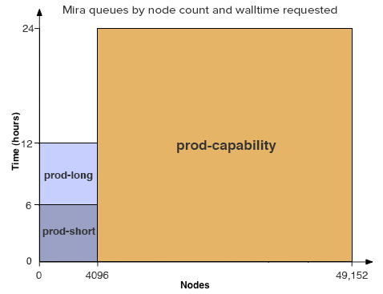
Mira job scheduling
Restrictions in queues
prod-long: restricted to the row 0.
prod-short, prod-capability: can run in the full machine
http://www.alcf.anl.gov/user-guides/job-scheduling-policy-bgq-systems
User Queued | Underlying Queue | Nodes | Wall-clock Time (hours) | Max. Running per User | Max. Queued per User
prod | prod-short | 512 - 4096 | 0 - ≤6 | 5 | 20
 | prod-long | 512 - 4096 | >6 - 12 | 5 | 20
 | prod-capability | 4097 - 49152 | 0 - 24 | 5 | 20
 | backfill ^{(*)} | 512 - 49152 | 0 - 6 | 5 | 20
prod-1024-torus | prod-1024-torus | 1024 | 0 - 12 | 5 | 16
prod-32768-torus | prod-32768-torus | 32768 | 0 - 24 | 1 | 20
(*) This queue is automatically selected if a project’s allocation is negative.
I/O to compute node ratio 1:128

Slide 36
Cetus job scheduling
User Queue | Partition Sizes in Nodes | Wall-clock Time (hours) | Max. Running per User | Max. Queued per User
default, low | 128, 256, 512, 1024 | 0 - 1 | 5 | 20
Cetus scheduling is designed to support application testing and debugging, not production work.
I/O to compute node ratio 1:128
Vesta job scheduling
User Queue | Partition Sizes in Nodes | Wall-clock Time (hours) | Max. Running per User | Max. Queued Node-hours
default | 32, 64, 128, 256, 512, 1024 | 0 - 2 | 5 | 1024
singles | 32, 64, 128, 256, 512, 1024 | 0 - 2 | 1 | 1024
low | 32, 64, 128, 256, 512, 1024 | 0 - 2 | None | 4096
I/O to compute node ratio 1:32
http://www.alcf.anl.gov/user-guides/job-scheduling-policy-bgq-systems

Slide 37
Mira job boot times
Each time a job is submitted using a standard qsub command, all nodes in a partition are rebooted.
Boot times depend on the size of the partition:
Nodes in partition | Boot time (minutes)
≤ 2048 | 1
4096 | 1.5
8192 | 3
16384 | 4
32768 | 6
49152 | 7
The scheduler will attempt to boot the block up to three times if the boot procedure fails, so it may take as much as three times as long under rare circumstances.

Slide 38
Cobalt resource manager and job scheduler
Cobalt is resource management software on all ALCF systems
Similar to PBS but not the same
Job management commands:
qsub: submit a job
qstat: query a job status
qdel: delete a job
qalter: alter batched job parameters
qmove: move job to different queue
qhold: place queued (non-running) job on hold
qrls: release hold on job
qavail: list current backfill slots available for a particular partition size
For reservations:
showres: show current and future reservations
userres: release reservation for other users

Slide 39
qsub Options
Syntax:
qsub [-d] [-v] -A <project name> -q <queue> --cwd <working directory>
--env envvar1=value1:envvar2=value2 --kernel <kernel profile>
-K <kernel options> -O <outputprefix> -t time <in minutes>
-e <error file path> -o <output file path> -i <input file path>
-n <number of nodes> -h --proccount <processor count>
--mode <mode> -M <email> --dependencies <jobid1>:<jobid2> <command> <args>
Standard options:
-A project project to charge
-q queue queue
-t <time_in_minutes> required runtime
-n <number_of_nodes> number of nodes
--proccount <number_of_cores> number of CPUs
--mode <script | cX> running mode
--env VAR1=1:VAR2=1 environment variables
<command> <args> command with arguments
-O project <output_gile_prefix> prefix for output files (default jobid)
-M <email_address> e-mail notification of job start, end
--dependencies <jobid1>:<jobid2> set dependencies for job being submitted
-I or --interactive run an interactive command
Further options and details may be found in the man pages (> man qsub) or at:
http://trac.mcs.anl.gov/projects/cobalt/wiki/CommandReference

Slide 40
Cobalt job control: basic method
Basic: submit a BG/Q executable qsub --mode cN … path/executable
N is number of processes (MPI ranks) per node
Node has 16 cores --mode c1 — 1 rank/node --mode c2 — 2 rank/node … --mode c16 — 1 rank/core --mode c32 — 2 rank/core --mode c64 — 4 rank/core
Threads qsub --mode c1 --env OMP_NUM_THREADS=64 qsub --mode c2 --env OMP_NUM_THREADS=32 … qsub --mode c16 --env OMP_NUM_THREADS=4 ….

Slide 41
Cobalt job control: script method
Script: submit a script (bash, csh, ….) qsub --mode script … path/script
Script example: qsub -t 10 -n 8192 -A myproject --mode script myscript.sh #!/bin/sh echo "Starting Cobalt job script” runjob --np 131072 -p 16 --block $COBALT_PARTNAME : <executable> <args…>
New #COBALT syntax: qsub -t 10 -n 8192 --mode script myscript.sh #!/bin/bash #COBALT -A myproject -O My_Run_$jobid runjob --np 131072 -p 16 --block $COBALT_PARTNAME --verbose=INFO : <executable> <args…>
MPI ranks
ranks/node
separator
expands to Cobalt jobid

Slide 42
Job dependencies
Following job in sequence depends on completion of current job
> qsub -A MyProject -t 12:00:00 -n 8192 --mode c32 myprogram
** Project ’MyProject'; job rerouted to queue 'prod-capability'
234439
> qsub -A MyProject -t 12:00:00 -n 8192 --mode c32 myprogram \ --dependencies 234439
** Project ’MyProject'; job rerouted to queue 'prod-capability'
234440
> qstat -u myusername
JobID User WallTime Nodes State Location
====================================================
234439 myusername 12:00:00 8192 queued None
234440 myusername 12:00:00 8192 dep_hold None
Cobalt Job ID

Slide 43
Job dependencies (cont’d)
Job 24439 fails (ends with error code):
> qstat -u myusername
JobID User WallTime Nodes State Location
====================================================
234440 myusername 12:00:00 8192 dep_fail None
Release 23440 to allow it to run:
> qrls --dependencies 23440
> qstat -u myusername
JobID User WallTime Nodes State Location
====================================================
234440 myusername 12:00:00 8192 queued None

Slide 44
Advanced runs using script mode
Multiple (consecutive) runs in a single job
Multiple simultaneous runs in a single job
Combinations of the above
See:
http://www.alcf.anl.gov/user-guides/cobalt-job-control
http://trac.mcs.anl.gov/projects/cobalt/wiki/BGQUserComputeBlockControl

Slide 45
Reservations
Reservations allow exclusive use of a partition for a specified group of users for a specific period of time
a reservation prevents other users’ jobs from running on that partition
often used for system maintenance or debugging
R.pm (preventive maintenance), R.hw* or R.sw* (addressing HW or SW issues)
reservations are sometimes idle, but still block other users’ jobs from running on a partition
should be the exception not the rule
Requesting
See: http://www.alcf.anl.gov/user-guides/reservations
Email reservation requests to support@alcf.anl.gov
View reservations with showres
Release reservations with userres
When working with others in a reservation, these qsub options are useful:
--run_users <user1>:<user2>:… All users in this list can control this job
--run_project <projectname> All users in this project can control this job

Slide 46
Questions?

Slide 47
Part II

Slide 48
Section: After your job is submitted

Slide 49
qstat: show status of a batch job(s)
qstat # list all jobs
JobID User WallTime Nodes State Location
======================================================
301295 smith 00:10:00 16 queued None
About jobs
JobID is needed to kill the job or alter the job parameters
Common states: queued, running, user_hold, maxrun_hold, dep_hold, dep_fail
qstat -f <jobid> # show more job details
qstat -fl <jobid> # show all job details
qstat -u <username> # show all jobs from <username>
qstat -Q
Instead of jobs, this shows information about the queues
Will show all available queues and their limits
Includes special queues used to handle reservations

Slide 50
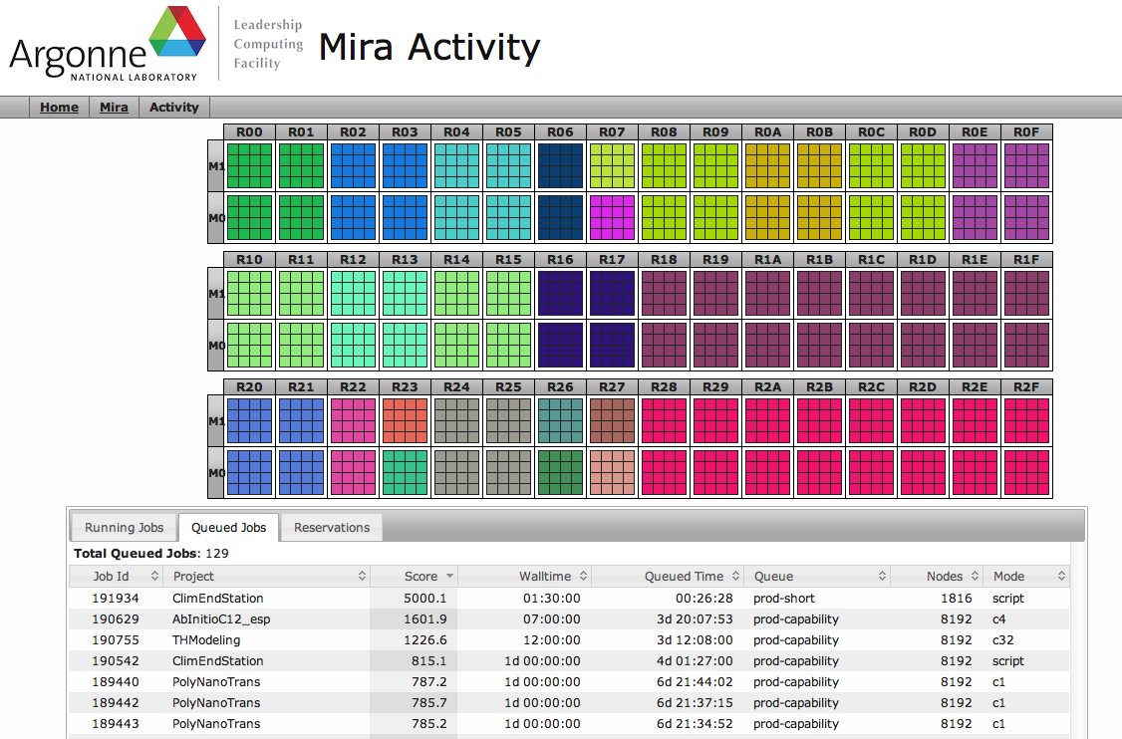
Machine status web page
4096 nodes
2048 nodes
Running Jobs
Queued Jobs
Reservations
8192 nodes
http://status.alcf.anl.gov/mira/activity (beta, a.k.a. The Gronkulator)

Slide 51
Machine status web page (cont’d)
http://status.alcf.anl.gov/cetus/activity
http://status.alcf.anl.gov/vesta/activity

Slide 52
Machine status web page (cont’d)
http://status.alcf.anl.gov/tukey/activity

Slide 53
Cobalt files for a job
Cobalt will create 3 files per job, the basename <prefix> defaults to the jobid, but can be set with “qsub -O myprefix”
Cobalt log file: <prefix>.cobaltlog
first file created by Cobalt after a job is submitted
contains submission information from qsub command, runjob, and environment variables
Job stderr file: <prefix>.error
created at the start of a job
contains job startup information and any content sent to standard error while the user program is running
Job stdout file: <prefix>.output
contains any content sent to standard output by user program

Slide 54
qdel: kill a job
qdel <jobid1> <jobid2>
delete the job from a queue
terminated a running job

Slide 55
qalter, qmove: alter parameters of a Job
Allows to alter the parameters of queued jobs without resubmitting
Most parameters may only be changed before the run starts
Usage: qalter [options] <jobid1> <jobid2> …
Example: > qalter -t 60 123 124 125 (changes wall time of jobs 123, 124 and 125 to 60 minutes)
Type ‘qalter -help’ to see full list of options
qalter cannot change the queue; use qmove instead:
> qmove <destination_queue> <jobid>

Slide 56
qhold, qrls: holding and releasing
qhold - Hold a submitted job (will not run until released) qhold <jobid1> <jobid2>
To submit directly into the hold state, use qsub –h
qrls - Release a held job (in the user_hold state) qrls <jobid1> <jobid2>
Jobs in the dep_hold state released by removing the dependency qrls --dependencies <jobid> or qalter –dependencies none <jobid>
Jobs in the admin_hold state may only be released by a system administrator

Slide 57
Possibilities why a job is not running yet
There is a reservation, which interferes with your job
showres shows all reservations currently in place
There are no available partitions for the requested queue
partlist shows all partitions marked as functional
partlist shows the assignment of each partition to a queue
Name Queue State //
============================================================================//
… //
MIR-04800-37B71-1-1024 prod-short:backfill busy //
MIR-04880-37BF1-1-1024 prod-short:backfill blocked (MIR-048C0-37BF1-512) //
MIR-04C00-37F71-1-1024 prod-short:backfill blocked (MIR-04C00-37F31-512) //
MIR-04C80-37FF1-1-1024 prod-short:backfill idle //
… //
Job submitted to a queue which is restricted to run at this time

Slide 58
Optimizing for queue throughput
Small (≤ 4K) , long (6h < time < 12h) jobs submitted to prod will be redirected to prod-long, which is restricted to row 0.
Consider instead:
Small (≤ 4K) , short (≥ 6h) jobs in prod queue will be redirected to prod-short, which can run anywhere.
Large (> 4K) jobs in prod queue will be redirected to prod-capability, which can run anywhere.
Shotgun approach:
If your code is amenable, submit a mix of job sizes and lengths.
Check for drain windows:
partlist | grep idle
full partlist output:
Name Queue State Backfill Geometry
===============================================================================================
…
MIR-04800-37B71-1-1024 prod-short:backfill busy - 4x4x4x8x2
MIR-04880-37BF1-1-1024 prod-short:backfill blocked (MIR-048C0-37BF1-512) - 4x4x4x8x2
MIR-04C00-37F71-1-1024 prod-short:backfill blocked (MIR-04C00-37F31-512) - 4x4x4x8x2
MIR-04C80-37FF1-1-1024 prod-short:backfill idle 0:49 4x4x4x8x2
…
In this case, a job submitted for 1024 nodes can run immediately if its time is < 49 minutes
(might need to be a few minutes shorter to allow for scheduling delay)

Slide 59
Questions?

Slide 60
Section: Potential problems

Slide 61
When things go wrong… logging in
Check to make sure it’s not maintenance:
Login nodes on Blue Gene/Q and data analytics systems are often closed off during maintenance to allow for activities that would impact users
Look for reminders in the weekly maintenance announcement and the pre-login banner message
An all-clear email will be sent out at the close of maintenance
Remember that CRYPTOCard passwords:
Require a pin at the start
Are all all hexadecimal characters (0-9, A-F). Letters are all UPPER CASE.
On failed login, try in this order:
Try typing PIN + password again (without generating new password)
Try a different ALCF host to rule out login node issues (e.g., maintenance)
Push CRYPTOCard button to generate new password and try that
Walk through the unlock and resync steps at: http://www.alcf.anl.gov/user-guides/using-cryptocards#troubleshooting-your-cryptocard
Still can’t login?
Connect with ssh -vvv and record the output, your IP address, hostname, and the time that you attempted to connect.
Send this information in your e-mail to support@alcf.anl.gov

Slide 62
When things go wrong… running
Cobalt jobs, by default, produce three files (*.cobaltlog, *.error, *.output)
Only *.cobaltlog is generated at submit time, the others at runtime
Boot status (successful or not) written to *.cobaltlog
After booting, the *.error file will have a non-zero size:
Note: If your script job redirects the stderr of cobalt-mpirun, it will not end up in the job’s .error file
If you think there is an issue, it’s best to save all three files:
Send the jobid, machine name and a copy of the files to support@alcf.anl.gov

Slide 63
When things go wrong… running
RAS events appearing in your .error file not always a sign of trouble:
RAS stands for Reliability, Availability, and Serviceability
Few are signs of a serious issue, most are system noise:
Messages have a severity associated with them:
INFO
WARN
ERROR
FATAL
Only FATAL RAS events will terminate your application
ERROR may degrade performance but will NOT kill your job.
Still worth watching as they may indicate an application performance issue
If you run exits abnormally, the system will list the last RAS event encountered in the run. This RAS event did not necessarily cause the run to die.

Slide 64
Core files
Jobs experiencing fatal errors will generally produce a core file for each process
Examining core files:
Core files are in text format, readable with the ‘more’ command
bgq_stack command provides call stack trace from a core file:
Ex: bgq_stack <corefile>
Command line interface (CLI)
Can only examine one core file at a time
coreprocessor.pl command provides call stack trace from multiple cores:
Ex: coreprocessor.pl -c=<directory_with_core_files> -b=a.out
CLI and GUI. GUI interface requires X11 forwarding (ssh -X mira.alcf.anl.gov)
Provides information from multiple core files
Environment variables control core dump behavior:
BG_COREDUMPONEXIT=1 : creates a core dump when the application exits
BG_COREDUMPDISABLED=1 : disables creation of any core files
http://www.alcf.anl.gov/user-guides/bgqstack
http://www.alcf.anl.gov/user-guides/coreprocessor

Slide 65
Getting help
Online resources (24/7):
ALCF web pages:
http://www.alcf.anl.gov
http://www.alcf.anl.gov/user-guides
https://accounts.alcf.anl.gov
Mira/Cetus/Vesta/Tukey status (a.k.a. The Gronkulator):
http://status.alcf.anl.gov/{mira,cetus,vesta,tukey}/activity
Contact us:
e-mail: support@alcf.anl.gov
ALCF Help Desk:
Your Catalyst
News from ALCF:
ALCF Weekly Updates, ALCF newsletters, email via {mira,cetus,vesta,tukey}-notify lists, etc.
Hours: Monday – Friday, 9 a.m. – 5 p.m. (Central time)
Phone: 630-252-3111 or 866-508-9181 (toll-free, US only)

Slide 66
Help Us Help You
For better, faster results, provide ALCF these details when you contact us for help (where applicable):
Machine(s) involved (Mira/Cetus/Vesta/Tukey)
Job IDs for any jobs involved
Exact error message received
Exact command executed
Filesystem used when the problem was encountered with path to files
Account username and project name that the problem pertains to
For connection problems: IP address from which you are connecting
Application software name/information

Slide 67
Questions?

Slide 68
Section: Performance Tuning

Slide 69
Tools: performance, profiling, debugging
Non-system libraries and tools are under the /soft directory:
/soft/applications - applications
LAMMPS, NAMD, QMCPACK, etc.
/soft/buildtools - build tools
autotools, cmake, doxygen, etc.
/soft/compilers - IBM Compiler versions
/soft/debuggers - debuggers
DDT, Totalview
/soft/libraries - libraries
ESSL, PETSc, HDF5, NetCDF, etc.
/soft/perftools - performance tools
TAU, HPCToolkit, PAPI, OpenSpeedshop, Scalasca, HPM, etc.

Slide 70
MPI mapping
A mapping defines the assignment of MPI ranks to BG/Q processors
Default mapping is ABCDET
(ABCDE) are 5D torus coordinates, T is a CPU number
Rightmost letter of the mapping increases first as processes are distributed (T then E)
Mappings may be specified by user using the RUNJOB_MAPPING environment variable:
With a mapping string:
qsub --env RUNJOB_MAPPING=TEDACB --mode c32…
String may be any permutation of ABCDET
E dimension of torus is always of size 2
With a mapping file:
qsub --env RUNJOB_MAPPING=<FileName> --mode c32…
mapfile: each line contains 6 coordinates to place the task, first line for task 0,
second line for task 1…
allows for use of any desired mapping
file must contain one line per process and not contain conflicts (no verification)
use high-performance toolkits to determine communication pattern
http://www.alcf.anl.gov/user-guides/machine-partitions

Slide 71
Questions?

Slide 72
Section: Backups and Tape Archiving

Slide 73
Backups and tape archiving
Backups
On-disk snapshots of /home directories are done nightly
If you delete files accidentally, check:
- /gpfs/mira-home/.snapshot on Mira/Cetus
- /gpfs/vesta-home/.snapshots on Vesta
Only home directories are backed up to tape
Project directories are not backed up (/projects)
Manual data archiving to tape (HPSS)
HSI is an interactive client
GridFTP access to HPSS is available
Globus endpoint available: alcf#dtn_hpss
See http://www.alcf.anl.gov/user-guides/using-hpss

Slide 74
Questions?

Slide 75
Section: Hands-on Session

Slide 76
GSW14 Hands-on session
Log into Cetus or Vesta: > ssh username@cetus.alcf.anl.gov or > ssh username@vesta.alcf.anl.gov
Select MPI wrapper scripts:
The default user environment does not provide a set of MPI compiler wrappers. A wrapper may be selected by using the appropriate SoftEnv key.
For the following examples, ensure that you have the +mpiwrapper-xl key uncommented and that it is located before the @default line. > cat ~/.soft +mpiwrapper-xl @default > resoft Note: after editing your ~/.soft file, run command ‘resoft’ to refresh your environment.
http://www.alcf.anl.gov/user-guides/connect-log
http://www.alcf.anl.gov/user-guides/overview-how-compile-and-link

Slide 77
GSW14 Hands-on session
GSW14 queue and project name: -q Q.GSW14 -A ALCF_Getting_Started
Compilation example:
Create directory, copy files, and compile program: > cp -r /soft/cobalt/examples/compilation ~/GSW14/Hands-on
> cd ~/GSW14/Hands-on/compilation > ls > cat hello_mpi.cpp > cat Makefile > make
Submit job and check output: > qsub -t 5 -n 16 --mode c1 -A ALCF_Getting_Started -q Q.GSW14 -o hello_mpi.output hello_mpi_cpp > qstat -u <username> > cat hello_mpi.output
Example of interactive job submission:
Copy directory: > cp -r /soft/cobalt/examples/interactive ~/GSW14/Hands-on > cd ~/GSW14/Hands-on/interactive
Open the README file and follow the instructions to submit an interactive job.

Slide 78
GSW14 Hands-on session
Example of ensemble submission:
Copy directory: > cp -r /soft/cobalt/examples/ensemble ~/GSW14/Hands-on > cd ~/GSW14/Hands-on/ensemble
Open the README file and follow the instructions to submit a 1-rack job with two 512 blocks. NOTE: remember to adapt the number of nodes and the block sizes provided in this example to the min./max. partition sizes available in the machine where you want to run the test (see slides 12 & 14 for reference).
Example of subblock job submission:
Copy directory: > cp -r /soft/cobalt/examples/subblock ~/GSW14/Hands-on > cd ~/GSW14/Hands-on/subblock
Open the README file and follow the instructions to submit a job on multiple 128-node jobs on a midplane on Mira.
Example of python job submission:
Copy directory: > cp -r /soft/cobalt/examples/python ~/GSW14/Hands-on > cd ~/GSW14/Hands-on/python
Open the README file and follow the instructions to submit a python job.

Slide 79
Argonne Leadership Computing Facility Getting Started Videoconference
Thank you for your attention

