Slide 1
How we stood up Mira or Pay no attention to the people behind the curtain…
William (Bill) E. Allcock
ALCF Director of Operations

Slide 2
So much happened before Mira dropped in…
Anybody care to guess how long before the first rack of Mira arrived we actually started working on it?
We got our “Science / Mission need justification” approved in Jan 2009 or almost exactly 3 years before installation of the first Blue Gene/Q rack.
We recently completed the above for our next machine.
How do you get millions of dollars for a supercomputer (or a collider, or a light source…)
The DOE Critical Decision Process
CD-0: Why do we need it? What science will get done? Bigger models, more detailed, etc.
CD-1: Vendors, processors, how big, how fast, how much storage, and of course, how expensive.
CD-2: This is project performance, not system performance; Project plans, Earned Value Management, etc..
CD-3: Basically, we can spend money; Ends with acceptance of the machine(we pay the vendors)
CD-4: Mostly paperwork; We are working on this for Mira now.
Or, I could put it another way: You have to get passed Danny Lehman ☺. He is the Director of the Office of Project Assessment and he organizes the major external reviews that are part of the process. They are not fun, but they do make sure we are spending the tax payers money wisely.

Slide 3
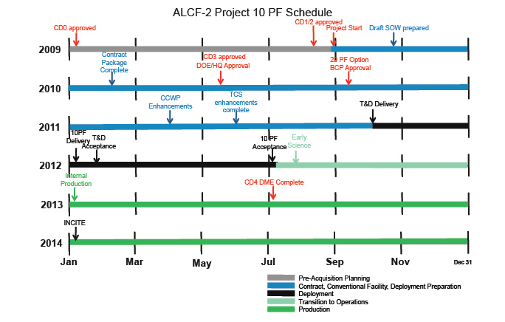
We even customize our project plan…
The previous slide gave the overview of the process. It can, and often is “customized”
Below was the proposed project plan. We did CD1,2, and 3 in two steps by doing half of CD2 with CD1 (CD1/2A) and have with CD3 (CD2B/3). We also ended up breaking acceptance into two chunks, so had a CD4a and CD4B
Notes:
Milestone Schedule at CD-2 & BCP Actual
CD-0, Approve Mission Need 01/09/2009 01/09/2009
CD-1, Approve Alternative Selection and Cost Range 08/31/2009 09/16/2009
CD-2a, Approve Performance Baseline and Start DME 08/31/2009 09/16/2009
CD-2b/3, Approve Procurement 05/28/2010 06/30/2010
L1 - Decision Point for 20 PF BCP Approved by DOE 09/30/2010 09/22/2010
Central Chilled Water Plant Enhancement & TCSComplete 08/31/2011 06/24/2011
Test & Development Machine Acceptance Complete 11/28/2012 01/18/2012
L1 - AT-24 Rack (CD4A) 11/2/2012 10/11/2012
L2 - AT-48 Acceptance Testing Complete 07/03/2013 12/18/2012
L1 - AT-48 DME Complete (CD4B) (Project Completion) 07/03/2013 01/23/2013

Slide 4
It takes the whole village and then some
This presentation will be primarily from the operations team point of view, but a change of this magnitude impacts everyone:
The Early Science Program (you may have heard of that one ☺ )
Get it approved, organized, who can participate, do their projects meet our constraints, allocate time, managing the program once it is running, etc..
The applications, benchmarks, and kernels that we use to assess and accept the machine
They have to be selected, they are often external, so we have to coordinate with the “owners”, we have to run baselines on the existing machines, understand how they work so we can project performance on hardware that doesn’t yet exist, work with the vendor to tune and evaluate starting on paper, then on emulators, simulators, pre-production hardware, and finally on the delivered hardware for acceptance.
Contracts / Purchasing
The Statement of Work for Mira and the associated hardware was a good inch thick and technically dense. We had to review every page and make sure there were no conflicts, corner cases, etc.. A procurement of this size requires approvals all the way to Washington.
Accounts, reports, etc.
All the normal, day-to-day things we do have to be made to work on a new system and they will be more prone to last minute, special case
Even the cleaning staff
All the tissues from the crying, and the coffee cups from the late nights… Just kidding… sort of ☺

Slide 5
Safety
Many of us spend most of our days sitting at a computer. Our biggest safety risks are stress, carpal tunnel, and lack of exercise.
This project involved MegaWatts of power gear being installed, connection of high voltage racks, rolling around racks that weighed two tons, or were on the order of 8 feet tall, welding, piping, water running right under high voltage receptacles and through the Blue Gene racks themselves. And we did this with 0 reportable safety incidents.
We did have one near miss
A design flaw in a rack PDU (power distribution unit, which is a fancy power strip) allowed a metal plug retaining clip to come loose, slide along the side of the PDU and into a ventilation hole and come into contact with 208V power. Luckily the person who caused this to happen when he bumped it with his elbow was wearing a jacket and the only result was a black mark on his jacket.
We immediately stopped work, put a work around in place (gaffers tape over enough of the ventilation holes to prevent it from happening), reported it to lab management, reported it complex wide (all the other labs) and worked with the vendor to modify their design so future units do not have the problem.

Slide 6
Facilities Preparation
Facilities preparation is one of the longest lead time items and was a substantial part of the project.
Space: Luckily, the TCS was built with this project in mind, so the data center space was already available.
Chilled Water: As a separate project, the lab built a new chilled water plant to provide the chilled water needed to cool the Blue Gene itself (not for air cooling the other equipment in the data center).
Leak detection: The BG/Q control system has some leak detection logic in it. Early on, it kept shutting down the racks for “slow leaks”. It was really a calibration / software error. There is a rudimentary system in place now and we are in the process of designing and procuring a more advanced one that will detect seepage (wet on the bottom of the pipe, but no drip) and for leaks that hit the floor, the ability to isolate where the water is within a few square feet as opposed to “THERE IS A LEAK SOMEWHERE”
To alleviate concerns with long term chemistry, corrosion, erosion, or plugging issues, we are modifying the water system to make the loop smaller (5000 vs. 20000 gallons), and eliminating black iron pipe.
Electrical Power: redundant 20MVa feeds were brought to the building
Flooring: This turned out to be a problem. Well, actually, the problem was the BG/Q racks being about 800# heavier than originally specified. We ended up having to replace the floor stanchions with stronger ones and replacing the tiles around the Blue Gene with stronger ones.

Slide 7
Planning, Infrastructure, and Networking
For Intrepid, everything pretty much came at the same time. For Mira, we brought the infrastructure in early, so that we could have much of it installed, tested, and configured ahead of time. This worked out extremely well and we will continue to do this in the future where feasible.
There is a surprising amount of compute power required just to support the operations of a facility of this size and a lot of detailed planning that goes into making it all work together.
We put a lot of redundancy into our network. The majority of the servers have two GigE uplinks for management. These uplinks go to two different in-rack switches. The in-rack switches have two uplinks going to two different blades in our router.
Databases: The Blue Gene service node is essentially a big DB2 database server. We have evolved a fairly sophisticated database infrastructure over the last several years. We recently deployed a high-availability / disaster recovery (HADR) configuration for some of our databases. All data is replicated to a duplicate database. That database can service reads, and is on stand-by for a bumpless take over in the event of a failure in the primary. We are considering the IBM PureScale technology, which would allow us to multiple, geographically distributed servers, all of which are active and load sharing.

Slide 8
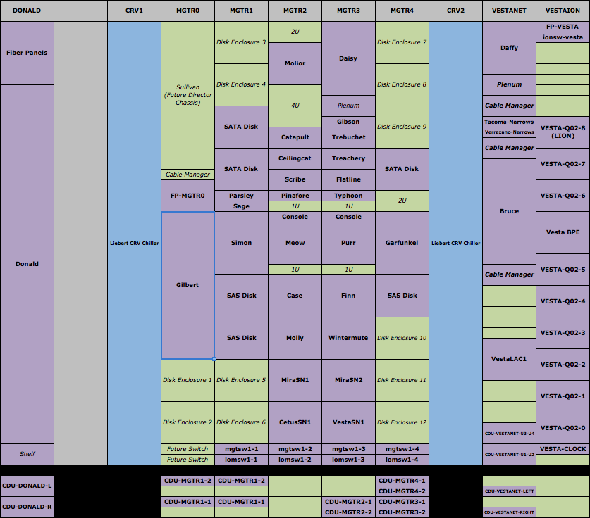
The BG/Q racks may be the brawn, but this is the brains of the operation…

Slide 9
Storage
Our plan was also to bring the storage in early and have it ready to go. However, you know what they say about the best laid plans…
We did bring the racks, drawers, and all the disks in early. However, delays in the controllers prevented us from actually having the storage configured and tested before the Blue Gene got here.
Many of you will remember the terrible flooding that occurred in Thailand in October 2011. 25% of the worlds production of hard drives is in Thailand and much of it was taken off line, causing the price of disk drives to double almost over night. And we had 10,000 brand new hard drives sitting on the floor… Ebay anyone? ☺
I/O performance was the most difficult issue for the acceptance of Intrepid. For Mira, we tried to ensure this would not be the case. We over provisioned the theoretical bandwidth by 33%. However, the controllers use Intel Sandy Bridge processors and they did not deliver the QPI performance expected so instead of delivering 20 GB/s per DDN couplet, they were a little under 15 GB/s. We are continuing to work with IBM and DDN to overcome this and meet our target of a minimum of 240 GB/s disk throughput using the IOR benchmark.
We are using the SFA-12Ke where e is for embedded. There are no external file servers. The file servers run in virtual machines inside the controller. This is part of why the QPI problem was such an issue. However, the concept is solid, and you will see more of this in the future. When you account for space, servers, racks, power, etc., tis probably saved us $4M over the life of the project.

Slide 10
The Blue Gene racks themselves
In many respects, the Blue Gene bring up went very well.
We didn’t hit the early deadlines, but those are always driven by crazy people in IBM who want to recognize revenue and for whom reality is a sketchy concept at best ☺
We did have an excellent working relationship for resolving the system problems that are a normal part of an early deployment. We were putting in PMRs (trouble tickets) and IBM had teams that were giving us good turn around on fixes.
We now have redundant service nodes (this is a single point of failure on BG/P machines like Intrepid)
There were some problems
Some, I have already mentioned:
The racks turning themselves off because the control system thought there was a water leak
The racks having an 800# weight gain problem
Due to a manufacturing problem (chip registration issues), IBM needed to replace a significant number of compute nodes, which delayed the project.
There were a very small number of compute nodes returning incorrect answers. IBM was able to determine root cause and there are now diagnostics that catch those nodes in manufacturing.
And one thing I wish we could fix, but it is a very hard technical problem
The BG family of machines are essentially synchronous. They have a shared clock signal propagated from the master to every rack. This master clock is a single point of failure and it would be a significant improvement if that could be fixed.

Slide 11
Final thoughts…
Trying to distill three years of work down into a few slides is an impossible task.
This represents a few of the more significant things we had to deal with
In large part, you may not even realize that the operations team is out there. In one respect, that is a good thing, since that generally means we are doing our job and the machine is humming along. ☺
Hopefully, you found this peak behind the curtain interesting and it gave you an idea of some of what it takes to field this kind of resource.
Power supplies – <RANT>What is it with Power Supplies? We have been dealing with electricity for what, some 250 years? You would think we could have the power supplies figured out, but it is surprisingly common to have power supply problems in IT equipment. We are 2 for 2 on the Blue Genes (IBM replaced all the power supplies on Intrepid and will be doing so on Mira in the near future). The DDN9900s on Intrepid had power supply problems. The folks at Myricom can’t do math and not only were the power supplies not redundant, you can’t even completely fill one of the 512 port 10G switch chasses we have with that generations Ethernet / 2Z cards. It wont have enough power to even run. </RANT>

