Slide 1
Polaris Overview
April 27, 2022
Kevin Harms
Brian Homerding

Slide 2
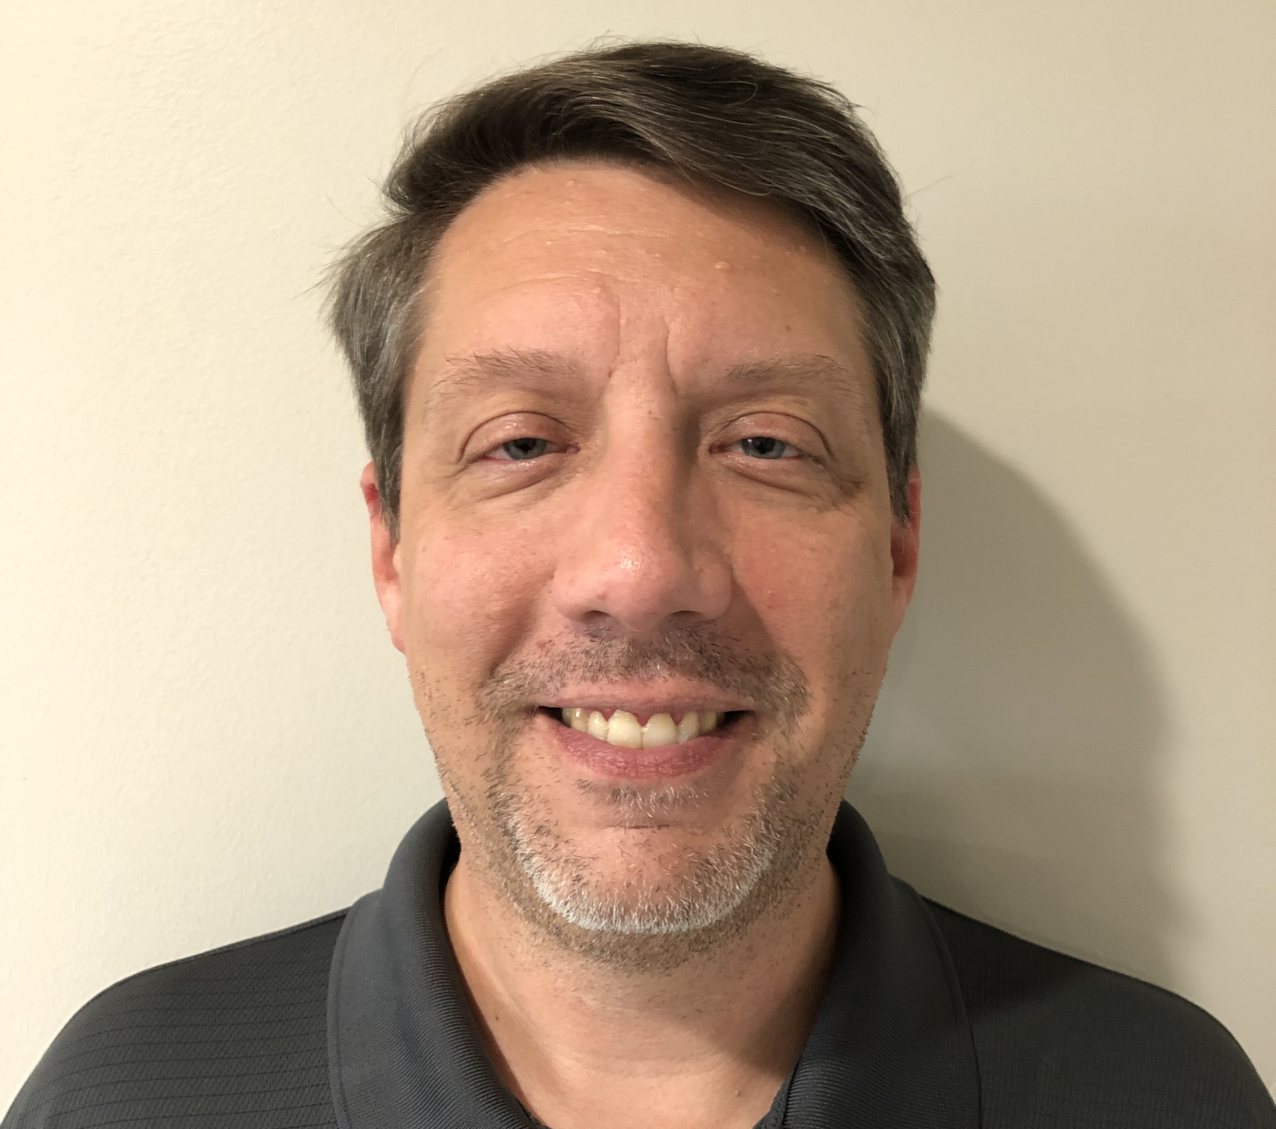

Introductions
Kevin Harms is a team lead of the Performance Engineering group within the Argonne Leadership Computing Facility (ALCF). His interests include working on high performance storage and I/O. Kevin received his Master of Science from Illinois Institute of Technology and his Bachelor of Science from Purdue University.
Kevin will be covering the hardware overview
Brian Homerding is a member of the Performance Engineering group within the Argonne Leadership Computing Facility (ALCF). His interests include high performance portability frameworks and compilers. Brian received his Master of Science from Northern Illinois University and his Bachelor of Arts from the University of Illinois Urbana-Champaign.
Brian will be covering the software overview

Slide 3
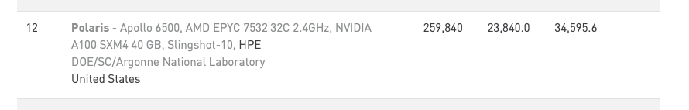
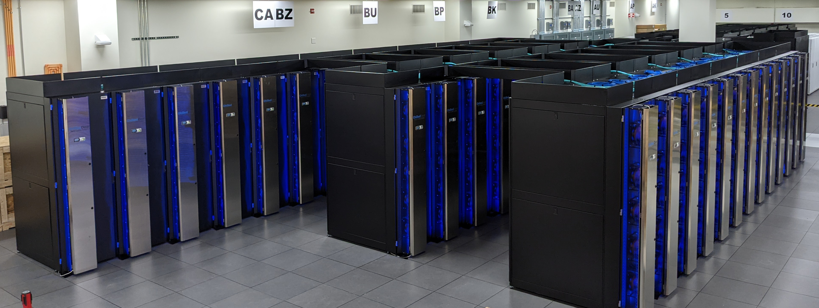
Polaris
https://www.alcf.anl.gov/polaris
ALCF’s latest computational resource
Provide a on-ramp to Aurora
Currently limited to ALCF staff as part of standup
Targeting 2H2022 for wider general access
Top500 November 2021

Slide 4
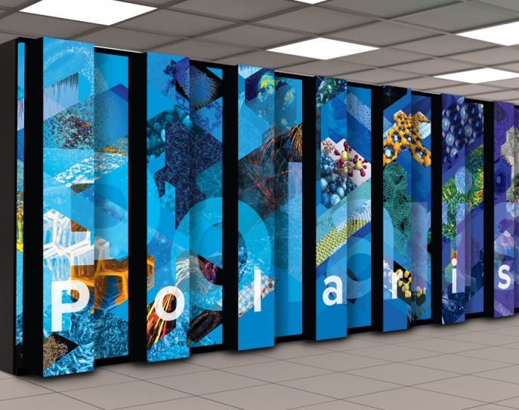
Hardware

Slide 5
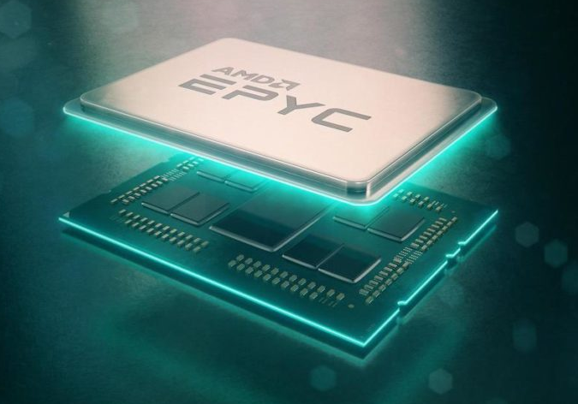
Single AMD EPYC “milan” 7543P CPU Specs
Base Frequency | 2.8 GHz
Max Boost Clk | 3.7 GHz
# of Zen3 Cores | 32
# of Threads | 64
Total DDR4 Memory | 512 GB
# of Memory Channels | 8
DDR4 Memory BW | 204.8 GB/s
Total Shared L3 Cache | 256 MB
L2 Cache per Core | 512 KB
L1 Cache per Core | 32 KB
PCIe Gen 4 | 128 lanes (8 ports)
PCIe Gen4 BW | 64 GB/s
TDP | 225 W

Slide 6
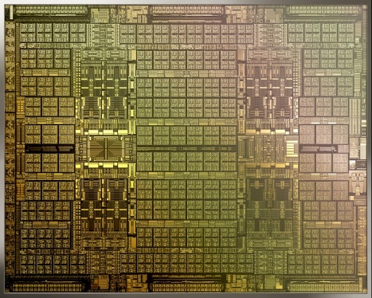
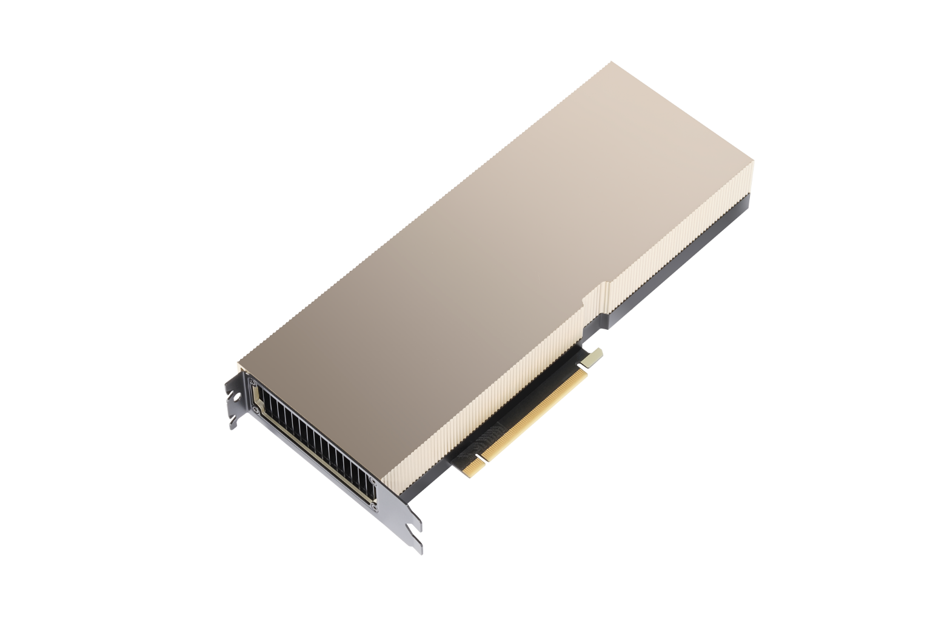

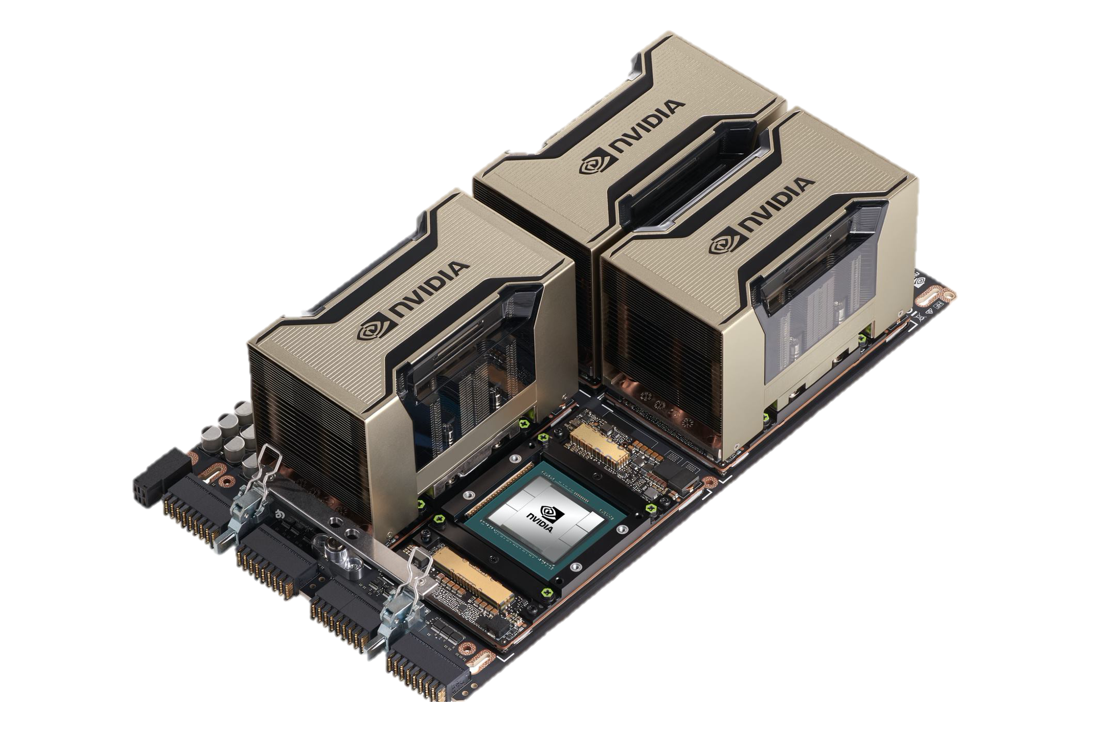
NVIDIA HGX A100 Specs
 | A100 PCIe | HGX
FP64 | 9.7 TF | 38.8 TF
FP64 Tensor Core | 19.5 TF | 78 TF
FP32 | 19.5 TF | 78 TF
BF16 Tensor Core | 312 TF | 1.3 PF
FP16 Tensor Core | 312 TF | 1.3 PF
INT8 Tensor Core | 624 TOPS | 2496 TOPS
GPU Memory | 40 GB HBM2 | 160 GB HBM2
GPU Memory BW | 1.6 TB/s | 6.4 TB/s
Interconnect | PCIe Gen4 64 GB/s | NVLink 600 GB/s
Max TDP Power | 250W | 400W
Ampere 7nm
A100 PCIe
HGX A100 4-GPU

Slide 7
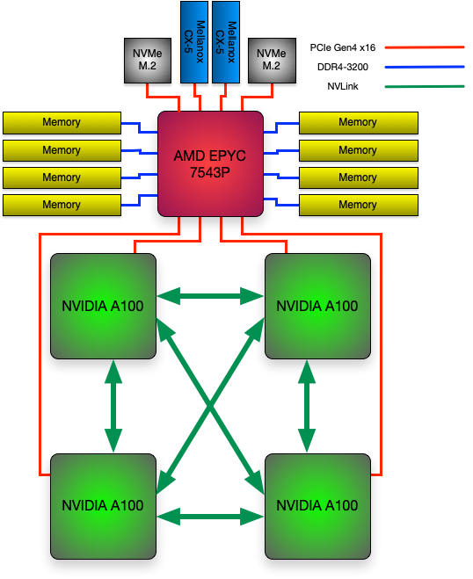
Polaris Single Node Configuration
# of AMD EPYC 7543P CPUs | 1
# of NVIDIA A100 GPUs | 4
Total HBM2 Memory | 160 GB
HBM2 Memory BW per GPU | 1.6 TB/s
Total DDR4 Memory | 512 GB
DDR4 Memory BW | 204.8 GB/s
# OF NVMe SSDs | 2
Total NVMe SSD Capacity | 3.2 TB
# of Cassini NICs | 2
Total Injection BW (w/ Cassini) | 50 GB/s
PCIe Gen4 BW | 64 GB/s
NVLink BW | 600 GB/s
Total GPU DP Tensor Core Flops | 78 TF

Slide 8
Slingshot Interconnect
SS-10 (100Gb)
Injection: ~14 TB/s
Bisection: ~24 TB/s
SS-11 (200Gb)
Injection: ~28 TB/s
Bisection: ~24 TB/s
Rosetta Switch
Multiple QoS levels
Aggressive adaptive routing
Advanced congestion control
Very low average and tail latency
High performance multicast and reduction
64 ports x 200 Gbps
Slingshot 10
Slingshot 11
HPE Cray MPI stack
Ethernet functionality
RDMA offload
MPI hardware tag matching
MPI progress engine
One-sided operations
Collectives
2X injection bandwidth
Mellanox ConnectX NIC
Cassini NIC
Notes:
Polaris has an option to upgrade the system to Slingshot-11, replacing the Mellanox NICs with Cassini NICs.

Slide 9
Slingshot Configuration
11 Total dragonfly groups, 10 compute groups and 1 non-compute group
2 links/arc between each group
4 links/arc within each group (between switches of a group)
1 link from each NIC (100Gb with SS10, 200Gb when upgraded to SS11)
Notes:
Point out we have multiple dragonfly groups, enabling evaluation of Rosetta traffic congestion management features.
Start with 100G Mellanox NICs and then upgrade to Cassini NICs which will allow testing of the advanced MPI messaging features.

Slide 10
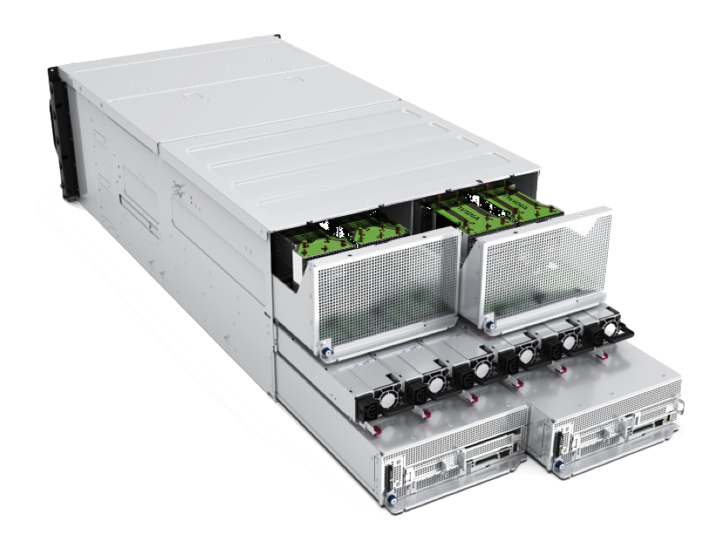
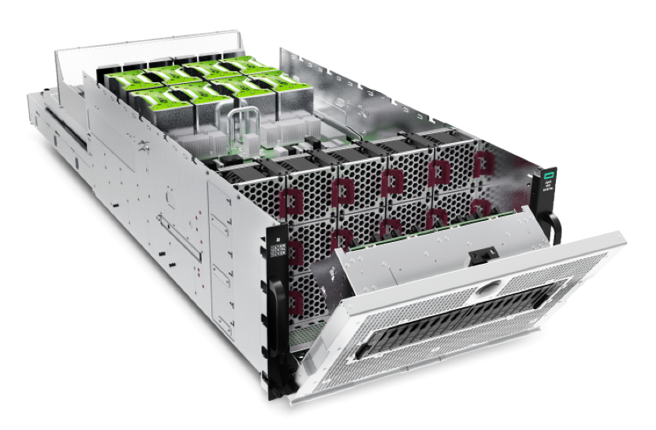
Polaris System Configuration
# of River Compute racks | 40
# of Apollo Gen10+ Chassis | 280
# of Nodes | 560
# of AMD EPYC 7543P CPUs | 560
# of NVIDIA A100 GPUs | 2240
Total GPU HBM2 Memory | 87.5TB
Total CPU DDR4 Memory | 280 TB
Total NVMe SSD Capacity | 1.75 PB
Interconnect | HPE Slingshot
# of Cassini NICs | 1120
# of Rosetta Switches | 80
Total Injection BW (w/ Cassini) | 28 TB/s
Total GPU DP Tensor Core Flops | 44 PF
Total Power | 1.8 MW
Apollo 6500 Gen10+

Slide 11
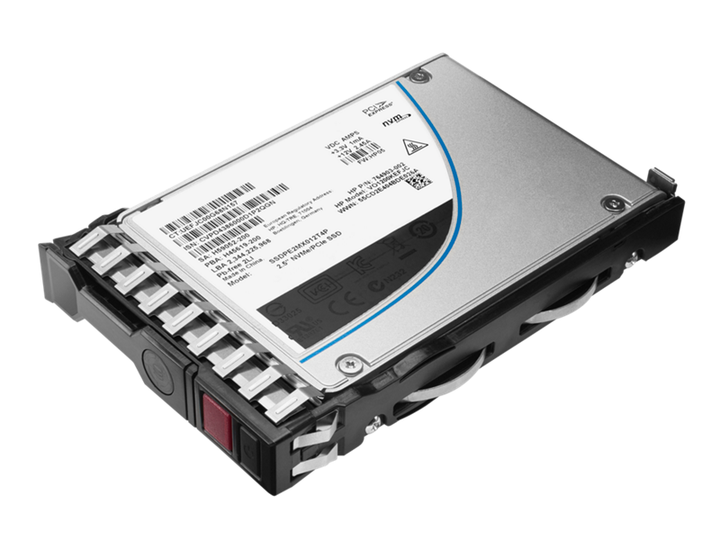
Node Local Storage
Each compute node has two NVMe SSDs
1.6 TB each / 3.2 TB total
Similar to Theta, ALCF provides no specific software for using SSDs
Each volume will be mounted as an ext4/xfs volume that is user accessible
Users access SSD via standard POSIX APIs
Data is destroyed when the job ends so any data users wish to keep must be moved to Grand or Eagle

Slide 12
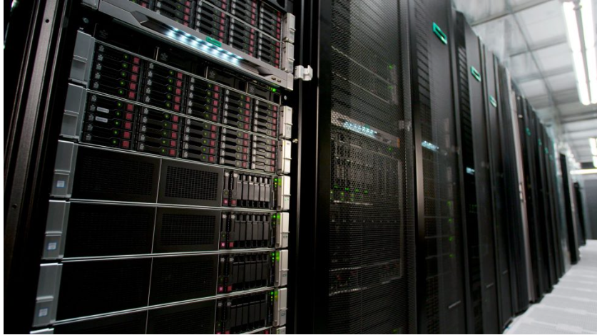
Storage
Polaris will be connected to existing ALCF storage resources
Grand – Global/Center-wide file system providing main project storage
100 PB @ 650 GB/s
Accessed via Lustre LNET routers using Polaris gateway nodes
Eagle – Community file system providing project storage that can be shared externally via Globus sharing
100 PB @ 650 GB/s
Accessed via Lustre LNET routers using Polaris gateway nodes
Gateway nodes can provide >1 TB/s
Home – shared home file system for convenience not for performance or bulk storage

Slide 13

Software

Slide 14
Polaris Software Overview
Provides an excellent platform for preparing application codes for Aurora
All programming models available on Aurora can be tested
Features HPE Cray (PE) Programming Environment
Provides excellent capabilities in simulation, data and learning using Nvidia’s existing HPC SDK
Support for HPE Cray MPI and MPICH via libfabric using Slingshot provider

Slide 15
Filesystem
Polaris will have a shared home filesystem
The Eagle and Grand filesystems available and mounted
/lus/grand
/lus/eagle
Main project storage
/lus/grand/projects
Community project storage
/lus/eagle/projects

Slide 16
Scheduler – PBS Professional
Primary commands
qsub
Request resources and start your script on the head node
-A - Allocation
-l - Options
qstat
Check on the status of requests
-Q - List queues
-f <jobid> - Detailed information about a job
-x <jobid> - Information about a completed job
qalter
Update your requests
qdel
Cancel unneeded requests

Slide 17
Scheduler – PBS Professional
Resource requests and placement
Job wide options
-l walltime=06:00:00
Resource selection
-l select=[<N>:]<chunk>[+[<N>:]<chunk> ...]
Simple example with system selection (128 compute nodes on Polaris)
-l select=128:system=polaris
Useful definitions
chunk
Set of resources allocated as a unit to a job
vnode
Virtual node. Abstract object representing a usable part of an execution host
ncpus
On Polaris this is equal to a hardware thread. Polaris has a single socket with 32 cores, each with 2 threads resulting in ncpus=64
ngpus
Number of GPUs. Generally will be four on Polaris. Could potentially be higher if using Multi Instance GPU (MIG) mode.

Slide 18
Some useful commands for working with PBS
qsub2pbs (Available on Theta and Cooley)
Translates Cobalt qsub command to PBS qsub command
Pass it a Cobalt command line and get a pbs one
pbsnodes
Provides information about the current state of nodes

Slide 19
Running MPI Applications
Jobs run directly on the compute nodes. The mpiexec command runs applications using the Parallel Application Launch Service (PALS)
mpiexec
Execute MPI applications on compute nodes using mpiexec
-n Total number of MPI ranks
-ppn Total number of MPI ranks per node
--cpu-bind CPU binding for application
--depth Number of CPUs per rank
--env Set environment variables
--hostfile Indicate file with hostname
Full list of options available from the man page

Slide 20
MPI Environment Variables
MPICH_GPU_SUPPORT_ENABLED
Enable MPI operations with communication buffers on GPU-attached memory regions
MPICH_OFI_NIC_VERBOSE
Print verbose information about NIC selection
MPICH_OFI_NIC_POLICY
Selects the rank-to-NIC assignment policy (BLOCK, ROUND-ROBIN, NUMA, GPU, USER)
MPICH_OFI_NIC_MAPPING
Specifies the rank-to-NIC mapping on each node

Slide 21
Programming Environment
HPE Cray PE for Polaris
HPE Cray MPI support for PGI offload to A100 for Multi-NIC and Multi-GPU support
Full Rome and Milan support
NVIDIA HPC SDK will provide primary support for programming A100
SYCL/Data Parallel C++ provided via
CodePlay computecpp compiler with Nvidia support
LLVM via Intel DPC++ branch which supports offload to Nvidia GPUs as well as Intel GPUs

Slide 22
Programming Models
Vendor Supported Programming Models
ECP Provided Programming Models
Cray
NVIDIA
LLVM
CodePlay
OpenMP w/o target
DPC++/SYCL
Kokkos
OpenMP with target
Raja
AMD
MPI +
HIP
OpenACC
CUDA
FORTRAN
C
C++
Notes:
HIP available via CUDA runtime
Kokkos and RAJA can use CUDA, OpenMP, HIP or possibly SYCL backends

Slide 23
Python
The HPE Cray PE provides python with several builtin modules
numpy
scipy
pandas
mpi4py
Optimized data learning and analytics frameworks are available and optimized for NVIDIA libraries

Slide 24
Data Analytics And Learning
Deep Learning
Tensorflow and PyTorch are optimized with CuDNN.
Other DL frameworks available and optimized by NVIDIA libraries.
Distributed data-parallel deep learning, using libraries such as Horovod, optimized to leverage the NCCL communication library from NVIDIA
Data Analytics
NVIDIA Rapids library for datascience and analytics
Python environment, and Numba for GPU using the CUDA backend
Cray/HPE AI Stack
Hyper-parameter optimization (HPO) library
Jupyter notebooks
SmartSim library for in-situ coupling of simulations with analytics and learning
Spark BigData Stack with modules optimized for GPU
Container environment based on singularity

Slide 25
Additional Software
The HPE Cray PE provides several programming environments.
HPE provides compiler wrappers by default which includes various libraries (including MPI libraries)
cc -> nvc
CC -> nvc++
ftn -> nvfortran
Addition software on the system is available through modules. The software available on the system is growing.
module avail
See what modules are currently available
module load ...
Users can utilize Spack to install needed software directly.
https://spack.readthedocs.io/en/latest/getting_started.html

Slide 26
Debuggers & Profilers
Debuggers
STAT (Stack Trace Analysis Tool)
Stack tracing at scale
gdb4hpc
Parallelized gdb for HPC
CUDA-GDB
NVIDIA tool for debugging CUDA
gdb
Profilers
PAT (Performance Analysis Tool)
Whole program performance analysis
NVIDIA® Nsight™
System-wide performance analysis tool

Slide 27
Information and Help
User documentation will be added to the ALCF support center
https://www.alcf.anl.gov/support-center
Additional information about Polaris
https://www.alcf.anl.gov/polaris
Getting help for ALCF resources
support@alcf.anl.gov

