Slide 1
Polaris Getting Started
September 28, 2022
Kevin Harms
Sam Foreman

Slide 2
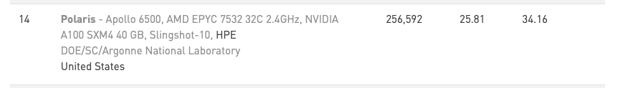
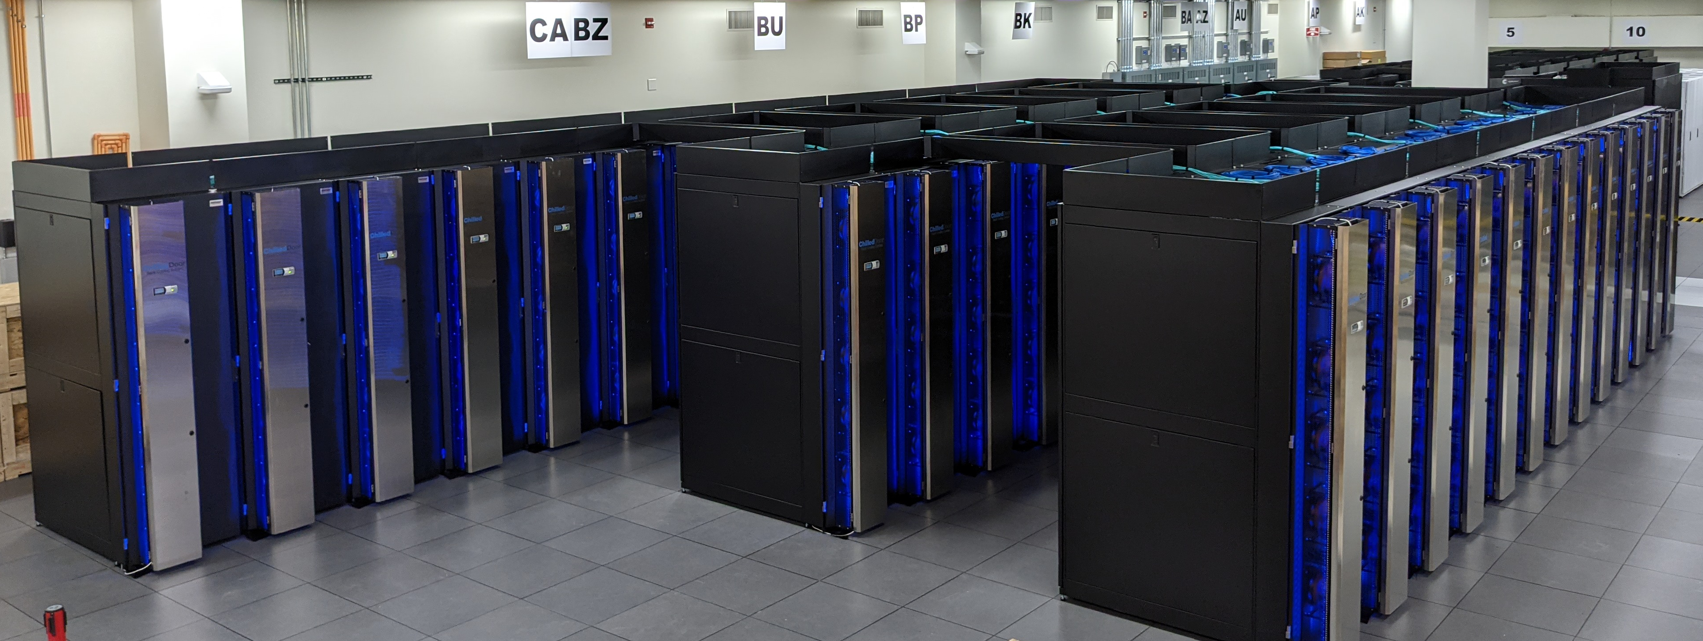
Polaris
https://www.alcf.anl.gov/polaris
ALCF’s latest computational resource
  Provides on-ramp to Aurora
Generally available ALCF resource
  INCITE, ALCC, DD
Top500 June 2022

Slide 3
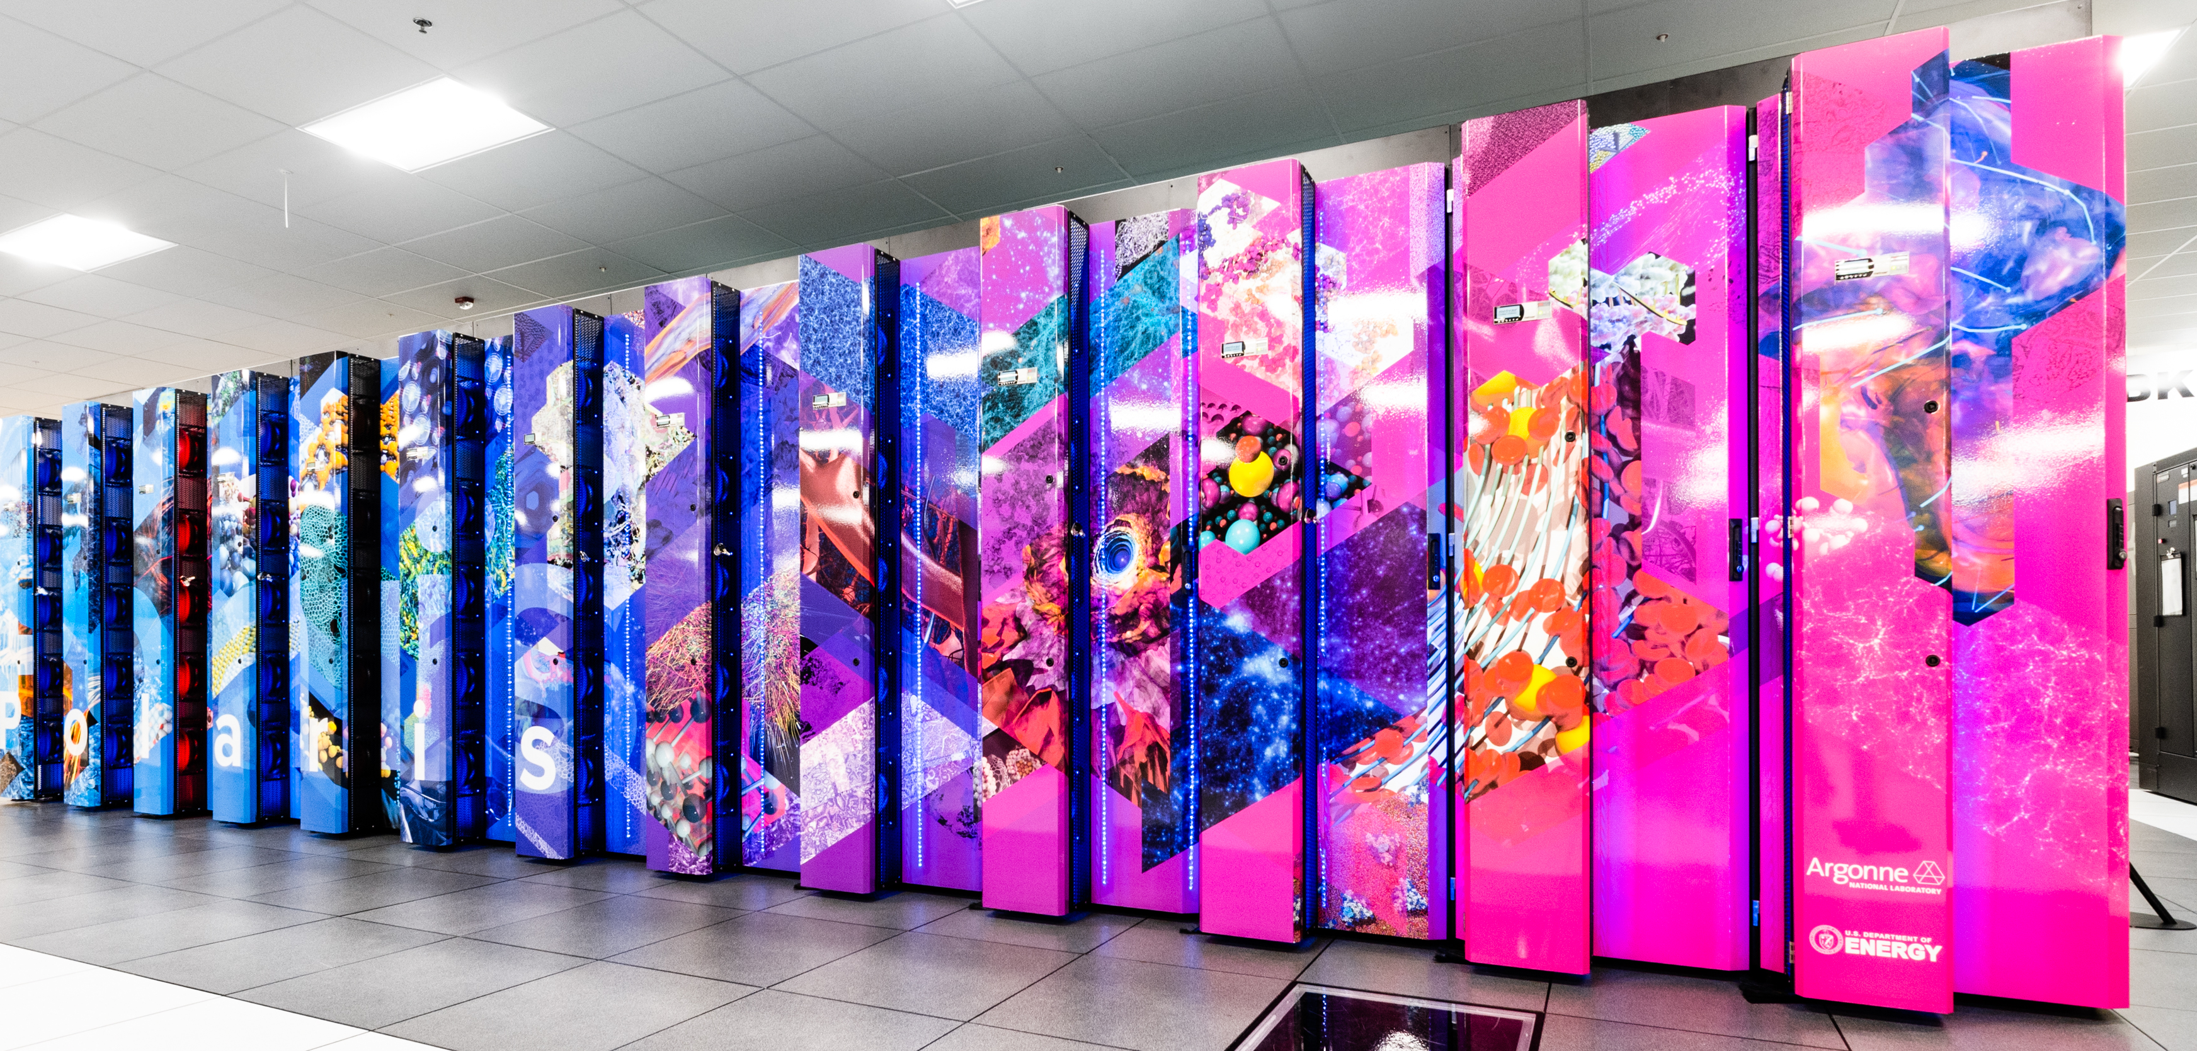
Hardware

Slide 4
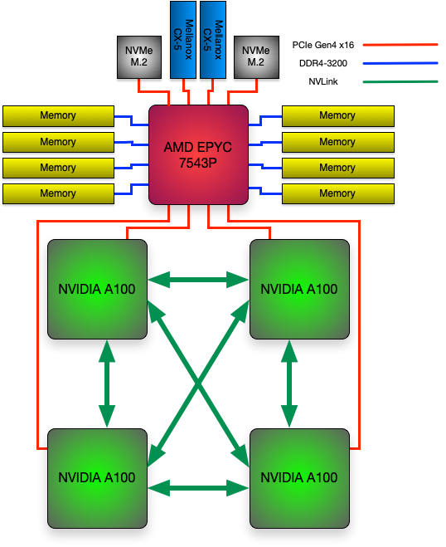
Polaris Single Node Configuration
# of AMD EPYC 7543P CPUs | 1
# of NVIDIA A100 GPUs | 4
Total HBM2 Memory | 160 GB
HBM2 Memory BW per GPU | 1.6 TB/s
Total DDR4 Memory | 512 GB
DDR4 Memory BW | 204.8 GB/s
# OF NVMe SSDs | 2
Total NVMe SSD Capacity | 3.2 TB
# of Mellanox NICs | 2
Total Injection BW (w/ Cassini) | 25 (50) GB/s
PCIe Gen4 BW | 64 GB/s
NVLink BW | 600 GB/s
Total GPU DP Tensor Core Flops | 78 TF

Slide 5
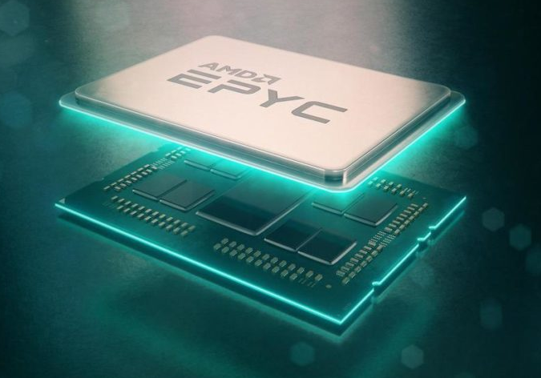
Single AMD EPYC “milan” 7543P CPU Specs
Base Frequency | 2.8 GHz
Max Boost Clk | 3.7 GHz
# of Zen3 Cores | 32
# of Threads | 64
Total DDR4 Memory | 512 GB
# of Memory Channels | 8
DDR4 Memory BW | 204.8 GB/s
Total Shared L3 Cache | 256 MB
L2 Cache per Core | 512 KB
L1 Cache per Core | 32 KB
PCIe Gen 4 | 128 lanes (8 ports)
PCIe Gen4 BW | 64 GB/s
TDP | 225 W

Slide 6
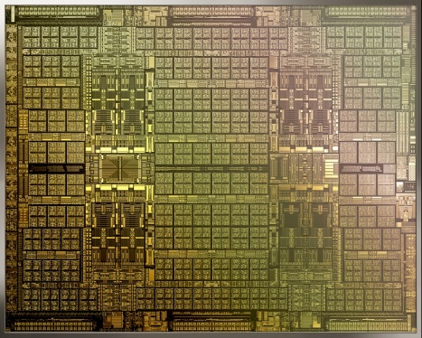
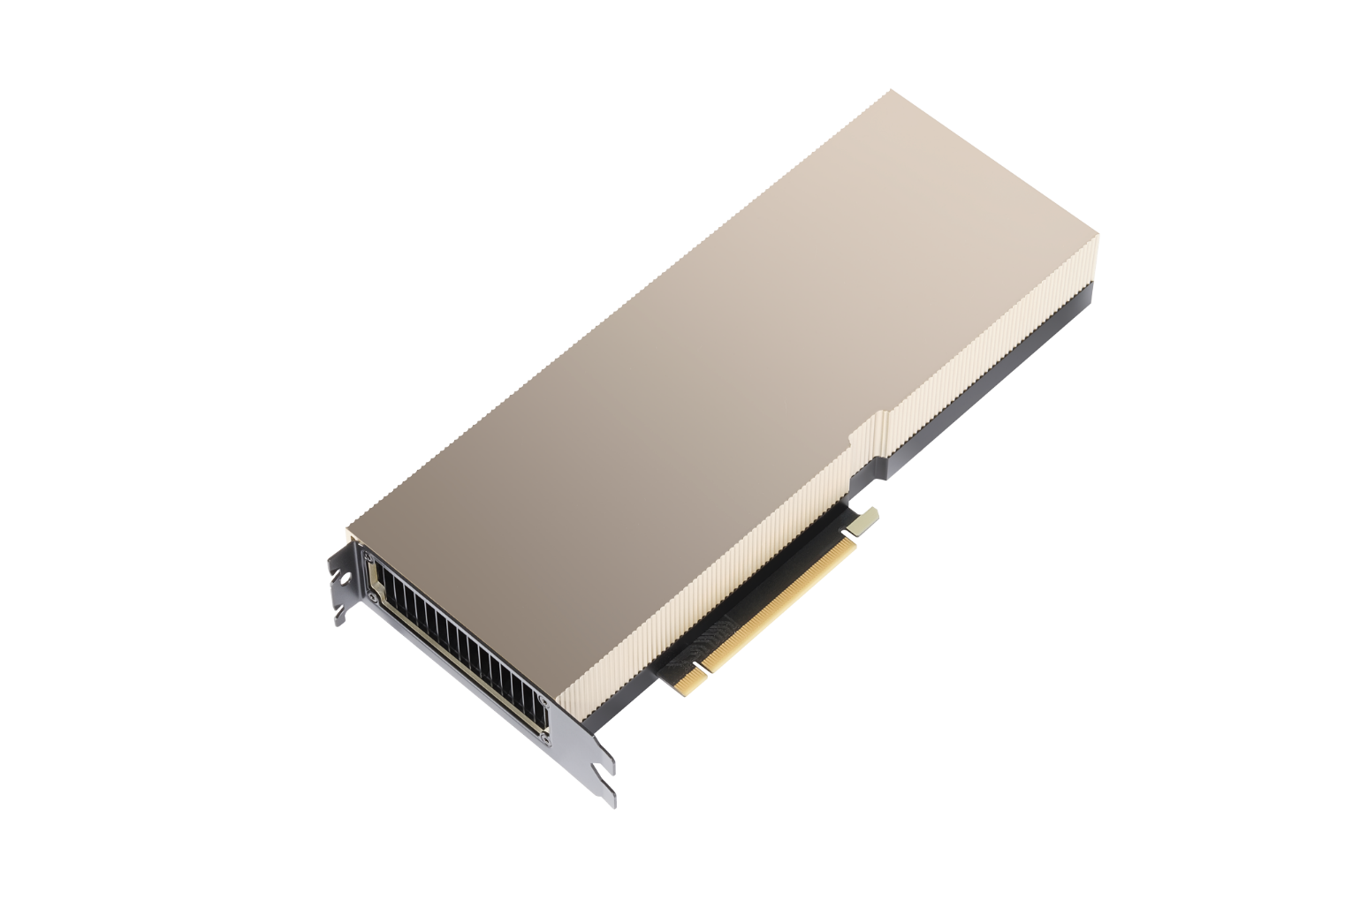

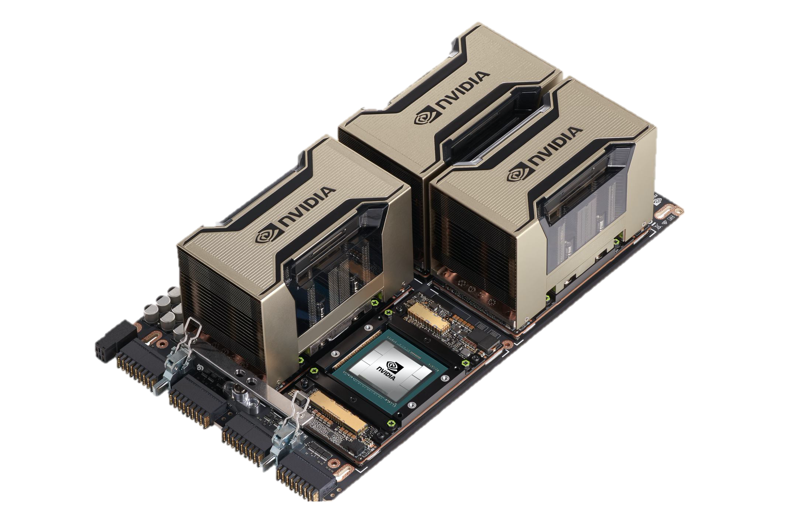
NVIDIA HGX A100 Specs
 | A100 PCIe | HGX
FP64 | 9.7 TF | 38.8 TF
FP64 Tensor Core | 19.5 TF | 78 TF
FP32 | 19.5 TF | 78 TF
BF16 Tensor Core | 312 TF | 1.3 PF
FP16 Tensor Core | 312 TF | 1.3 PF
INT8 Tensor Core | 624 TOPS | 2496 TOPS
GPU Memory | 40 GB HBM2 | 160 GB HBM2
GPU Memory BW | 1.6 TB/s | 6.4 TB/s
Interconnect | PCIe Gen4 64 GB/s | NVLink 600 GB/s
Max TDP Power | 250W | 400W
Ampere 7nm
A100 PCIe
HGX A100 4-GPU

Slide 7
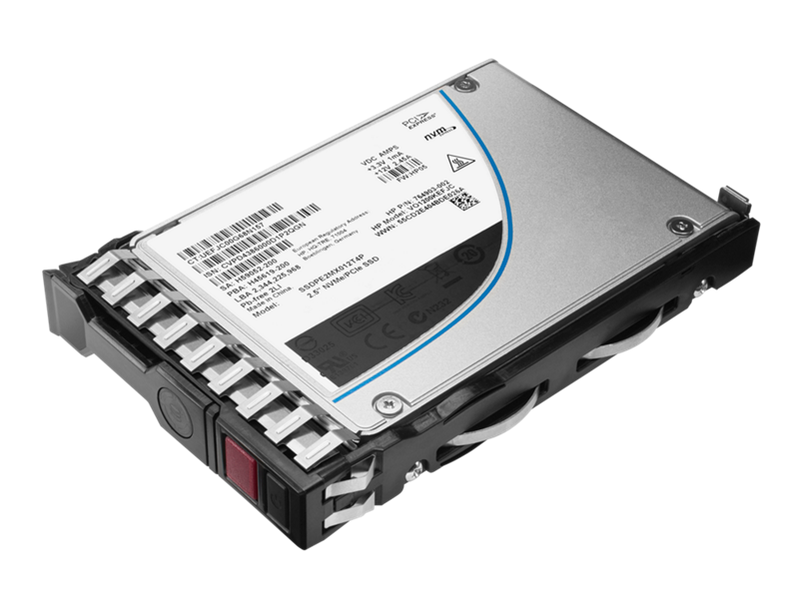
Node Local Storage
Each compute node has two NVMe SSDs
  1.6 TB each / 3.2 TB total
Similar to Theta, ALCF provides no specific software for using SSDs
RAID0 volume that is user accessible
Users access SSD via standard POSIX APIs
  /local/scratch
Data is destroyed when the job ends so any data users wish to keep must be moved to Grand or Eagle

Slide 8
Slingshot Interconnect
SS-10 (100Gb)
Injection: ~14 TB/s
Bisection: ~24 TB/s
SS-11 (200Gb)
Injection: ~28 TB/s
Bisection: ~24 TB/s
Rosetta Switch
Multiple QoS levels
Aggressive adaptive routing
Advanced congestion control
Very low average and tail latency
High performance multicast and reduction
64 ports x 200 Gbps
Slingshot 10
Slingshot 11
HPE Cray MPI stack
Ethernet functionality
RDMA offload
MPI hardware tag matching
MPI progress engine
One-sided operations
Collectives
2X injection bandwidth
Mellanox ConnectX NIC
Cassini NIC
Notes:
Polaris has an option to upgrade the system to Slingshot-11, replacing the Mellanox NICs with Cassini NICs.

Slide 9
Slingshot Configuration
11 Total dragonfly groups, 10 compute groups and 1 non-compute group
2 links/arc between each group
4 links/arc within each group (between switches of a group)
1 link from each NIC (100Gb with SS10, 200Gb when upgraded to SS11)
Notes:
Point out we have multiple dragonfly groups, enabling evaluation of Rosetta traffic congestion management features.
Start with 100G Mellanox NICs and then upgrade to Cassini NICs which will allow testing of the advanced MPI messaging features.

Slide 10
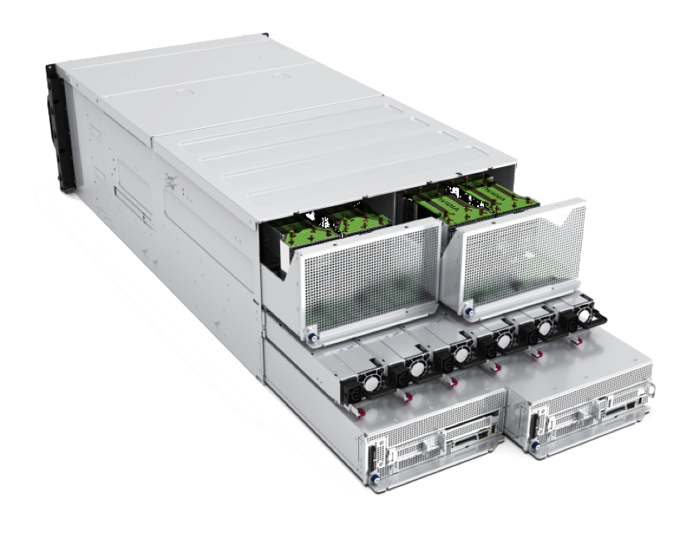
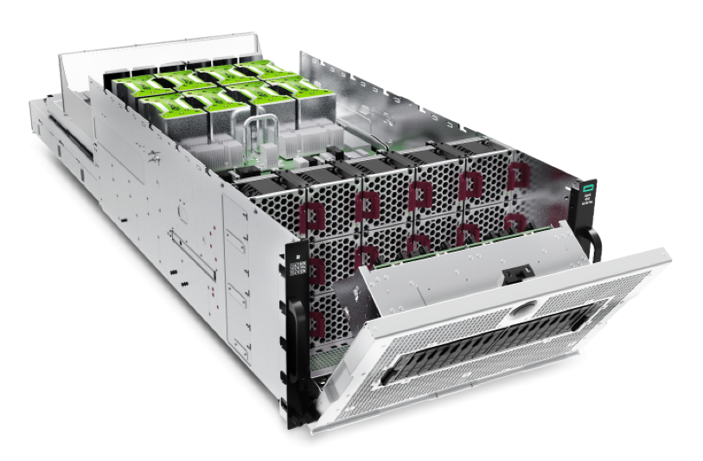
Polaris System Configuration
# of River Compute racks | 40
# of Apollo Gen10+ Chassis | 280
# of Nodes | 560
# of AMD EPYC 7543P CPUs | 560
# of NVIDIA A100 GPUs | 2240
Total GPU HBM2 Memory | 87.5TB
Total CPU DDR4 Memory | 280 TB
Total NVMe SSD Capacity | 1.75 PB
Interconnect | HPE Slingshot
# of Cassini NICs | 1120
# of Rosetta Switches | 80
Total Injection BW (w/ Cassini) | 28 TB/s 13 TB/s
Total GPU DP Tensor Core Flops | 44 PF
Total Power | 1.8 MW
Apollo 6500 Gen10+

Slide 11
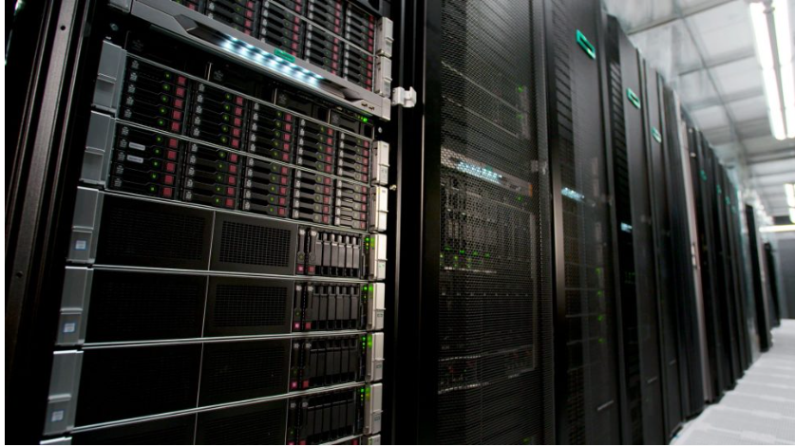
Storage
Polaris will be connected to existing ALCF storage resources
  Grand – Global/Center-wide file system providing main project storage
    100 PB @ 650 GB/s
    Accessed via Lustre LNET routers using Polaris gateway nodes
  Eagle – Community file system providing project storage that can be shared externally via Globus sharing
    100 PB @ 650 GB/s
    Accessed via Lustre LNET routers using Polaris gateway nodes
  Gateway nodes can provide >1 TB/s
  Home – shared home file system for convenience not for performance or bulk storage

Slide 12

Software

Slide 13
Login
Requires ALCF account
  https://accounts.alcf.anl.gov
  Project: ?
  Resource: polaris
ssh -A username@polaris.alcf.anl.gov
  Use your ALCF username
  Password is pin + one-time-password

Slide 14
Filesystem
Polaris shared common /home with other ALCF systems
The Eagle and Grand filesystems available and mounted
  /lus/grand
  /lus/eagle
Main project storage
  /lus/grand/projects
  /lus/grand/projects/$PROJECT ←
Community project storage
  /lus/eagle/projects

Slide 15
Modules
Polaris provides modules (Lmod) as a convenient way to access HPE or ALCF provided libraries
module list
  Shows the currently loaded modules
module load <module>
  Loads a module into your environment
  Only effects the current shell
module unload <module>
  Removes module from your environment
  Only effects the current shell
module avail
  Lists all available modules
module use <path>
  Adds an alternate path to the module search path
x3109c0s25b1n0:~ # module list
Currently Loaded Modules:
craype-x86-rome
libfabric/1.11.0.4.125
craype-network-ofi
perftools-base/22.05.0
nvhpc/21.9
craype/2.7.15
cray-dsmml/0.2.2
cray-mpich/8.1.16
cray-pmi/6.1.2
cray-pmi-lib/6.0.17
cray-pals/1.1.7
cray-libpals/1.1.7
PrgEnv-nvhpc/8.3.3
craype-accel-nvidia80

Slide 16
Compiling
Cray Programming Environment (PE)
  HPE provides compiler wrappers by default which includes various libraries (including MPI libraries)
    Integrates with modules environment
    HPE provided modules will add headers/libraries/compiler+linker options to compiler
    -craype-verbose to show actual compile/link command
  PrgEnv-nvidia (default)
    cc -> nvc
    CC -> nvc++
    ftn -> nvfortran
    Support CUDA and OpenMP target offload
    nvcc still available but not used by wrappers
  PrgEnv-gnu
    cc -> gcc
    CC -> g++
    ftn -> gfortran
Libraries found in
  /opt/nvidia
  /opt/cray

Slide 17
Running
#!/bin/bash
#PBS -A $PROJECT
#PBS -lwalltime=01:00:00
#PBS -lselect=4
#PBS -lsystem=polaris
#PBS -lfilesystems=home:eagle
rpn=4 # assume 1 process per GPU
procs=$((PBS_NODES*rpn))
# job to “run” from your submission directory
cd $PBS_O_WORKDIR
module load <something>
set +x # report all commands to stderr
env
mpiexec -n $procs -ppn $rpn --cpu-bind core -genvall ./bin <opts>
Two parts to running jobs
  Interacting with scheduler
  Launching job using mpiexec
Shell script
  describes parameters for scheduler
  Commands to run included mpiexec to launch
  Runs on ‘head’ node of your job
    Permissible to run computation in your shell script
  Need to load any of your non-default modules which provide library paths
qsub -q prod ./run.sh
  Will return the jobid
  Output and error logs are in submission directory

Slide 18
Scheduler – PBS Professional
Primary commands
  qsub
    Request resources and start your script on the head node
    -A - Allocation
    -l – Options
    -I – Interactive mode
    -q – Which queue to submit otherwise default queue
  qstat
    Check on the status of requests
    -Q - List queues
    -f <jobid> - Detailed information about a job
    -x <jobid> - Information about a completed job
  qalter
    Update your requests
  qdel
    Cancel/delete jobs

Slide 19
Scheduler – PBS Professional
Resource requests and placement
  Job wide options
    -l walltime=06:00:00
  Resource selection
    -l select=[<N>:]<chunk>[+[<N>:]<chunk> ...]
  Simple example with system selection (128 compute nodes on Polaris)
    -l select=128:system=polaris
Useful definitions
  chunk
    Set of resources allocated as a unit to a job
  vnode
    Virtual node. Abstract object representing a usable part of an execution host
  ncpus
    On Polaris this is equal to a hardware thread. Polaris has a single socket with 32 cores, each with 2 threads resulting in ncpus=64
  ngpus
    Number of GPUs. Generally will be four on Polaris. Could potentially be higher if using Multi Instance GPU (MIG) mode.

Slide 20
Some useful commands for working with PBS
qsub2pbs (Available on Theta and Cooley)
  Translates Cobalt qsub command to PBS qsub command
  Pass it a Cobalt command line and get a pbs one
pbsnodes
  Provides information about the current state of nodes

Slide 21
Queues
Polaris had 3 main queues
  https://www.alcf.anl.gov/support/user-guides/polaris/queueing-and-running-jobs/job-and-queue-scheduling/index.html
  debug
    2 nodes max
    1 hour max
    10 minutes min
  debug-scaling
    10 nodes max
    1 hour max
    10 minutes min
  prod
    10 nodes min
    496 nodes max
    30 minutes min
    Up to 6/12/24 hours max
    Queue will route job to other queues

Slide 22
Running MPI Applications
Jobs run directly on the compute nodes. The mpiexec command runs applications using the Parallel Application Launch Service (PALS)
mpiexec
  Execute MPI applications on compute nodes using mpiexec
    -n Total number of MPI ranks
    -ppn Total number of MPI ranks per node
    --cpu-bind CPU binding for application
    --depth Number of CPUs per rank
    --env Set environment variables
    --hostfile Indicate file with hostname
    Full list of options available from the man page
    https://www.alcf.anl.gov/support/user-guides/polaris/queueing-and-running-jobs/example-job-scripts/index.html

Slide 23
MPI Control
man mpi_intro
  Lists various environment variables to control CrayMPI

Slide 24
Python
The Cray PE provides python (cray-python module) with several builtin modules
  numpy
  scipy
  pandas
  mpi4py

Slide 25
Debuggers & Profilers
Debuggers
  STAT (Stack Trace Analysis Tool)
    Stack tracing at scale
  gdb4hpc
    Parallelized gdb for HPC
  CUDA-GDB
    NVIDIA tool for debugging CUDA
  gdb
Profilers
  PAT (Performance Analysis Tool)
    Whole program performance analysis
  NVIDIA® Nsight™
    GPU performance analysis tool

Slide 26
Information and Help
User documentation will be added to the ALCF support center
  https://www.alcf.anl.gov/support-center
Additional information about Polaris
  https://www.alcf.anl.gov/polaris
Getting help for ALCF resources
  support@alcf.anl.gov

