Slide 1
Intro to Intel Extensions of Scikit-learn to Accelerate Machine Learning Frameworks
Name of Event
Bob Chesebrough AI Software Solutions Engineer

Slide 2
Learning Objectives
At the end of the webinar you will be able to:
Describe the value of the Intel AI Analytics Toolkit
Describe the value of one component of the library called Intel Extensions for Scikit-learn*
Where to get the toolkit
Identify classification, regression, clustering, and dimensionality reduction algorithms powered by AI Analytics Toolkit
Describe the application of a few lines of code to enable these optimizations
Stretch Goal: Describe Compute Follows Data methodology for application of Scikit-learn to Intel GPUs
Notes:
At the end of the course you will be able to:
Describe Intel® oneAPI and specific implementations using the Intel® oneAPI AI Analytics Toolkit such as Intel® Extension for Scikit-learn*
Describe and categorize types of problems where the Intel® Extension for Scikit-learn* library are appropriate
Identify parts of library that apply to a given problem category
Describe conceptual knowledge of several key scikit-learn algorithms and what they are used for
Articulate and apply a few minimal codes changes to achieve better than stock performance of many common ML algorithms
Analyze code to identify where library optimizations can be applied, and then apply these appropriate code cha

Slide 3

Programming Challenges for Multiple Architectures
Application Workloads Need Diverse Hardware
Growth in specialized workloads
Variety of data-centric hardware required
Separate programming models and toolchains for each architecture are required today
Software development complexity limits freedom of architectural choice
Scalar
Vector
Spatial
Matrix
Middleware & Frameworks
CPU programming model
GPU programming model
FPGA programming model
Other accel.
programming models
CPU
GPU
FPGA
Other accel.
XPUs
Notes:
To set the stage – lets review some of the Programming challenges we encounter today in software development
The nature of the data we rely on to draw insights range from scalar, to vector, to spatial, matrix, sound, video, images, words and all these different data domains have families of algorithms that pertain to them specifically
Additionally the advancement of newer and differently configured accelerators spanning the gamut of HW make it a challenge to develop performant applications that can smoothly adapt to new technology and get good performance
That means that developing software for each hardware platform requires a separate investment, with little ability to reuse that work to target a different architecture.

Slide 4

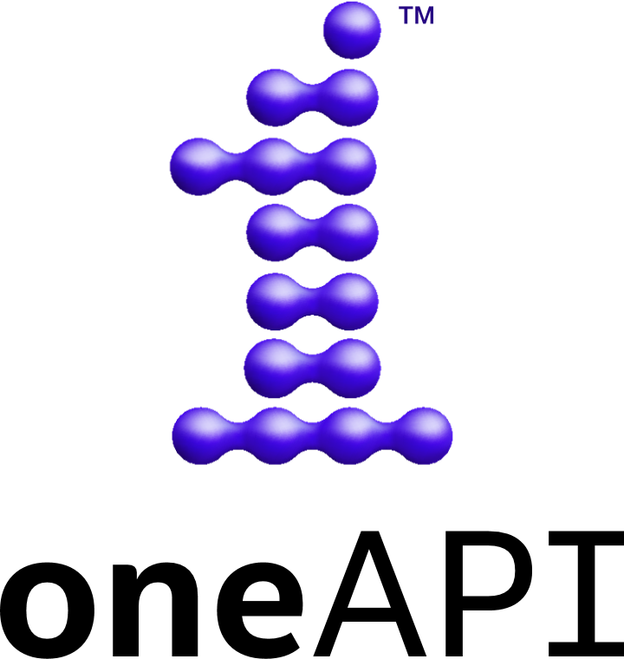
oneAPI One Programming Model for Multiple Architectures and Vendors
Application Workloads Need Diverse Hardware
Scalar
Vector
Spatial
Matrix
Freedom to Make Your Best Choice
Choose the best accelerated technology the software doesn’t decide for you
Realize all the Hardware Value
Performance across CPU, GPUs, FPGAs, and other accelerators
Develop & Deploy Software with Peace of Mind
Open industry standards provide a safe, clear path to the future
Compatible with existing languages and programming models including C, C++, Python, SYCL, OpenMP, Fortran, and MPI
Middleware & Frameworks
Industry Initiative
Intel Product
CPU
GPU
FPGA
Other accel.
Notes:
The oneAPI industry initiative delivers a unified software development environment across CPU and accelerator architectures.
The oneAPI Industry Initiative is based on standards and an open specification
Includes a unified language & libraries that deliver full native code performance
Based on open specifications and/or standards, such as SYCL by the Khronos roup, for cross-vendor compatibility
Delivers native code performance across a range of hardware including CPUs, GPUs, FPGAs, & AI accelerators
oneAPI is the foundational programming stack & is used to optimize middleware & frameworks that sit on top of it, including AI frameworks
such as TensorFlow & Scikit-learn which are accessible via Python
Optimized user and industry applications sit at the very top, some of which leverage middleware and frameworks
Intel’s product is a reference implementation of the oneAPI initiative. Our products are currently cast in a variety of toolkits

Slide 5

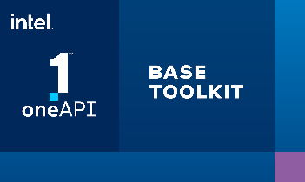
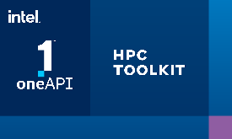


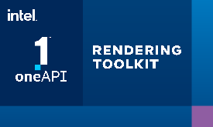

Intel® oneAPI Toolkits
A complete set of proven developer tools expanded from CPU to Accelerators
Intel® oneAPI Base Toolkit
A core set of high-performance libraries and tools for building C++, SYCL and Python applications
Add-on Domain-specific Toolkits
Intel® oneAPI Tools for HPC
Intel® oneAPI Tools for IoT
Deliver fast Fortran, OpenMP & MPI applications that scale
Build efficient, reliable solutions that run at network’s edge
Intel® AI Analytics Toolkit
Intel® oneAPI Rendering Toolkit
Accelerate machine learning & data science pipelines end-to-end with optimized DL frameworks & high-performing Python libraries
Create performant, high-fidelity visualization applications
Toolkit
powered by oneAPI
Intel® Distribution of OpenVINO™ Toolkit
Deploy high performance inference & applications from edge to cloud
Latest version available 2022.1
Notes:
Intel oneAPI cross-architecture products have been in production since Dec. 2020
[and openvino toolkit was production-ready before that]
Intel’s reference implementation of oneAPI is a set of toolkits.
For this course we will focus on the circled implementation – which is the Intel* oneAPI AI Analytics Toolkit which , for the purpose of our course, has Python bindings and libraries for data science applications
Intel oneAPI AI Analytics Toolkit releases product updates with new features and enhancements quarterly!
It is important to keep your packages up to date
Keep your frameworks, many are built on oneAPI, up-to=date as well
This course will focus on machine learning related frameworks accelerated with oneAPI

Slide 6








Intel’s oneAPI Ecosystem
Application Workloads Need Diverse Hardware
Built on Intel’s Rich Heritage of CPU Tools Expanded to XPUs
Middleware & Frameworks (Powered by oneAPI)
oneAPI
A cross-architecture language based on SYCL standards
Powerful libraries designed for acceleration of domain-specific functions
A complete set of advanced compilers, libraries, and porting, analysis and debugger tools
Powered by oneAPI
Frameworks and middleware that are built using one or more of the oneAPI industry specification elements, the SYCL language, and libraries listed on oneapi.com.
...
Direct Programming
API-Based Programming
Intel® oneAPI Product
Libraries
Compatibility Tool
Languages
oneMKL
oneTBB
oneVPL
oneDPL
Analysis & Debug Tools
oneDAL
oneDNN
oneCCL
Low-Level Hardware Interface
XPUs
CPU
GPU
FPGA
Other accelerators
Available Now
Visit software.intel.com/oneapi for more details
Some capabilities may differ per architecture and custom-tuning will still be required. Other accelerators to be supported in the future.
Notes:
Intel’s reference implementation of oneAPI is a set of toolkits.
Under the hood, the AI Analytics toolkit , see the read oval, benefits from its SYCL roots which form the base foundation on which the AI & Python models we develop rests. We will see the advantages and ease and speed of tapping these foundation layers via python and machine learning libraries throughout the course, via interactions with Numpy, SciPy, Scikit-learn and more.
For this course, we are focusing on how to take advantage of the optimizations provided in this Middleware & Frameworks layer

Slide 7
Intel’s oneAPI Ecosystem
Application Workloads Need Diverse Hardware
Built on Intel’s Rich Heritage of CPU Tools Expanded to XPUs
Middleware & Frameworks (Powered by oneAPI)
oneAPI
A cross-architecture language based on SYCL standards
Powerful libraries designed for acceleration of domain-specific functions
A complete set of advanced compilers, libraries, and porting, analysis and debugger tools
Powered by oneAPI
Frameworks and middleware that are built using one or more of the oneAPI industry specification elements, the SYCL language, and libraries listed on oneapi.com.
...
Intel® oneAPI Product
Libraries
Compatibility Tool
Languages
oneMKL
oneTBB
oneVPL
oneDPL
Analysis & Debug Tools
oneDAL
oneDNN
oneCCL
Low-Level Hardware Interface
XPUs
CPU
GPU
FPGA
Other accelerators
Available Now
Visit software.intel.com/oneapi for more details
Some capabilities may differ per architecture and custom-tuning will still be required. Other accelerators to be supported in the future.

Slide 8
Intel® oneAPI AI Analytics Toolkit
Intel® AI Analytics Toolkit
Deep Learning
Machine Learning
Intel® Optimization for TensorFlow
Intel® Extension for Scikit-learn
Intel-optimized XGBoost
Accelerate end-to-end AI and data analytics pipelines with libraries optimized for Intel® architectures
Who Uses It?
Data scientists, AI researchers, ML and DL developers, AI application developers
Top Features/Benefits
Deep learning performance for training and inference with Intel optimized DL frameworks and tools
Drop-in acceleration for data analytics and machine learning workflows with compute-intensive Python packages
Intel® Optimization for PyTorch
Intel® Neural Compressor
Data Analytics
Model Zoo for Intel® Architecture
Intel® Distribution of Modin
OmniSci Backend
Intel-optimized Python
NumPy
SciPy
Pandas
Numba
Python
CPU
GPU
Hardware support varies by individual tool. Architecture support will be expanded over time.
Get the Toolkit HERE or via these locations
Intel Installer
Docker
Apt, Yum
Conda
Intel® DevCloud
8
Learn More: software.intel.com/oneapi/ai-kit
Back to Domain-specific Toolkits for Specialized Workloads
Notes:
AI Analytics kit is part of our oneAPI initiative and ecosystem building
AI Analytics kit is of interest to AI and Data Analytics folks, data scientists, data engineers, and so on.
The AI Analytics toolkit spans Deep Learning, Machine Learning, Data Analytics, and Intel Optimized Python
This course focuses on the circled areas
This course is primarily targeted at Machine Learning layer including XGBoost and Scikit-learn*
But we will also include training for acceleration using Numpy, Scipy, Pandas etc, as these are all powered by oneAPI and these packages provide key coverage for almost all AI projects

Slide 9
Acquiring oneAPI AI Analytics Toolkit or Intel Extensions for scikit-learn specifically
If you just want the Intel Extensions for scikit-learn for your system (without the other library components):
There are multiple ways: visit link below
https://www.intel.com/content/www/us/en/developer/articles/guide/intel-extension-for-scikit-learn-getting-started.html
Summary – installation by: Conda, pip, docker container, …
sdsd
Comprehensive Library: https://www.intel.com/content/www/us/en/developer/tools/oneapi/ai-analytics-toolkit-download.html

Slide 10
Motivation
Achieve acceleration on Intel CPU & current and future GPU
Be ready for future innovations from Intel
Can be achieved with a few lines of code

Slide 11
Procedure for Ignition!
Intel CPU: for Intel current and future CPUs
- Apply import patch for Intel Optimized function
Intel GPU: for Intel current and future GPUs
- Apply import patch for Intel Optimized function
- Apply Compute Follows Data method to cast NumPy arrays to tensor

Slide 12
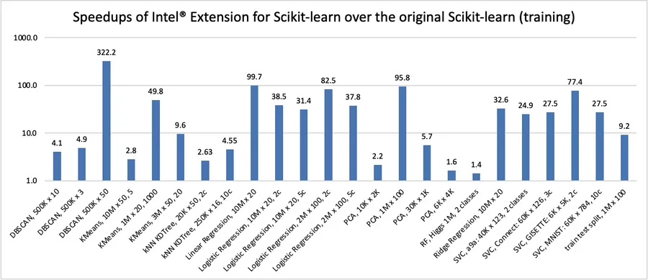
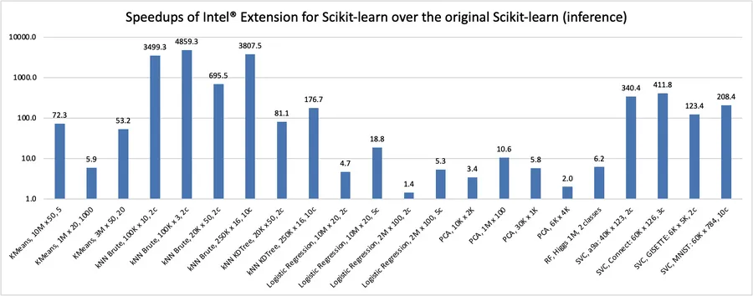
What’s in this for the a Developer?
Seamless way to speed up your Scikit-learn application.
23 commonly used machine learning algorithms have been accelerated
We will explore patching to enable these optimized algorithms
In Hands on labs you will see, and experience dramatic speedups using several of these
Notes:
Intel extensions for scikit-learn* has optimized 23 common algorithms in scikit learn spanning clustering, dimensionality reduction, classification, regression, train test splitting, and more
By default, we use the maximum available instruction set on Intel CPU. This allows for dramatic speedups which you will feel, see, and explore in hands on labs through out the course
Intel has developed multicore architectures which are also vector enabled. Vectorization primitives have been added over time which added ISA support and HW support for sider vector lanes starting in earlier days with 64 bit vector lanes, thru 128 bit, 256 bit. We have separate code branches for AVX512 for some algorithms.. There are also different implementations of MKL functions for different instruction sets. Vectorization affects the performance in many cases. As does multicore, where threading can achieve even more performance gains. Later, we will briefly describe how wider vector lanes can benefit performance

Slide 13
Gallery of Algorithms
Notes:
Next we will explore the gallery of sklearn algorithms optimized in the Intel Extensions for scikit-learn library

Slide 14
Gallery of Algorithms Optimized for Intel CPU
Name
DBSCAN | Linear Regression | K Nearest Neighbor Classifier | K Nearest Neighbor Regressor
KMeans | Elasticnet Regression (L1 & L2) | Random Forest Classifier | Assert All Finite
Nearest Neighbor (Unsupervised) | Lasso Regression (L1) | Random Forest Regressor | ROC AUC score
Principal Component Analysis (PCA) | Ridge Regression (L2) | Support Vector Classifier | Train Test Split
tSNE | Logistic Regression | Support Vector Regressor | Pair Wise Distance
Notes:
Nearest Neighbor
Not to be confused w K Nearest Neighbor (though they are related with Nearest being like a base version)). Unsupervised Learner (does not require y value – unlike the K versions). It finds a predefined number of training samples closest in distance to the new point. The principle behind nearest neighbor methods is to find a predefined number of training samples closest in distance to the new point, and predict the label from these. As an example, we could a Nearest Neighbors class from an array representing our data set and ask who’s the closest point to [1,1,1]
nuSVC & nuSVR are classification and regression versions of Support Vector Machine type of algorithm. They are built using different method under the hood from ordinary SVC and SVR which we will describe in more depth. The differences between the nu and regular versions is too deep to go into in this class, but you have a choice newteen two different implementation and knowing the names will allow you to drill down to which ones are best for your use.
PCA
This is a heavy hitter. Primarily used for dimensionality reduction. It helps kmeans which can be challenged by high dimensional data. PCA Finds the long axis the corresponds to the most variance of the data, then finds the orthogonal next best axis to express the next most variances, and so on. It is very useful in helping visualize data in a scatter matrix plot or pairsplot for binary data as it moves (dithers) the data in ways to prevent them from bunching up at the extremes of coordinates.
STOP NARRATING NOW
The rest of speaker notes is for
BACKGROUND INFO note recorded to video:
Nearest Neighbor (Unsupervised) Unsupervised nearest neighbors is the foundation of many other learning methods, notably manifold learning and spectral clustering. NearestNeighbors implements unsupervised nearest neighbors learning. It acts as a uniform interface to three different nearest neighbors algorithms: BallTree, KDTree, and a brute-force algorithm based on routines in sklearn.metrics.pairwise. The choice of neighbors search algorithm is controlled through the keyword 'algorithm', which must be one of ['auto', 'ball_tree', 'kd_tree', 'brute']. When the default value 'auto' is passed, the algorithm attempts to determine the best approach from the training data. For a discussion of the strengths and weaknesses of each option, see Nearest Neighbor Algorithms.
The principle behind nearest neighbor methods is to find a predefined number of training samples closest in distance to the new point, and predict the label from these. The number of samples can be a user-defined constant (k-nearest neighbor learning), or vary based on the local density of points (radius-based neighbor learning). The distance can, in general, be any metric measure: standard Euclidean distance is the most common choice. Neighbors-based methods are known as non-generalizing machine learning methods, since they simply “remember” all of its training data (possibly transformed into a fast indexing structure such as a Ball Tree or KD Tree).
Despite its simplicity, nearest neighbors has been successful in a large number of classification and regression problems, including handwritten digits and satellite image scenes. Being a non-parametric method, it is often successful in classification situations where the decision boundary is very irregular. The classes in sklearn.neighbors can handle either NumPy arrays or scipy.sparse matrices as input. For dense matrices, a large number of possible distance metrics are supported. For sparse matrices, arbitrary Minkowski metrics are supported for searches.
Adv
it is unsupervised - requires no y:
For big data, both standard tree algorithms will fail when there are millions of points in hundreds of dimensions (or less even). In such cases, you will have to use approximate nearest neighbours algorithms
Dis
scklearnex must only use ‘euclidean’ or ‘minkowski’ with p != 2.
nuSVC & nuSVR
Similar to SVC with parameter kernel='linear', but implemented in terms of liblinear rather than libsvm,
Adv
has more flexibility in the choice of penalties and loss functions and should scale better (to large numbers of samples). This class supports both dense and sparse input and the multiclass support is handled according to a one-vs-the-rest scheme.
it has more flexibility in the choice of penalties and loss functions and should scale better (to large numbers of samples). This class supports both dense and sparse input and the multiclass support is handled according to a one-vs-the-rest scheme.
PCA
Dimensionality reduction. Preprocess to reduce dimensions (columns) for kmeans. Think jpeg lossy compression versus raw image as an analogy to lossy data size reduction (columns) for tabular - also though images can use it too. Finds the long axis the corresponds to the most variance of the data, then finds the orthogonal next best axis to experess the next most variances, and so on
Adv
PCA can help us improve performance at a very low cost of model accuracy. Other benefits of PCA include reduction of noise in the data, feature selection (to a certain extent), and the ability to produce independent, uncorrelated features of the data.
DisAdvantages:
intel sklearnex specific: All parameters except svd_solver != ‘full’.
Generally:
PCA tries to place dissimilar data points far apart in a lower dimension representation. But in order to represent high dimension data on low dimension, non-linear manifold, it is important that similar datapoints must be represented close together, which is not what PCA does. This is done efficiently by t-SNE. So, it can efficiently capture the structure of trickier manifolds in the dataset

Slide 15
Gallery of Algorithms Optimized for Intel GPU
Name
Linear Regression | Logistic Regression | DBSCAN
KNeighborsRegressor | Support Vector Classifier | KMeans
Random Forest Regressor | K Nearest Neighbor Classifier | Principal Component Analysis (PCA)
 | Random Forest Classifier
Notes:
Nearest Neighbor
Not to be confused w K Nearest Neighbor (though they are related with Nearest being like a base version)). Unsupervised Learner (does not require y value – unlike the K versions). It finds a predefined number of training samples closest in distance to the new point. The principle behind nearest neighbor methods is to find a predefined number of training samples closest in distance to the new point, and predict the label from these. As an example, we could a Nearest Neighbors class from an array representing our data set and ask who’s the closest point to [1,1,1]
nuSVC & nuSVR are classification and regression versions of Support Vector Machine type of algorithm. They are built using different method under the hood from ordinary SVC and SVR which we will describe in more depth. The differences between the nu and regular versions is too deep to go into in this class, but you have a choice newteen two different implementation and knowing the names will allow you to drill down to which ones are best for your use.
PCA
This is a heavy hitter. Primarily used for dimensionality reduction. It helps kmeans which can be challenged by high dimensional data. PCA Finds the long axis the corresponds to the most variance of the data, then finds the orthogonal next best axis to express the next most variances, and so on. It is very useful in helping visualize data in a scatter matrix plot or pairsplot for binary data as it moves (dithers) the data in ways to prevent them from bunching up at the extremes of coordinates.
STOP NARRATING NOW
The rest of speaker notes is for
BACKGROUND INFO note recorded to video:
Nearest Neighbor (Unsupervised) Unsupervised nearest neighbors is the foundation of many other learning methods, notably manifold learning and spectral clustering. NearestNeighbors implements unsupervised nearest neighbors learning. It acts as a uniform interface to three different nearest neighbors algorithms: BallTree, KDTree, and a brute-force algorithm based on routines in sklearn.metrics.pairwise. The choice of neighbors search algorithm is controlled through the keyword 'algorithm', which must be one of ['auto', 'ball_tree', 'kd_tree', 'brute']. When the default value 'auto' is passed, the algorithm attempts to determine the best approach from the training data. For a discussion of the strengths and weaknesses of each option, see Nearest Neighbor Algorithms.
The principle behind nearest neighbor methods is to find a predefined number of training samples closest in distance to the new point, and predict the label from these. The number of samples can be a user-defined constant (k-nearest neighbor learning), or vary based on the local density of points (radius-based neighbor learning). The distance can, in general, be any metric measure: standard Euclidean distance is the most common choice. Neighbors-based methods are known as non-generalizing machine learning methods, since they simply “remember” all of its training data (possibly transformed into a fast indexing structure such as a Ball Tree or KD Tree).
Despite its simplicity, nearest neighbors has been successful in a large number of classification and regression problems, including handwritten digits and satellite image scenes. Being a non-parametric method, it is often successful in classification situations where the decision boundary is very irregular. The classes in sklearn.neighbors can handle either NumPy arrays or scipy.sparse matrices as input. For dense matrices, a large number of possible distance metrics are supported. For sparse matrices, arbitrary Minkowski metrics are supported for searches.
Adv
it is unsupervised - requires no y:
For big data, both standard tree algorithms will fail when there are millions of points in hundreds of dimensions (or less even). In such cases, you will have to use approximate nearest neighbours algorithms
Dis
scklearnex must only use ‘euclidean’ or ‘minkowski’ with p != 2.
nuSVC & nuSVR
Similar to SVC with parameter kernel='linear', but implemented in terms of liblinear rather than libsvm,
Adv
has more flexibility in the choice of penalties and loss functions and should scale better (to large numbers of samples). This class supports both dense and sparse input and the multiclass support is handled according to a one-vs-the-rest scheme.
it has more flexibility in the choice of penalties and loss functions and should scale better (to large numbers of samples). This class supports both dense and sparse input and the multiclass support is handled according to a one-vs-the-rest scheme.
PCA
Dimensionality reduction. Preprocess to reduce dimensions (columns) for kmeans. Think jpeg lossy compression versus raw image as an analogy to lossy data size reduction (columns) for tabular - also though images can use it too. Finds the long axis the corresponds to the most variance of the data, then finds the orthogonal next best axis to experess the next most variances, and so on
Adv
PCA can help us improve performance at a very low cost of model accuracy. Other benefits of PCA include reduction of noise in the data, feature selection (to a certain extent), and the ability to produce independent, uncorrelated features of the data.
DisAdvantages:
intel sklearnex specific: All parameters except svd_solver != ‘full’.
Generally:
PCA tries to place dissimilar data points far apart in a lower dimension representation. But in order to represent high dimension data on low dimension, non-linear manifold, it is important that similar datapoints must be represented close together, which is not what PCA does. This is done efficiently by t-SNE. So, it can efficiently capture the structure of trickier manifolds in the dataset

Slide 16
Code & Results
Notes:
Next we will explore the topic of Patching

Slide 17
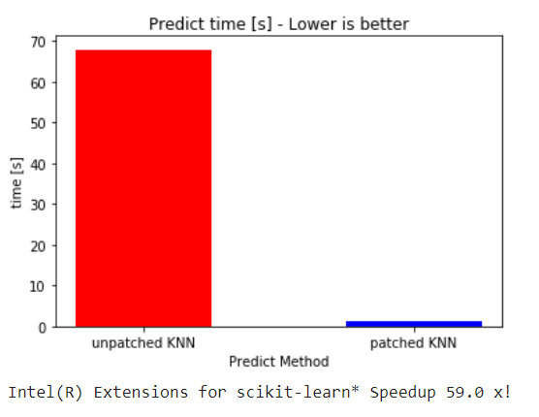
Some results: recent run
KNN acceleration results we expect to see in next months workshop on the Intel DevCloud.
This is a comparison of stock library to Intel Extensions for Scikit-learn*
Optimization Notice
Copyright © 2022, Intel Corporation. All rights reserved. *Other names and brands may be claimed as the property of others.
Notes:
Architecture: x86_64 CPU op-mode(s): 32-bit, 64-bit Byte Order: Little Endian Address sizes: 46 bits physical, 48 bits virtual CPU(s): 24 On-line CPU(s) list: 0-23 Thread(s) per core: 2 Core(s) per socket: 6 Socket(s): 2 NUMA node(s): 2 Vendor ID: GenuineIntel CPU family: 6 Model: 85 Model name: Intel(R) Xeon(R) Gold 6128 CPU @ 3.40GHz Stepping: 4 CPU MHz: 1200.254 CPU max MHz: 3700.0000 CPU min MHz: 1200.0000 BogoMIPS: 6800.00 Virtualization: VT-x L1d cache: 384 KiB L1i cache: 384 KiB L2 cache: 12 MiB L3 cache: 38.5 MiB NUMA node0 CPU(s): 0-5,12-17 NUMA node1 CPU(s): 6-11,18-23 Vulnerability Itlb multihit: KVM: Vulnerable Vulnerability L1tf: Mitigation; PTE Inversion Vulnerability Mds: Mitigation; Clear CPU buffers; SMT vulnerable Vulnerability Meltdown: Mitigation; PTI Vulnerability Spec store bypass: Mitigation; Speculative Store Bypass disabled v ia prctl and seccomp Vulnerability Spectre v1: Mitigation; usercopy/swapgs barriers and __user pointer sanitization Vulnerability Spectre v2: Mitigation; Full generic retpoline, IBPB condit ional, IBRS_FW, STIBP conditional, RSB filling Vulnerability Srbds: Not affected Vulnerability Tsx async abort: Mitigation; Clear CPU buffers; SMT vulnerable Flags: fpu vme de pse tsc msr pae mce cx8 apic sep mtr r pge mca cmov pat pse36 clflush dts acpi mmx f xsr sse sse2 ss ht tm pbe syscall nx pdpe1gb rd tscp lm constant_tsc art arch_perfmon pebs bts rep_good nopl xtopology nonstop_tsc cpuid aperf mperf pni pclmulqdq dtes64 monitor ds_cpl vmx s mx est tm2 ssse3 sdbg fma cx16 xtpr pdcm pcid d ca sse4_1 sse4_2 x2apic movbe popcnt tsc_deadli ne_timer aes xsave avx f16c rdrand lahf_lm abm 3dnowprefetch cpuid_fault epb cat_l3 cdp_l3 inv pcid_single pti ssbd mba ibrs ibpb stibp tpr_sh adow vnmi flexpriority ept vpid ept_ad fsgsbase tsc_adjust bmi1 hle avx2 smep bmi2 erms invpci d rtm cqm mpx rdt_a avx512f avx512dq rdseed adx smap clflushopt clwb intel_pt avx512cd avx512b w avx512vl xsaveopt xsavec xgetbv1 xsaves cqm_l lc cqm_occup_llc cqm_mbm_total cqm_mbm_local dt herm ida arat pln pts hwp hwp_act_window hwp_ep p hwp_pkg_req pku ospke md_clear flush_l1d

Slide 18
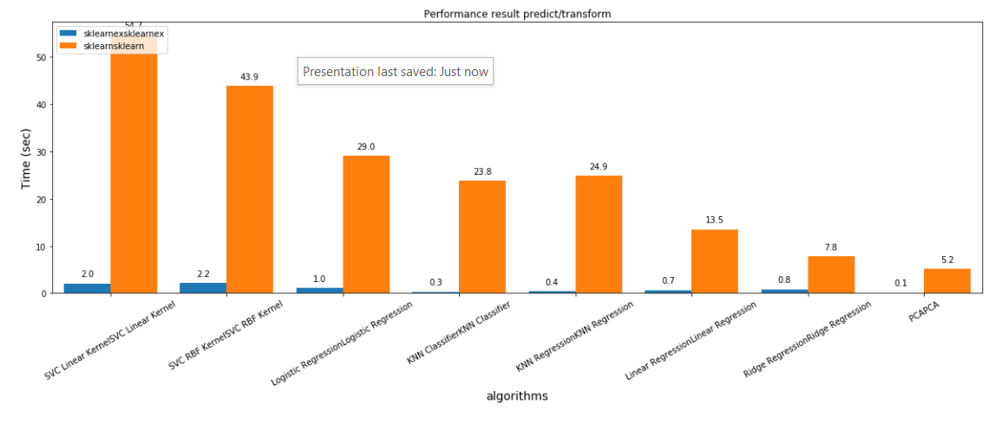
A few more results you will generate in next months workshop!
Optimization Notice
Copyright © 2022, Intel Corporation. All rights reserved. *Other names and brands may be claimed as the property of others.
Notes:
Architecture: x86_64 CPU op-mode(s): 32-bit, 64-bit Byte Order: Little Endian Address sizes: 46 bits physical, 48 bits virtual CPU(s): 24 On-line CPU(s) list: 0-23 Thread(s) per core: 2 Core(s) per socket: 6 Socket(s): 2 NUMA node(s): 2 Vendor ID: GenuineIntel CPU family: 6 Model: 85 Model name: Intel(R) Xeon(R) Gold 6128 CPU @ 3.40GHz Stepping: 4 CPU MHz: 1200.254 CPU max MHz: 3700.0000 CPU min MHz: 1200.0000 BogoMIPS: 6800.00 Virtualization: VT-x L1d cache: 384 KiB L1i cache: 384 KiB L2 cache: 12 MiB L3 cache: 38.5 MiB NUMA node0 CPU(s): 0-5,12-17 NUMA node1 CPU(s): 6-11,18-23 Vulnerability Itlb multihit: KVM: Vulnerable Vulnerability L1tf: Mitigation; PTE Inversion Vulnerability Mds: Mitigation; Clear CPU buffers; SMT vulnerable Vulnerability Meltdown: Mitigation; PTI Vulnerability Spec store bypass: Mitigation; Speculative Store Bypass disabled v ia prctl and seccomp Vulnerability Spectre v1: Mitigation; usercopy/swapgs barriers and __user pointer sanitization Vulnerability Spectre v2: Mitigation; Full generic retpoline, IBPB condit ional, IBRS_FW, STIBP conditional, RSB filling Vulnerability Srbds: Not affected Vulnerability Tsx async abort: Mitigation; Clear CPU buffers; SMT vulnerable Flags: fpu vme de pse tsc msr pae mce cx8 apic sep mtr r pge mca cmov pat pse36 clflush dts acpi mmx f xsr sse sse2 ss ht tm pbe syscall nx pdpe1gb rd tscp lm constant_tsc art arch_perfmon pebs bts rep_good nopl xtopology nonstop_tsc cpuid aperf mperf pni pclmulqdq dtes64 monitor ds_cpl vmx s mx est tm2 ssse3 sdbg fma cx16 xtpr pdcm pcid d ca sse4_1 sse4_2 x2apic movbe popcnt tsc_deadli ne_timer aes xsave avx f16c rdrand lahf_lm abm 3dnowprefetch cpuid_fault epb cat_l3 cdp_l3 inv pcid_single pti ssbd mba ibrs ibpb stibp tpr_sh adow vnmi flexpriority ept vpid ept_ad fsgsbase tsc_adjust bmi1 hle avx2 smep bmi2 erms invpci d rtm cqm mpx rdt_a avx512f avx512dq rdseed adx smap clflushopt clwb intel_pt avx512cd avx512b w avx512vl xsaveopt xsavec xgetbv1 xsaves cqm_l lc cqm_occup_llc cqm_mbm_total cqm_mbm_local dt herm ida arat pln pts hwp hwp_act_window hwp_ep p hwp_pkg_req pku ospke md_clear flush_l1d

Slide 19
Patching
Notes:
Next we will explore the topic of Patching

Slide 20
Introduction to patching
Intel® Extension for Scikit-learn* provides a way to accelerate existing scikit-learn code.
In code, we will import sklearnex – this is the python library name for Intel Extensions for Scikit-learn*
Via patching: replacing the stock scikit-learn algorithms with their optimized versions provided by the extension.
You may enable patching in different ways:
Without editing the code: using a command line flag
Within code: using an import and a function call
Un-patching: using methods to follow
k
Notes:
Patching – aka “Monkey patching”
Pathcing is applied by first importing the sklearnex library – which is how you refer to Intel Extensions for scikit-learn library in your code
Patching Is how we enable specific scikit learn functions. This can be done globally via command line, globally by placing the patch at the TOP of your code, or surgically (for specific regions or specific functions
Unpatching can be done within the code in the same ways:
globally by placing the patch at the TOP of your code, or surgically (for specific regions or specific functions

Slide 21
Patching Alternatives
Command line:
Inside script or Jupyter Notebook:
python -m sklearnex my_application.py
from sklearnex import patch_sklearn patch_sklearn()
Notes:
The top box shows how to apply patching to an entire python file at one time. The Scitkit-learn* function powered by oneAPI will be enabled for the whole program
The bottom box shows how to apply patching to all the “scikit-learn* imports” that follow the patch

Slide 22
Patching Alternatives
Unpatching is similar:
from sklearnex import unpatch_sklearn unpatch_sklearn()
Notes:
You can unpatch in a similar way

Slide 23
Patching Alternatives
Patching or patching or unpatch specified functions surgically:
from sklearnex import patch_sklearn patch_sklearn(“SVC”)
patch_sklearn([“SVC”, “PCA”])
from sklearnex import unpatch_sklearn unpatch_sklearn(“SVC”)
Notes:
To control more precise behavior, patching and unpatching an be applied to specific functions or lists of functions

Slide 24
Getting the list of optimized functions:
from sklearnex import get_patch_names
get_patch_names()
For up to date info
Supported Functions and Parameters
Notes:
Here is how to determine which scikit-learn* algorithms Intel has optimized
In a python program or Jupyter Notebook import the get_patch_names function from the sklearnex library and execute the get_patch_names function
This will generate the functions in this list. Or click on the link to get up-to-date info on what is optimized

Slide 25
Patching and imports: The Order
Import sklearnex
Apply “monkey patch” BEFORE
Import desired sklearn algorithms AFTER the patch
from sklearnex import patch_sklearn
patch_sklearn() # apply BEFORE import of targets
from sklearn.model_selection import train_test_split
The import order is very important!
Patch BEFORE you import the targeted scikit-learn* library!
Notes:
The order in which patching is applied is critical. To use the functions enabled or by sklearnex, you Must patch before the import or the desired function as seen in the code example
Unpatching is similar

Slide 26
Train and Test Split: The Syntax
Import sklearnex
Apply “monkey patch”
Import desired sklearn algorithms AFTER the patch
from sklearnex import patch_sklearn
patch_sklearn() # apply BEFORE import of targets
from sklearn.model_selection import train_test_split
# Split the data and put 30% into the test set X_train, X_test, y_train, y_test = train_test_split( ... X, y, test_size=0.3)
Notes:
Here we reserve 30% of the data as the Test set. Meaning we train on 70% of the data
Notice that we can keep the relevant associations among the train features with the train targets, and the test features with the test targets

Slide 27
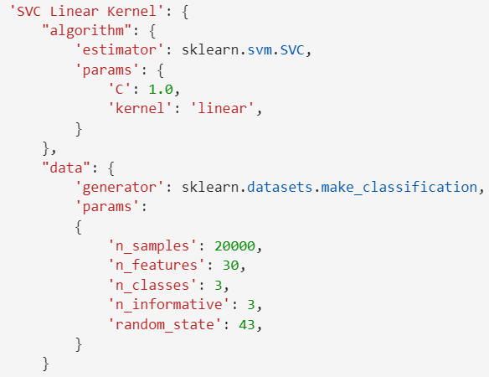
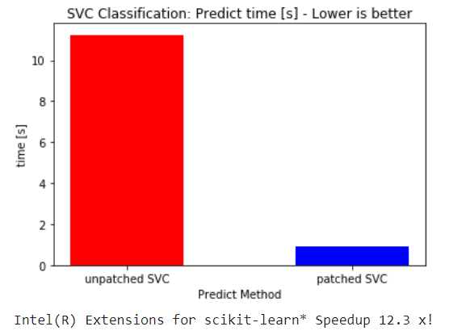
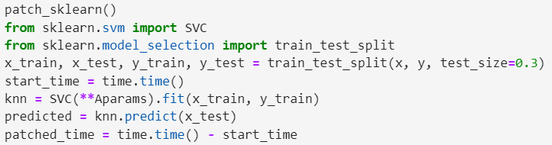
Example Code for SVC on CPU
Optimization Notice
Copyright © 2022, Intel Corporation. All rights reserved. *Other names and brands may be claimed as the property of others.
Notes:
Architecture: x86_64 CPU op-mode(s): 32-bit, 64-bit Byte Order: Little Endian Address sizes: 46 bits physical, 48 bits virtual CPU(s): 24 On-line CPU(s) list: 0-23 Thread(s) per core: 2 Core(s) per socket: 6 Socket(s): 2 NUMA node(s): 2 Vendor ID: GenuineIntel CPU family: 6 Model: 85 Model name: Intel(R) Xeon(R) Gold 6128 CPU @ 3.40GHz Stepping: 4 CPU MHz: 1200.254 CPU max MHz: 3700.0000 CPU min MHz: 1200.0000 BogoMIPS: 6800.00 Virtualization: VT-x L1d cache: 384 KiB L1i cache: 384 KiB L2 cache: 12 MiB L3 cache: 38.5 MiB NUMA node0 CPU(s): 0-5,12-17 NUMA node1 CPU(s): 6-11,18-23 Vulnerability Itlb multihit: KVM: Vulnerable Vulnerability L1tf: Mitigation; PTE Inversion Vulnerability Mds: Mitigation; Clear CPU buffers; SMT vulnerable Vulnerability Meltdown: Mitigation; PTI Vulnerability Spec store bypass: Mitigation; Speculative Store Bypass disabled v ia prctl and seccomp Vulnerability Spectre v1: Mitigation; usercopy/swapgs barriers and __user pointer sanitization Vulnerability Spectre v2: Mitigation; Full generic retpoline, IBPB condit ional, IBRS_FW, STIBP conditional, RSB filling Vulnerability Srbds: Not affected Vulnerability Tsx async abort: Mitigation; Clear CPU buffers; SMT vulnerable Flags: fpu vme de pse tsc msr pae mce cx8 apic sep mtr r pge mca cmov pat pse36 clflush dts acpi mmx f xsr sse sse2 ss ht tm pbe syscall nx pdpe1gb rd tscp lm constant_tsc art arch_perfmon pebs bts rep_good nopl xtopology nonstop_tsc cpuid aperf mperf pni pclmulqdq dtes64 monitor ds_cpl vmx s mx est tm2 ssse3 sdbg fma cx16 xtpr pdcm pcid d ca sse4_1 sse4_2 x2apic movbe popcnt tsc_deadli ne_timer aes xsave avx f16c rdrand lahf_lm abm 3dnowprefetch cpuid_fault epb cat_l3 cdp_l3 inv pcid_single pti ssbd mba ibrs ibpb stibp tpr_sh adow vnmi flexpriority ept vpid ept_ad fsgsbase tsc_adjust bmi1 hle avx2 smep bmi2 erms invpci d rtm cqm mpx rdt_a avx512f avx512dq rdseed adx smap clflushopt clwb intel_pt avx512cd avx512b w avx512vl xsaveopt xsavec xgetbv1 xsaves cqm_l lc cqm_occup_llc cqm_mbm_total cqm_mbm_local dt herm ida arat pln pts hwp hwp_act_window hwp_ep p hwp_pkg_req pku ospke md_clear flush_l1d

Slide 28
Target Intel GPU
The intent is to demonstrate “HOW” to target Intel GPU using Intel Extensions for Scikit-learn*
The intention today is NOT to demonstrate GPU performance

Slide 29
Compute Follows Data
Using a support library, we cast our data to device tensor, then send it to the device
Any enabled sklearn methods involving that tensor are computed on the device, typically during call to fit()
Results are returned to the host
This is Compute Follows Data

Slide 30

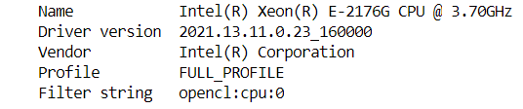
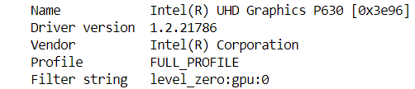
dpctl library
dpctl is the library used to control access to the compute devices
Import dpctl
Getting a list of available devices :

Slide 31
dpctl SyclDevice
A device represents a specific accelerator in the system.
Import dpctl
Getting a list of available devices :

Slide 32
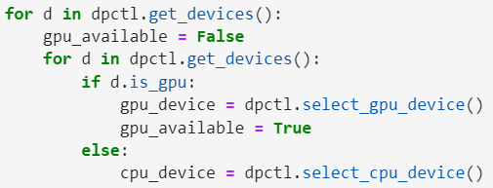
Device Queue
Get queue of all devices available
Pick the one you wish to target: in this case gpu_device

Slide 33
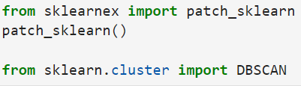
Apply patch to sklearn

Slide 34
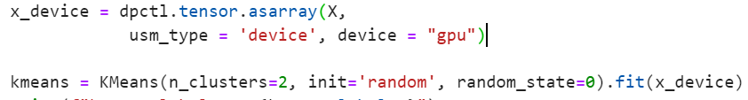
Prepare data
Cast Numpy arrays to dpctl tensor
Supply tensor to sklearn fit (“Compute Follow Data”)

Slide 35
Casting
Cast NumPy array FROM_NUMPY or asarray to dpctl. Tensor
If tensor is returned from sklearn, then cast it TO_NUMPY
Notes:
Notes about casting:
To call a function on the GPU cast FROM_Numpy to the device
To convert any returned device tenor, cast TO_MUMPY()

Slide 36
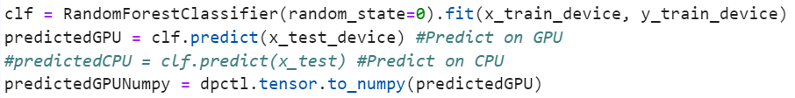
When to cast data Returned from the device?
Pay attention to return types from:
fit - many cases in scikit-learn, fit returns selfobject do NOT cast
fit_predict - returns ndarray requires casting after the call on host (to_numpy)
predict - returns ndarray requires casting after the call on host (to_numpy)
fit_transform - returns returns ndarray requires casting after the call on host (to_numpy)
tranform - typically returns ndarray requires casting after the call on host (to_numpy)

Slide 37
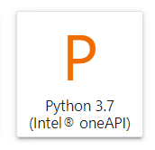
DevCloud Access
To run on the Intel DevCloud:
Setting up an account is quick and easy. Enroll here: https://devcloud.intel.com/oneapi/get_started/
For use on Intel® DevCloud, there are environment already configured for you: Simply launch a Jupyter* Notebook using the Python* 3.7 (Intel® oneAPI) Icon
For play outside of DevCloud, instructions are provided detailing how to acquire the library for your own system
Notes:
This course is intended to be run on the Intel DevCloud
Setting up an account is quick and easy. Enroll here: https://www.intel.com/content/www/us/en/developer/tools/devcloud/overview.html
For use on Intel® DevCloud, there are environment already configured for you: Simply launch a Jupyter* Notebook using the Python* 3.7 (Intel® oneAPI) Icon
For play outside of DevCloud, instructions are provided detailing how to acquire the library for your own system

Slide 38
Access to Notebooks
Repo:
From DevCloud Terminal: git clone https://github.com/IntelSoftware/Machine-Learning-using-oneAPI.git

Slide 39
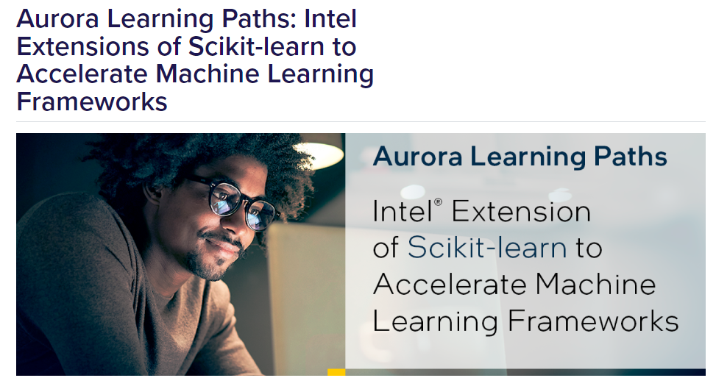
Continue the series!
https://www.alcf.anl.gov/aurora-learning-paths-intel-extensions-scikit-learn-accelerate-machine-learning-frameworks

Slide 40

Complete this Short Survey
Give us feedback…
Webinar Survey
Tell us what you thought of this webinar.
Give us feedback on what topics you’d like to see in future webinars.

Slide 42
System Info
Architecture: x86_64 CPU op-mode(s): 32-bit, 64-bit Byte Order: Little Endian Address sizes: 46 bits physical, 48 bits virtual CPU(s): 24 On-line CPU(s) list: 0-23 Thread(s) per core: 2 Core(s) per socket: 6 Socket(s): 2 NUMA node(s): 2 Vendor ID: GenuineIntel CPU family: 6 Model: 85 Model name: Intel(R) Xeon(R) Gold 6128 CPU @ 3.40GHz Stepping: 4 CPU MHz: 1200.254 CPU max MHz: 3700.0000 CPU min MHz: 1200.0000 BogoMIPS: 6800.00 Virtualization: VT-x L1d cache: 384 KiB L1i cache: 384 KiB L2 cache: 12 MiB L3 cache: 38.5 MiB NUMA node0 CPU(s): 0-5,12-17 NUMA node1 CPU(s): 6-11,18-23 Vulnerability Itlb multihit: KVM: Vulnerable Vulnerability L1tf: Mitigation; PTE Inversion Vulnerability Mds: Mitigation; Clear CPU buffers; SMT vulnerable Vulnerability Meltdown: Mitigation; PTI Vulnerability Spec store bypass: Mitigation; Speculative Store Bypass disabled v ia prctl and seccomp Vulnerability Spectre v1: Mitigation; usercopy/swapgs barriers and __user pointer sanitization Vulnerability Spectre v2: Mitigation; Full generic retpoline, IBPB condit ional, IBRS_FW, STIBP conditional, RSB filling Vulnerability Srbds: Not affected Vulnerability Tsx async abort: Mitigation; Clear CPU buffers; SMT vulnerable Flags: fpu vme de pse tsc msr pae mce cx8 apic sep mtr r pge mca cmov pat pse36 clflush dts acpi mmx f xsr sse sse2 ss ht tm pbe syscall nx pdpe1gb rd tscp lm constant_tsc art arch_perfmon pebs bts rep_good nopl xtopology nonstop_tsc cpuid aperf mperf pni pclmulqdq dtes64 monitor ds_cpl vmx s mx est tm2 ssse3 sdbg fma cx16 xtpr pdcm pcid d ca sse4_1 sse4_2 x2apic movbe popcnt tsc_deadli ne_timer aes xsave avx f16c rdrand lahf_lm abm 3dnowprefetch cpuid_fault epb cat_l3 cdp_l3 inv pcid_single pti ssbd mba ibrs ibpb stibp tpr_sh adow vnmi flexpriority ept vpid ept_ad fsgsbase tsc_adjust bmi1 hle avx2 smep bmi2 erms invpci d rtm cqm mpx rdt_a avx512f avx512dq rdseed adx smap clflushopt clwb intel_pt avx512cd avx512b w avx512vl xsaveopt xsavec xgetbv1 xsaves cqm_l lc cqm_occup_llc cqm_mbm_total cqm_mbm_local dt herm ida arat pln pts hwp hwp_act_window hwp_ep p hwp_pkg_req pku ospke md_clear flush_l1d
Optimization Notice
Copyright © 2022, Intel Corporation. All rights reserved. *Other names and brands may be claimed as the property of others.

