Slide 1
Accelerate Python Loops with the Intel AI Analytics Toolkit
Webinar
Bob Chesebrough AI Software Solutions Engineer

Slide 2
Learning Objectives
At the end of the webinar, you will be able to:
Describe a Python loop replacement strategy using NumPy constructs which:
Improves readability, maintainability
Performs fasts on current hardware and
Readies code for future HW & SW accelerations that Intel builds into silicon, and which are exposed via NumPy
Describe NumPy clause to aid aggregations, reductions, broadcasting, and “where” and “select” to significantly accelerate your Python code
Describe the value of the Intel AI Analytics Toolkit
Describe underlying reasons for the acceleration due to NumPy powered by oneAPI
Notes:
At the end of the course you will be able to:
Describe Intel® oneAPI and specific implementations using the Intel® AI Analytics Toolkit such as Intel® Extension for Scikit-learn*
Describe and categorize types of problems where the Intel® Extension for Scikit-learn* library are appropriate
Identify parts of library that apply to a given problem category
Describe conceptual knowledge of several key scikit-learn algorithms and what they are used for
Articulate and apply a few minimal codes changes to achieve better than stock performance of many common ML algorithms
Analyze code to identify where library optimizations can be applied, and then apply these appropriate code cha

Slide 3
Intel® AI Analytics Toolkit
Intel® AI Analytics Toolkit
Deep Learning
Machine Learning
Intel® Optimization for TensorFlow
Intel® Extension for Scikit-learn
Intel-optimized XGBoost
Accelerate end-to-end AI and data analytics pipelines with libraries optimized for Intel® architectures
Who Uses It?
Data scientists, AI researchers, ML and DL developers, AI application developers
Top Features/Benefits
Deep learning performance for training and inference with Intel optimized DL frameworks and tools
Drop-in acceleration for data analytics and machine learning workflows with compute-intensive Python packages
Intel® Optimization for PyTorch
Intel® Neural Compressor
Data Analytics
Model Zoo for Intel® Architecture
Intel® Distribution of Modin
OmniSci Backend
Intel-optimized Python
NumPy
SciPy
Pandas
Numba
Python
CPU
GPU
Hardware support varies by individual tool. Architecture support will be expanded over time.
Get the Toolkit HERE or via these locations
Intel Installer
Docker
Apt, Yum
Conda
Intel® DevCloud
3
Learn More: software.intel.com/oneapi/ai-kit
Back to Domain-specific Toolkits for Specialized Workloads
Notes:
AI Analytics kit is part of our oneAPI initiative and ecosystem building
AI Analytics kit is of interest to AI and Data Analytics folks, data scientists, data engineers, and so on.
The AI Analytics toolkit spans Deep Learning, Machine Learning, Data Analytics, and Intel Optimized Python
This course focuses on the circled areas
This course is primarily targeted at Machine Learning layer including XGBoost and Scikit-learn*
But we will also include training for acceleration using NumPy, Scipy, Pandas etc, as these are all powered by oneAPI and these packages provide key coverage for almost all AI projects

Slide 4
Intel® AI Analytics Toolkit
Deep Learning
Machine Learning
Intel® Optimization for TensorFlow
Intel® Extension for Scikit-learn
Intel-optimized XGBoost
Intel® Optimization for PyTorch
Intel® Neural Compressor
Data Analytics
Model Zoo for Intel® Architecture
Intel® Distribution of Modin
OmniSci Backend
Intel-optimized Python
NumPy
SciPy
Pandas
Numba
Python
CPU
GPU
Hardware support varies by individual tool. Architecture support will be expanded over time.
Notes:
AI Analytics kit is part of our oneAPI initiative and ecosystem building
AI Analytics kit is of interest to AI and Data Analytics folks, data scientists, data engineers, and so on.
The AI Analytics toolkit spans Deep Learning, Machine Learning, Data Analytics, and Intel Optimized Python
This course focuses on the circled areas
This course is primarily targeted at Machine Learning layer including XGBoost and Scikit-learn*
But we will also include training for acceleration using NumPy, Scipy, Pandas etc, as these are all powered by oneAPI and these packages provide key coverage for almost all AI projects

Slide 5
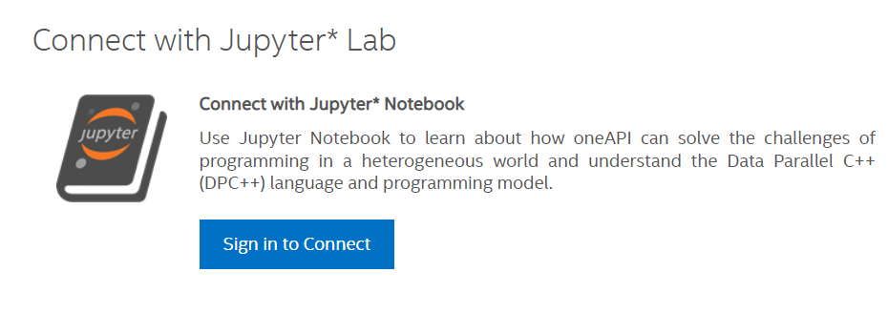
Intel DevCloud
Register Using QR Code Click Jupyter Icon link to sign in
https://devcloud.intel.com/oneapi/get_started/
Register And Login Here
Follow the ReadMe:
github.com/IntelSoftware/Machine-Learning-using-oneAPI/blob/main/README.md

Slide 6
Numpy – powered by oneAPI
Stock version has oneAPI included
Download AI Analytics toolkit here (get latest functionality here first)
Are you getting the performance you expect using NumPy?
Are you using NumPy effectively?
Note: Keep NumPy library up to date
Are you using NumPy effectively?
Notes:
Stock version of NumPy has oneAPI included
Download oneAPI analytics toolkit here (get latest functionality here first)
Are you getting the performance you expect using NumPy?
May you already use NumPy. Are you using NumPy effectively?
Note: Keep NumPy library up to date
Are you using NumPy effectively?

Slide 7
Python is Great & Fast …
For rapidly prototyping ideas
Tackling just about every imaginable coding task
Getting project rolling quickly … Examples of code are everywhere!
Easy: Dynamically typed – making programming easy
Easy & Fast: : Leverage huge number of libraries, easily installable
For AI: fast/no porting: easy portability of models across architectures
Notes:
Python is great. Its my native language now, having developed in other languages in the past
It is fantastic for:
rapidly proto typing ideas
Tackling just about every imaginable coding task
Getting project rolling quickly … Examples of code are everywhere
Easy: Dynamically typed – making programming easy
Easy & Fast: : Leverage huge number of libraries, easily installable
For AI: fast/no porting: easy portability of models across architectures

Slide 8
Python is SLOW
For some things:
REPEATED low level tasks
Large loops
Nested Loops
List comprehensions (if large)
BUT
There are ways to mitigate its weaknesses
Take advantage of those libraries
NUMPY – this is powered by oneAPI !
And others!
Notes:
But Python can be slow for REPEATED low level tasks especially one that repeat A LOT!
Large loops with many loop iterations
Nested loops
Even list comprehensions if they encompass many iterations
But NumPy is a library means of compensating for slow loopy code in Python

Slide 9
NumPy Vectorization:
This practice of replacing explicit loops with array expressions is commonly referred to as vectorization. In general, vectorized array operations will often be one or two (or more) orders of magnitude faster than their pure Python equivalents, with the biggest impact [seen] in any kind of numerical computations. - Wes McKinney (Pandas inventor)
Notes:
Here is a nice description of what we are doing in this class and with NumPy in general:
replacing explicit loops with array expressions is commonly referred to as vectorization. In general, vectorized array operations will often be one or two (or more) orders of magnitude faster than their pure Python equivalents, with the biggest impact [seen] in any kind of numerical computations.

Slide 10
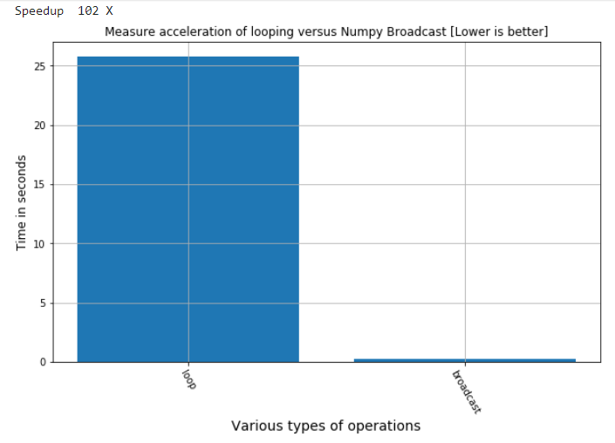
Vectorization is NOT just theory!
You will see, hear about the speedups possible, then you will experience it in code
This is why we strongly encourage the use of libraries powered by Intel oneAPI such as NumPy, Scipy, and the rest
Get the goodness of Python but inherit vectorization speed inherent with NumPy powered by Intel oneAPI
100 X speed up using NumPy broadcasting versus loop
Notes:
Vectorization is not just a theory or a concept in a compiler optimization handbook. It provides real accelerations and typicaly makes code more readable and maintainable
Here we show the results we get in the Jupyter notebook as a result of using a concept called NumPy broadcasting to speed up an other large ugly loop in our case in the hands on lab, 100X over the loopy code

Slide 11
Why are these speedups so dramatic?
NumPy takes advantage of vectorization: powered by Intel oneAPI
Specifically, oneMKL, for vectorization
Vector width allows multiple operations in single HW instruction.
Many FP instructions computed in single instruction
AVX2: 256 bits: 8 floats wide
AVX512: 512 bits: 16 floats wide
Notes:
Why are these speedup so large?
In this case it is NOT related to multiple cores – that is a topic of parallelization that can sometimes be applied in ADDITION to this topic of vectorization.
We will describe vectorization at a lower level up to the NUMPY level definition in a few slides.
There are several reasons NumPy powered by oneAPI accelerates so much
One is that NumPy is geared to be able to take advantage of Intel wide vector lanes, when that is appropriate, and to use new vectorized instructions on this hardware to get outsized speedups.
At this low level “C” compiled level, the compiled version combines many floating point instructions into a single instruction taking one to a small few number of clock cycles. In a traditional Python loop – you forgo this capability for reasons we explain later

Slide 12
We are comparing to simple loops in Python
In Python, these operations are COSTLY
Python is dynamically typed
Has to check the data type before any operation to ensure correct operations are applied
Even a simple integer is not simple
A class or structure that contains
Reference counters and other values
These are updated every operation
Scalar Instructions
1
+
1
=
2
3
+
2
=
5
Loop Iterations
5
+
3
=
8
7
+
4
=
11
9
+
5
=
14
Notes:
In Python, even seemingly obvious types, such as Integers, are NOT what you might think of if you have a C programming background. An integer in Python is a data structure with reference counters and other control structures that indicate what kinds of operations can be done with this partiucal instance of the variable. Each use of a variable – essentially, each touch – requires instructions to be performed at a low level to check the underlying data type, see what operations can be applied, update any refence counters etc – and these don’t take very much on an instruction by instruction basis
BUT over billions of loop iterations – these are taxes on performance that ADD up!
Python is dynamically typed . This means that a list in Python can hold anything!
An integer in element one, a float in element 2, a string in element 3 and on and on. In a python loop traversin gthis list each and every encounter requires many low level steps to be performed

Slide 13
Effect of Noncontiguous Memory Access
A list of integers in python are NOT generally in contiguous locations
For this list: [1, 2, 3, 4, 5, 6, 7, 8]
Accessing many of these in loops is VERY Costly (could be hundreds of clock cycles)
 | 5 | 7
 |  |  |  |  |  | 3
 |  |  |  | 8
2
 |  |  |  |  |  |  | 1
 |  | 6 |  |  |  |  |  |  | 4
Notes:
And to top it all off
The memory layout for the Python lists is scattered all over memory! It needs a score card to keep track! This takes time!

Slide 14
Cache is used ineffectively
Random reads from all over memory hurt performance.
Modern Intel CPU’s read in Cache line of consecutive memory so that consecutive data is already to go when needed. The cache line may contain 16 consecutive elements or more.
But with random reads, our next data element is read from a completely different place in memory – wasting the remaining elements that were ready to be served from the cache line.
This is analogous to a chef opening and cooking a single egg from a carton of 16 to service customer number 1.
Then opening a NEW carton of eggs from a SECOND carton for customer number 2. The other eggs get tossed out [analogous to cache line eviction ].
These are SOME reasons why vectorization is better – it mitigates all the above.
Notes:
AND it is inefficient.
Intel HW is designed to do you a favor. When you ask for a memory element, it will return that memory element ultimately from main memory, or a lower somewhat faster cache, but it does so using an egg carton analogy, or a “City Bus” analogy – called a “cache line”.
\
An analogy is a carton of eggs as depicted here
Lest say you are asked by family to fry an egg – you don’t have any in your refrigerator, so you go the Store to buy a carton
You bring it home and put it in the fridge (memory to cache)
You go back to fridge, take out the carton and fry a single egg
Carton sits on counter
NEXT family member asks for an egg.
And guess what?
We drive back to the store to buy another carton because (in Python) the egg we wanted was not in the carton!)
And we repeat this insanity over and over
Eventually, out counter top is full of wasted cartons of eggs. We might get lucky and be able to use or two later, but inevitably, many of these carton are knocked off to the floor and the eggs wasted.
In computer hardware parlance, this is a cache eviction – its very costly
\ Bus Analogy
A City Bus is sent to pick up passengers from a stop
As long as the HW had to send the City bus, many, many clock cycles to main memory, it might as well pick up a load of waiting passengers of data that VERY VERY often be interested in the same destination VERY VERY soon
Imagine how wasteful it would be for the city bus to take a BUS FULL of people all across town, and drop off ONLY ONE Passenger – and THEN trap all the rest of the passengers on the bus waiting until their name or number is specifically called
In Python lists and loops, this is very similar
We ask for the first element in a list and a t low level, instructions go off find the memory location, load up a full bus (why bother returning an empty bus), deliver that single integer from the list to be used
Then, then next Python element in the list is requested, BUT sadly, because the names passenger comes from another state, it is NOT ON the current bus! We have to wait for the Bus for that town to load up and arrive.
Meanwhile both busses are parking at our stop waiting to be used.
Then we read the next element – another city bus!
Etc

Slide 15
Cache is used ineffectively with random memory accesses
Cache Eviction: Similar to not enough room on the table
Table full of egg cartons
Notes:
Here is the result of such cache evictions
Broken eggs and wasted effort abound

Slide 16
Additionally: concerning memory
An array of integers in NumPy are contiguous locations.
Modern CPU’s return a cache line (like a carton of eggs) for the contiguous memory elements nearby one you chose to load initially.
The assumption is if I just used memory address 0x12345, then likely I will use 0x12346 very soon.
Contiguous memory addresses
1
2
3
4
5
6
7
8
Notes:
Additionally, an array of integers in Numpy are contiguous in memory – meaning if we send a bus to a location, it is meaningful to load the bus with consecutively number passengers. These passengers are already ear marked for special duty in the VECTORIZED LOOP.
Unlike the loopy Python example with Integer structures, the analogy is that we don’t have to send the bus all over town to pick up single passengers.
These are just a few reasons why NumPy functions and aggregations powered by oneAPI, can be so much faster and efficient when computing with them

Slide 17
How do I move my code patterns to NumPy?
NumPy Vectorization encompasses…
NumPy Universal Functions (Ufuncs)
Aggregations
Fancy Indexing
Broadcasting
NumPy Where & Select for Conditionals
Are ALL loops vectorizable?
We will give guidance!
Notes:
How do I move my code patterns to NumPy?
We will explore several ways:
NumPy Universal Functions (Ufuncs)
Aggregations
Fancy Indexing
Broadcasting
NumPy Where & Select for Conditionals

Slide 18
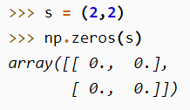
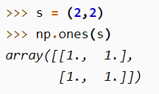
How to create NumPy arrays
From existing lists:
By dimensions but empty:
By Shape – fill with zeros or ones:
Notes:
There are several common ways to create a NumPy array – and this is not an exclusive list
You can copy the contents of list to a NumPy array and it will upcast the resulting arrays to be of, in this case, a floating point array
You can create and empty array based on dimensions of an array and fill it later
You can pre-populate an array sof given shape, with ones, or zeros or even an identity matrix

Slide 19
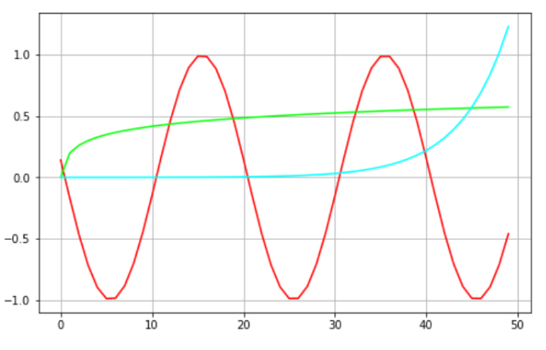
ufuncs
ufuncs are written in C (for speed) and linked into Python with NumPy’s ufunc facility
Universal Functions | Description: These are vectorized
Math operations | add, subtract, multiply, divide, reciprocal, matmul, log, exp, square, sqrt, …
Trigonometric | sin, cos, tan, arcsin, arccos, arctan, hypot, sinh, cosh, tanh, degrees, radians
Bit-twiddling | bitwise_and, bitwise_or, bitwise_xor, invert, left_shift, right_shift
Comparison Functions | greater, greater_equal, less, less_equal, not_equal, equal, logical_and, logical_or, logical_xor, logical_not
Floating Functions | isfinite, isinf, isnan, isnat, fabs, signbit, copysign, nextafter, spacing, modf, ldexp, frexp, fmod, floor, ceil, trunc
Notes:
Universal Functions
This is only a summary of the kinds of ufuncs optimized – a summary of sorts with examples

Slide 20
NumPy Universal functions (ufunc): Vectorized!
ufunc is a “vectorized” wrapper for a function
Implements vectorization support in Intel AVX2 and AVX512
Takes a fixed number of specific inputs
Produces a fixed number of specific outputs
Applies function in per element-wise fashion.
For detailed information on universal functions, see Universal functions (ufunc) basics.
import numpy as np arr = np.trunc([-3.1666, 3.6667]) print(arr) out: [-3. 3.]
Notes:
Universal Functions encompass all the things in the icon graphic above and more. Exp, log, trig, floating point math, comparisons, and more

Slide 21
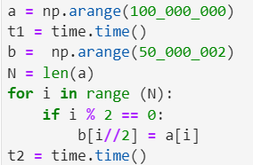
Sophisticated Indexing
Slicing and Indexing can replace many common loop concepts
Results 4.5 X
Notes:
Fancy loop indexing provided in NumPy allows many otherwise tedious loops to be replaced with a single line of code
The code on the left assigned all the even indices in “a” to a new vector “b”
The code on the right replaces the inefficient loop with a single, easily understood and maintainable line of code this simple line was 4.5X faster in our DevCloud notebook
Architecture: x86_64 CPU op-mode(s): 32-bit, 64-bit Byte Order: Little Endian Address sizes: 46 bits physical, 48 bits virtual CPU(s): 24 On-line CPU(s) list: 0-23 Thread(s) per core: 2 Core(s) per socket: 6 Socket(s): 2 NUMA node(s): 2 Vendor ID: GenuineIntel CPU family: 6 Model: 85 Model name: Intel(R) Xeon(R) Gold 6128 CPU @ 3.40GHz Stepping: 4 CPU MHz: 1200.254 CPU max MHz: 3700.0000 CPU min MHz: 1200.0000 BogoMIPS: 6800.00 Virtualization: VT-x L1d cache: 384 KiB L1i cache: 384 KiB L2 cache: 12 MiB L3 cache: 38.5 MiB NUMA node0 CPU(s): 0-5,12-17 NUMA node1 CPU(s): 6-11,18-23 Vulnerability Itlb multihit: KVM: Vulnerable Vulnerability L1tf: Mitigation; PTE Inversion Vulnerability Mds: Mitigation; Clear CPU buffers; SMT vulnerable Vulnerability Meltdown: Mitigation; PTI Vulnerability Spec store bypass: Mitigation; Speculative Store Bypass disabled v ia prctl and seccomp Vulnerability Spectre v1: Mitigation; usercopy/swapgs barriers and __user pointer sanitization Vulnerability Spectre v2: Mitigation; Full generic retpoline, IBPB condit ional, IBRS_FW, STIBP conditional, RSB filling Vulnerability Srbds: Not affected Vulnerability Tsx async abort: Mitigation; Clear CPU buffers; SMT vulnerable Flags: fpu vme de pse tsc msr pae mce cx8 apic sep mtr r pge mca cmov pat pse36 clflush dts acpi mmx f xsr sse sse2 ss ht tm pbe syscall nx pdpe1gb rd tscp lm constant_tsc art arch_perfmon pebs bts rep_good nopl xtopology nonstop_tsc cpuid aperf mperf pni pclmulqdq dtes64 monitor ds_cpl vmx s mx est tm2 ssse3 sdbg fma cx16 xtpr pdcm pcid d ca sse4_1 sse4_2 x2apic movbe popcnt tsc_deadli ne_timer aes xsave avx f16c rdrand lahf_lm abm 3dnowprefetch cpuid_fault epb cat_l3 cdp_l3 inv pcid_single pti ssbd mba ibrs ibpb stibp tpr_sh adow vnmi flexpriority ept vpid ept_ad fsgsbase tsc_adjust bmi1 hle avx2 smep bmi2 erms invpci d rtm cqm mpx rdt_a avx512f avx512dq rdseed adx smap clflushopt clwb intel_pt avx512cd avx512b w avx512vl xsaveopt xsavec xgetbv1 xsaves cqm_l lc cqm_occup_llc cqm_mbm_total cqm_mbm_local dt herm ida arat pln pts hwp hwp_act_window hwp_ep p hwp_pkg_req pku ospke md_clear flush_l1d

Slide 22
NumPy Aggregation & Statistics Functions
Functions | Description: These are vectorized
np.mean() | Compute the arithmetic mean along the specified axis.
np.std() | Compute the standard deviation along the specified axis.
np.var() | Compute the variance along the specified axis.
np.sum() | Sum of array elements over a given axis.
np.prod() | Return the product of array elements over a given axis.
np.cumsum() | Return the cumulative sum of the elements along a given axis.
np.cumprod() | Return the cumulative product of elements along a given axis.
np.min(), np.max() | Return the minimum / maximum of an array or minimum along an axis.
np.argmin(), np.argmax() | Returns the indices of the minimum / maximum values along an axis
np.all() | Test whether all array elements along a given axis evaluate to True.
np.any() | Test whether any array element along a given axis evaluates to True.
Notes:
Performance acceleration for these is about the same as for the other methods – just letting know these exist
AI users rely heavily on np.mean(), np.std(), np.sum(), and the cumprod will be very handy to tackle a specific flow dependency issue we will see in hands on labs

Slide 23
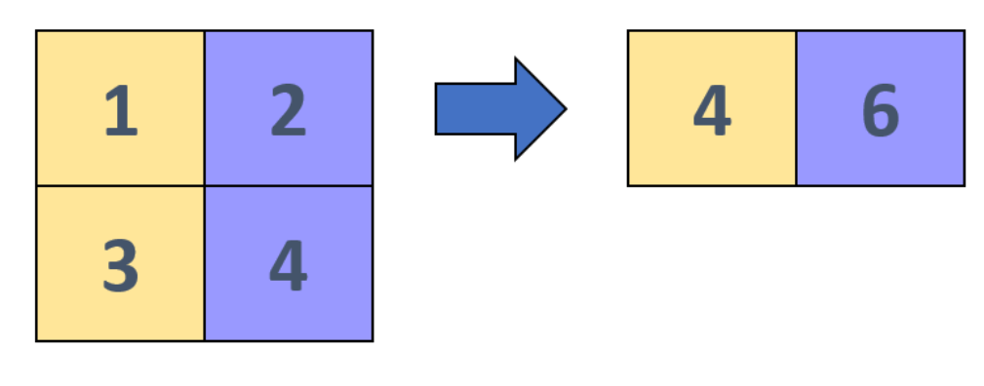
NumPy Aggregations: Vectorized!
Aggregation is an operation to reduce the dimensionality of an array or vector
Implements vectorization support in Intel AVX2 and AVX512
Replace loops you are using to compute averages, sums, standard deviation, min, max etc
Use NumPy aggregation instead. Its more readable, faster, and future proof
A = [1 2 3] for v in range(len(A)): S += v mean = S/len(A)
A = np.array(A) mean = A.mean()
1
2
3
np.mean =
2
Notes:
Aggregation: compression results of higher dimensions to lower ones – you may find patterns like this in your own code

Slide 24
NumPy Aggregations: Vectorized!
Aggregations can be applied along different axes
A
[[1 2 3]
[4 5 6]]
A.sum(axis = 0)
array([5 7 9])
A.sum(axis = 1)
array([6 15])
Notes:
Aggregation: compression results of higher dimensions to lower ones – such as computing a mean, median, sum, standard deviation etc, It can be applied to compute a single scalar value or applied to get sub totals by row or by column

Slide 25
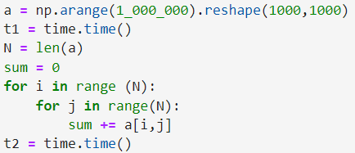
Aggregation: Example
100X speed up over naïve loop
Notes:
Admonition to move such loopy code to Numpy method
On the left a Naïve and loopy way to add all numbers in an array
On the left, a single, easily read and understood line of code, that I the lab example is about 100X faster on DevCloud

Slide 26
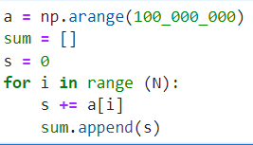
NumPy: Aggregation & Statistics
Result: 100 Million elements: roughly 13X
Notes:
Replace loopy code patterns like the one on the left to compute a cumulative sum or product with the code on the right
Easier to read and maintain
20X faster

Slide 27
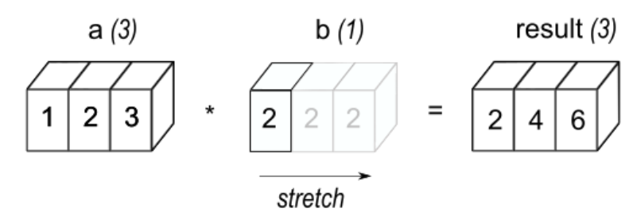
NumPy Broadcasting: Vectorized!
Support with AVX2 and AVX512 instructions
Apply an operator with a scalar to each element in vector
Also, apply operator with lower dimension vector to larger dimension
a = np.array([1.0 2.0 3.0])
b = 2.0
a * b
array([ 2. 4. 6.])
Notes:
Broadcasting applies operations on a smaller dimensional array or scalar to a different array with larger dimensions
This is not something you learn in Linear Algebra class as operations I Linear Algebra are particular about matching dimensions. To make this work, the smaller array or scalar has to be enlarged (and data copied appropriately) to eventually have two matching dimensions for both intermediate arrays prior to applying the operation at hand

Slide 28
Broadcasting Graphically
Non-matching dimensions are extended and data copied at HW level
Once dimensions match the vectors can be added, subtracted etc.
First example:
a.shape (1, 3)
b.shape (1,1) # extend/copy to (1, 3)
result.shape (1, 3)
Notes:
Here is a graphic way to think about broadcasting
We want to add a scalar, the value 2, to every element of a larger array (containing 1,2,3
First the b arrays is stretched, enlarged, to the correct dimensions, with appropriate copying of the value 2 to the extra space.
Now I have two arrays of the same length that can be added in the usual Linear Algebra fashion with vectorized methods

Slide 29
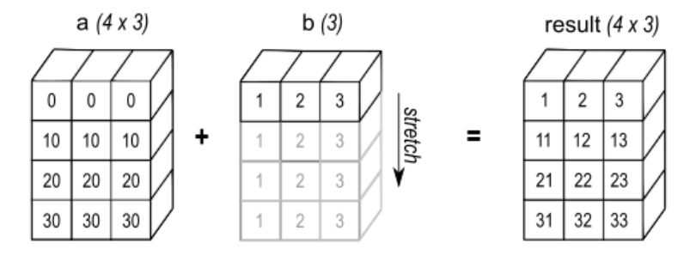
Broadcasting Graphically
Non-matching dimensions are extended and data copied at HW level
Once dimensions match the vectors can be added, subtracted etc.
Second example:
a.shape (4, 3)
b.shape (1, 3) # extend/copy to (4, 3)
result.shape (4, 3)
Notes:
Here is another example of adding a 1D vector to a 2D arrays
Extend the smaller array (or vector), copy the data in vectorized way, to match dimensions, then add
Lets say “a” has shape 4,3 and “b” has shape 1,3
We extend be by copying to be 4,3
Then add the two arrays

Slide 30
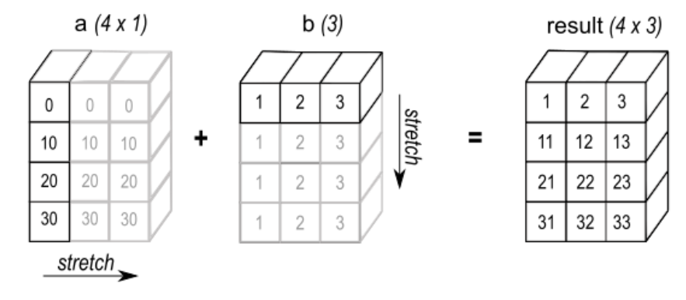
Broadcasting Graphically
Non-matching dimensions are extended and data copied at HW level
Once dimensions match the vectors can be added, subtracted etc.
Third example:
a.shape (4, 1)
b.shape (1, 3) # extend/copy to (4, 3)
result.shape (4, 3)
Notes:
Other operations can also be broadcast – you can do array multiplication for example to quickly get an outer product!

Slide 31
Broadcasting Example
Simple Multiplication table
Notes:
Here we are just creating a multiplication table. Not for real world consumption but to illustrate the point with concepts already known. In the example I used to calculate results I got on the order of
This applies a multiplication of two 1D vectors to arrive at a larger 2D array
The code on the right is functionally the same as the loopy code on the left but WAY faster
Do you have loopy code in your AI models?
Look up Jake Vanderplas on youtube, any video he does on Numpy and other topics are pure gold. He demonstrates a way to use broadcasting to efficiently do a pairwise distance or similar using broadcasting

Slide 32
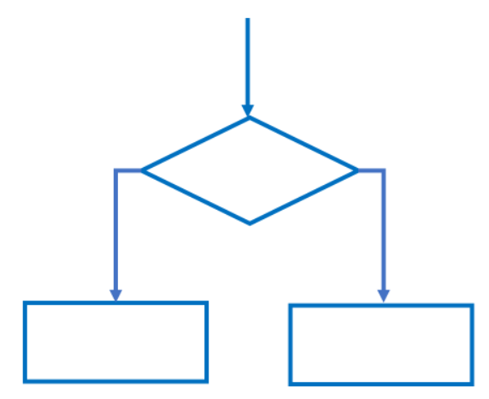
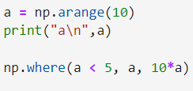
numpy.where
numpy.where: see : Return elements chosen from x or y depending on condition.
Notes:
Now we move on to conditional statement – “if” statements – that really can slow you loopy code down and can sometime be a challenge to write in Numpy…
Unless you know about numpy.Where and Numpy.Select!
“Where” Returns elements chosen from x or y depending on condition.
See the official documentation
Here is an example of conditionally multiplying a vector of values by 10 – if a < 5 then don’t multiply

Slide 33
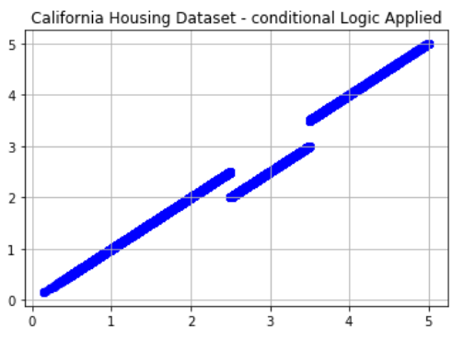
NumPy Where, NumPy Select
If statements (conditional logic) might severely limit performance:
Numpy: handles conditionals quickly, efficiently
Results: ~ 20 X
Notes:
Replace loopy code with a one liner. Does conditional processing
Here is example where we discount the median price for California Housing for a range of prices to conduct an experiment
The where clause is much more readable and maintainable and we also get a nice boost in speed around 20X

Slide 34
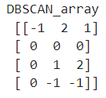
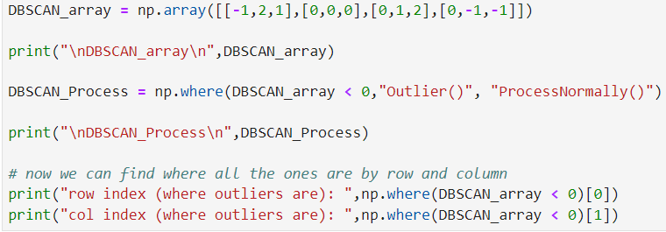
Numpy Where
Find row, col indices fast
Notes:
Find mask patterns easily!
Based on reshaped DBSCAN output (-1 are outliers) we conditionally process the data differently

Slide 35
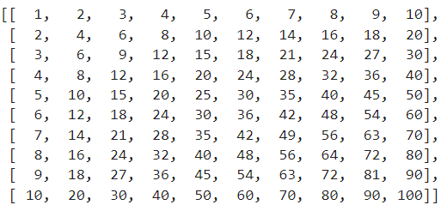
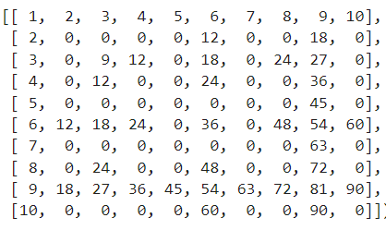
Numpy.where: More Complex logic
Results: ~ 20 X
Notes:
Add conditional logic in parenthesis with AND, OR, NOT etc
This by default blanks the non interesting location with zero
Here the interesting pattern we are examining are where we highlight multiple of 12 and 9
Shows default value being assigned zero at the end when condition not met
Fills table with zeros except for ones we are interested in
The results for a 1000x1000 array

Slide 36
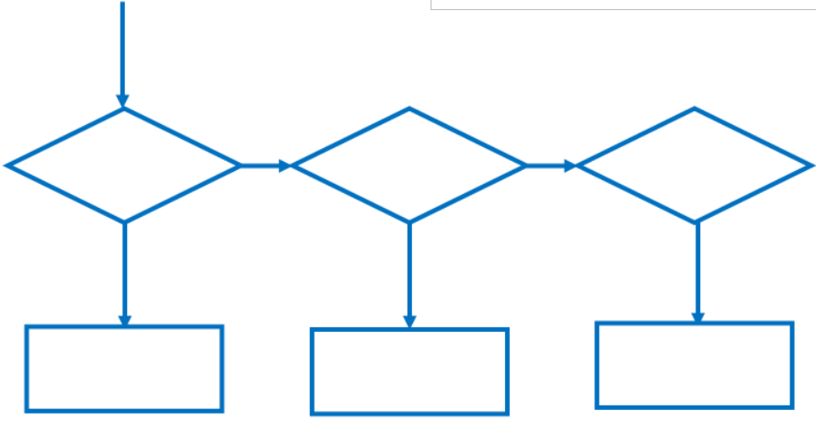
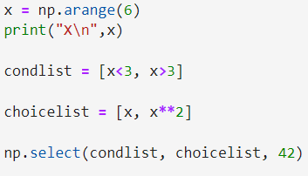
Numpy Select
Numpy.select: see
Return an array drawn from elements in choice list, depending on conditions.
Great for pulling together elements or functions(elements) from different arrays, DataFrames, different parts of the same array, etc
Notes:
Applies conditional logic in a vectorized way
Here X is a increasing sequence of values
The condition means
Whenever x < 3 then return x,
Else
When X > 3 return x**2
Default (x == 3) returns 42

Slide 37
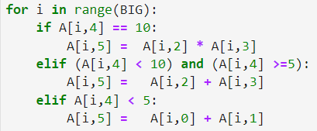
Numpy: Select Example
Results: ~ 20 X
Notes:
This time I am starting with using Numpy arrays but accessing them with a loop – inefficiently
There is ugly conditional code (not based on any known real world problem) but I am sure you have real codes that are even more complex
The code is more readable, maintainable and we get nice acceleration: roughly 26X times

Slide 38
The Pandas Connection
Pandas is built on top of Numpy
All the methods describe before apply
We will demonstrate alternative ways to achieve speedups when Pandas Apply is slow due to conditional logic in the custom called function
Notes:
As you may know, Pandas is built on top of Numpy. So enhancements made to Numpy powered by oneAPI also apply to Pandas

Slide 39
Methods
Use “Apply” for simple functions to apply to columns
When things get slow, convert data to NumPy arrays
to_numpy()
Replace conditional logic in the Apply with numpy.where or numpy.select
It is even possible to use numpy. select to manipulate Pandas dataframes directly
Notes:
To summarize what we will apply in the hands on lab, We encourage using Pandas.Apply when it performas well for you – mainly when the applied functions is fairly straightforward with little conditional branching
When Conditional Logic get more tedious, where different rows of different columns are being read and combined, the Apply method may perform more slowly
Consider replacing Pandas. Apply with a direct use of Numpy.Select to simplify the logic (you use DataFrames in your choice list or conditional list )
Or usuallt faster, convert the pertinent parts of the dataframe to numpy using to_numpy()
Then use the Numpy Select as usual
Then assign the output result from the numpy.select back the column you intended to update

Slide 40
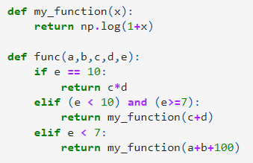
Using numpy.select as alternative to pandas.apply
Notes:
Here is a contrived example
We have applied the logic in func to a Pandas.apply via a lambda function
Then time the result

Slide 41
Using numpy.select as alternative to pandas.apply
Results: 200 X +
Notes:
Then try replacing the Pandas Apply with a NumPy select as follows
We create a condition list (remember to use tuples as the elements inside the list) as shown
Then create a choice list that essentially call the same function as before, with the mods you wish to make to the resulting output column
Call select (here we give the default value as we had done on the previous slide
Then assign the result back to the dataFrame!
Done!
Results on DevCloud were over 200X faster then the Pandas. Apply

Slide 42
Poll Audience
Live Demo/Lab

Slide 43
Call to Action
Loops:
Find large single, double, and triple nested loops in your code and replace with Scipy/ Scikit-Learn*, or NumPy alternative
Find time consuming list comprehensions and replace with a NumPy alternative .
If statements:
replace with numpy.where or numpy.select options if possible
Using array masking that follows the conditional logic
Notes:
Scipy/ Scikit-Learn*, or NumPy/ Pandas are powered by oneAPI or have Intel Extensions for them.
FIND ALTERNATIVES to existing legacy loops

Slide 44
Complete this Short Survey
Give us feedback…
Webinar Survey
Tell us what you thought of this webinar.
Give us feedback on what topics you’d like to see in future webinars and workshops.

Slide 45
Thanks for attending the session
Notes:
Thanks for attending this session

Slide 46
BACKUP

Slide 47
Notices & Disclaimers
This document contains information on products, services and/or processes in development. All information provided here is subject to change without notice. Contact your Intel representative to obtain the latest forecast, schedule, specifications and roadmaps.
The products and services described may contain defects or errors known as errata which may cause deviations from published specifications. Current characterized errata are available on request. No product or component can be absolutely secure. Intel technologies’ features and benefits depend on system configuration and may require enabled hardware, software or service activation. Learn more at intel.com, or from the OEM or retailer.
Software and workloads used in performance tests may have been optimized for performance only on Intel microprocessors. Performance tests, such as SYSmark and MobileMark, are measured using specific computer systems, components, software, operations and functions. Any change to any of those factors may cause the results to vary. You should consult other information and performance tests to assist you in fully evaluating your contemplated purchases, including the performance of that product when combined with other products. For more complete information visit www.intel.com/benchmarks.
INFORMATION IN THIS DOCUMENT IS PROVIDED “AS IS”. NO LICENSE, EXPRESS OR IMPLIED, BY ESTOPPEL OR OTHERWISE, TO ANY INTELLECTUAL PROPERTY RIGHTS IS GRANTED BY THIS DOCUMENT. INTEL ASSUMES NO LIABILITY WHATSOEVER AND INTEL DISCLAIMS ANY EXPRESS OR IMPLIED WARRANTY, RELATING TO THIS INFORMATION INCLUDING LIABILITY OR WARRANTIES RELATING TO FITNESS FOR A PARTICULAR PURPOSE, MERCHANTABILITY, OR INFRINGEMENT OF ANY PATENT, COPYRIGHT OR OTHER INTELLECTUAL PROPERTY RIGHT.
Copyright ©, Intel Corporation. All rights reserved. Intel, the Intel logo, Xeon, Core, VTune, and OpenVINO are trademarks of Intel Corporation or its subsidiaries in the U.S. and other countries.
Optimization Notice
Intel’s compilers may or may not optimize to the same degree for non-Intel microprocessors for optimizations that are not unique to Intel microprocessors. These optimizations include SSE2, SSE3, and SSSE3 instruction sets and other optimizations. Intel does not guarantee the availability, functionality, or effectiveness of any optimization on microprocessors not manufactured by Intel. Microprocessor-dependent optimizations in this product are intended for use with Intel microprocessors. Certain optimizations not specific to Intel microarchitecture are reserved for Intel microprocessors. Please refer to the applicable product User and Reference Guides for more information regarding the specific instruction sets covered by this notice. Notice revision #20110804

Slide 48
Intel(r) DevCloud testing specs
Architecture: x86_64 CPU op-mode(s): 32-bit, 64-bit Byte Order: Little Endian Address sizes: 46 bits physical, 48 bits virtual CPU(s): 24 On-line CPU(s) list: 0-23 Thread(s) per core: 2 Core(s) per socket: 6 Socket(s): 2 NUMA node(s): 2 Vendor ID: GenuineIntel CPU family: 6 Model: 85 Model name: Intel(R) Xeon(R) Gold 6128 CPU @ 3.40GHz Stepping: 4 CPU MHz: 1200.254 CPU max MHz: 3700.0000 CPU min MHz: 1200.0000 BogoMIPS: 6800.00 Virtualization: VT-x L1d cache: 384 KiB L1i cache: 384 KiB L2 cache: 12 MiB L3 cache: 38.5 MiB NUMA node0 CPU(s): 0-5,12-17 NUMA node1 CPU(s): 6-11,18-23 Vulnerability Itlb multihit: KVM: Vulnerable Vulnerability L1tf: Mitigation; PTE Inversion Vulnerability Mds: Mitigation; Clear CPU buffers; SMT vulnerable Vulnerability Meltdown: Mitigation; PTI Vulnerability Spec store bypass: Mitigation; Speculative Store Bypass disabled v ia prctl and seccomp Vulnerability Spectre v1: Mitigation; usercopy/swapgs barriers and __user pointer sanitization Vulnerability Spectre v2: Mitigation; Full generic retpoline, IBPB condit ional, IBRS_FW, STIBP conditional, RSB filling Vulnerability Srbds: Not affected Vulnerability Tsx async abort: Mitigation; Clear CPU buffers; SMT vulnerable Flags: fpu vme de pse tsc msr pae mce cx8 apic sep mtr r pge mca cmov pat pse36 clflush dts acpi mmx f xsr sse sse2 ss ht tm pbe syscall nx pdpe1gb rd tscp lm constant_tsc art arch_perfmon pebs bts rep_good nopl xtopology nonstop_tsc cpuid aperf mperf pni pclmulqdq dtes64 monitor ds_cpl vmx s mx est tm2 ssse3 sdbg fma cx16 xtpr pdcm pcid d ca sse4_1 sse4_2 x2apic movbe popcnt tsc_deadli ne_timer aes xsave avx f16c rdrand lahf_lm abm 3dnowprefetch cpuid_fault epb cat_l3 cdp_l3 inv pcid_single pti ssbd mba ibrs ibpb stibp tpr_sh adow vnmi flexpriority ept vpid ept_ad fsgsbase tsc_adjust bmi1 hle avx2 smep bmi2 erms invpci d rtm cqm mpx rdt_a avx512f avx512dq rdseed adx smap clflushopt clwb intel_pt avx512cd avx512b w avx512vl xsaveopt xsavec xgetbv1 xsaves cqm_l lc cqm_occup_llc cqm_mbm_total cqm_mbm_local dt herm ida arat pln pts hwp hwp_act_window hwp_ep p hwp_pkg_req pku ospke md_clear flush_l1d

