Slide 1
Affinity in Aurora
Colleen Bertoni, Thomas Applencourt, Brian Homerding, Kris Rowe, Abhishek Bagusetty, Nathan Nichols, Victor Anisimov

Slide 2
Affinity in Aurora - Overview
It’s confusing but it doesn’t have to be!
Affinity is a tendency, attraction, or preference to something (Merriam-Webster Dictionary)
Affinity in HPC means using the shortest and the fastest path for data transfer
Memory affinity means a proximity of a memory bank to a particular processing unit
  It is known as NUMA: non-uniform memory access
  Local vs non-local memory (do not confuse with distributed memory)
  Accessing the data stored in a local or non-local memory has different costs
Compute affinity is a proximity of an accelerator device to the host
  Multiple hosts and multiple devices
The degree of locality determines the efficiency of data transfer between memory and processing units
All that is also known as NUMA architecture
Make the data transfer efficient
Why NUMA architecture?

Slide 3
The Origin of NUMA
An ideal computer node has
  Single CPU - easy to program
  Operated at the blazing speed - infinitely fast
  Equipped with unlimited RAM - vast memory
In reality, none of the above is practical
A modern compute node is a parallel machine - highly parallel architecture
  Multiple processors on a single silicon
  Multiple GPU accelerators
  Multiple memory units accompanying the processing units
This architecture leads to Non-Uniform Memory Access - affinity interconnects the pieces
  Multiple pieces in the node: CPUs, compute cores, GPUs, memory banks
Application programs must be highly parallel to utilize the compute power of the modern architectures
What do we have in a single node in Aurora?

Slide 4
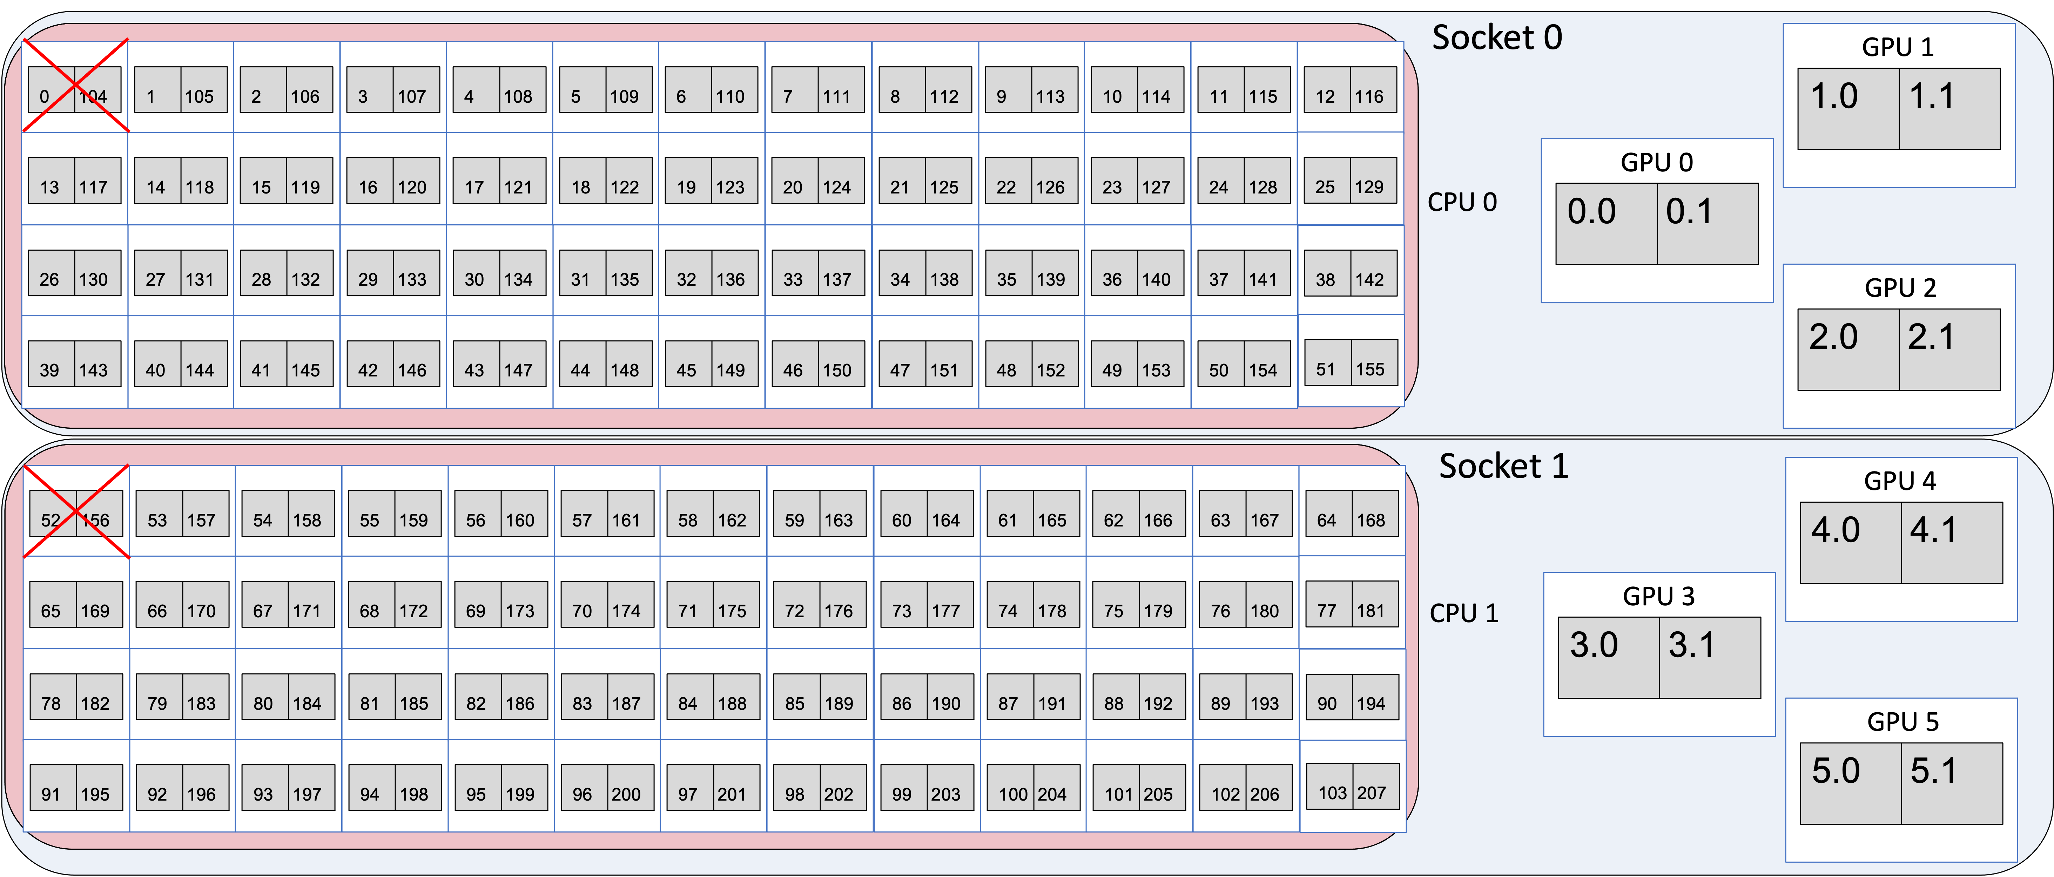
Compute Resources of a Single Node in Aurora
512 Gb DDR
64 Gb HBM
512 Gb DDR
64 Gb HBM
Each Aurora node has (in aggregate values)
2 sockets
2 CPUs
104 physical cores
208 logical cores
1 Tb of DDR
128 Gb HBM
6 GPUs
12 tiles, 768 Gb
Double precision
Peak: 187 TFlops
Amazing compute capabilities to do new innovative science!
How to properly use these resources?

Slide 5
Errors to Avoid
512 Gb DDR
64 Gb HBM
512 Gb DDR
64 Gb HBM
Each Aurora node has (in aggregate values)
2 sockets
2 CPUs
104 physical cores
208 logical cores
1 Tb of DDR
128 Gb HBM
6 GPUs
12 tiles, 768 Gb
Double precision
Peak: 187 TFlops
1) mpiexec –n1 –ppn1 ./EXE rank allocates 1Tb fails exceeds the limit of 512 Gb
2) mpiexec –n2 –ppn2 ./EXE 2 ranks each allocate 512Gb also fails ranks land on the same socket
3) mpiexec –n6 –ppn6 ./EXE 6 ranks each drive 1 GPU very slow data traffic across sockets
Correct usage requires the knowledge of how the pieces interconnect

Slide 6
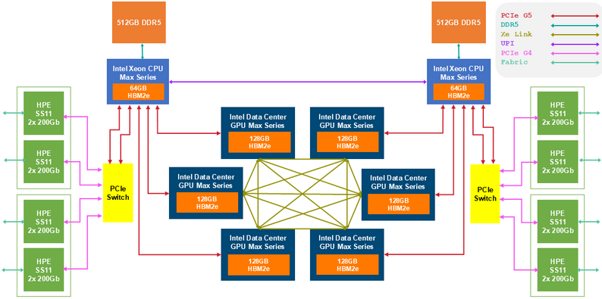
Topology of a Single Compute-Node in Aurora
2 sockets
  1 CPU per socket
  3 GPUs per socket
CPU
  52 cores per CPU
  2 threads per core
  104 threads per CPU
  512 Gb DDR per CPU
  64 Gb HBM per CPU
GPU
  2 tiles (mini-GPUs) per GPU
  64 Gb per tile (128 Gb GPU)
64Gb 64Gb
64Gb 64Gb
64Gb 64Gb
64Gb 64Gb
64Gb 64Gb
64Gb 64Gb
12 MPI ranks per node is the most common configuration (1 MPI rank per 1 GPU tile; 12 tiles total)
Avoid jam packing the parallel tasks. Instead, evenly distribute them over the available resources.
  How to best assign 12 MPI ranks in the node?

Slide 7
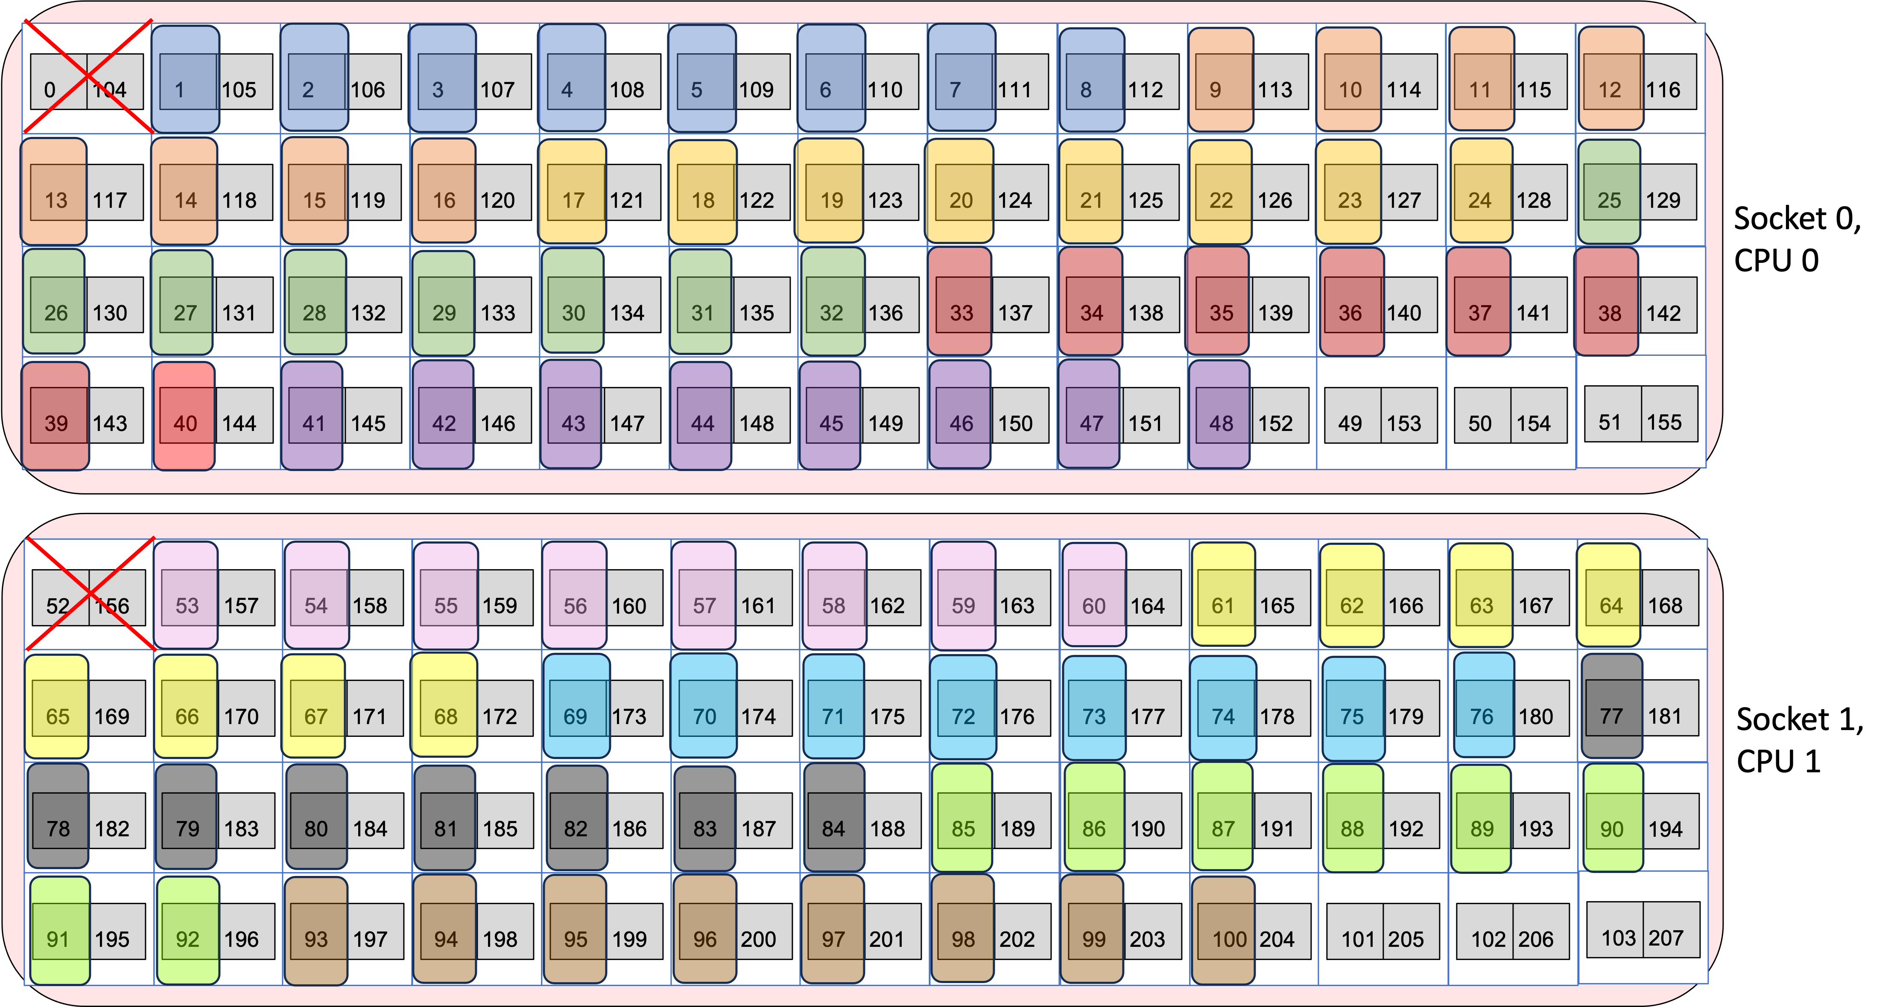
Optimal MPI Rank Binding to CPU Cores in Aurora
Having 12 MPI ranks and 2 CPUs implies assigning 6 MPI ranks per CPU
6 MPI ranks share 512 Gb DDR and 64 Gb HBM 1 MPI rank can spawn 8 OpenMP threads (8 cores)
512 Gb DDR
CPU 0
Cores: 1 – 51
Hyperthreads 105-155
64 Gb HBM
512 Gb DDR
CPU 1
Cores: 53 – 103
Hyperthreads 157-207
64 Gb HBM
export CPU_BIND_SCHEME="--cpu-bind=list:1-8:9-16:17-24:25-32:33-40:41-48:53-60:61-68:69-76:77-84:85-92:93-100"
mpiexec -n 12 -ppn 12 ${CPU_BIND_SCHEME} ./EXE
Socket 0
Socket 1

Slide 8
Topology of a Single Compute-Node in Aurora
2 sockets
  1 CPU per socket
  3 GPUs per socket
CPU
  52 cores per CPU
  2 threads per core
  104 threads per CPU
  512 Gb DDR per CPU
  64 Gb HBM per CPU
GPU
  2 tiles (mini-GPUs) per GPU
  64 Gb per tile (128 Gb GPU)
64Gb 64Gb
64Gb 64Gb
64Gb 64Gb
64Gb 64Gb
64Gb 64Gb
64Gb 64Gb
Each PVC GPU has two tiles, and each tile has a separate 64 Gb HBM
We want to pin the MPI rank to the CPU cores and the GPU-tile residing on the same socket
  How to best assign 12 MPI ranks per node?

Slide 9
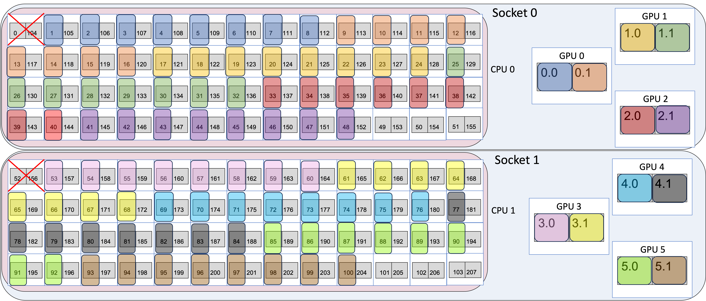
Bind MPI Rank to the Nearest GPU Tile on a Socket
CPU: 6 MPI ranks share 512 Gb DDR and 64 Gb HBM 1 MPI rank can spawn 8 OpenMP threads (8 cores)
GPU: Socket 0 – GPU 0,1,2 & Socket 1 – GPU 3,4,5 1 MPI rank connects to 1 GPU tile, which has 64Gb
512 Gb DDR
64Gb 64Gb
64 Gb HBM
64Gb 64Gb
Format:
GPU_id.Tile_id
0-5 . 0-1
64Gb 64Gb
512 Gb DDR
64Gb 64Gb
64 Gb HBM
64Gb 64Gb
64Gb 64Gb
export CPU_BIND_SCHEME="--cpu-bind=list:1-8:9-16:17-24:25-32:33-40:41-48:53-60:61-68:69-76:77-84:85-92:93-100"
export GPU_BIND_SCHEME="--gpu-bind=list:0.0:0.1:1.0:1.1:2.0:2.1:3.0:3.1:4.0:4.1:5.0:5.1” (GPU_id.Tile_id)
export ZE_FLAT_DEVICE_HIERARCHY=COMPOSITE (default option in Aurora)
mpiexec -n 12 -ppn 12 ${CPU_BIND_SCHEME} ${GPU_BIND_SCHEME} ./EXE
Socket 0
Socket 1

Slide 10
GPU Binding by Using gpu_tile_compact.sh
There is a better way to bind MPI ranks to GPU tiles than using the mpiexec option --gpu-bind=list
ALCF has designed a wrapper script gpu_tile_compact.sh to bind 12 GPU tiles to 12 MPI ranks.
The script sets the environment variable ZE_AFFINITY_MASK for each MPI rank.
mpiexec -n 12 -ppn 12 ${CPU_BIND_SCHEME} gpu_tile_compact.sh ./EXE
The mapping of MPI ranks
to GPU tiles works as follows:
MPI (Rank 0) → GPU 0 : Tile 0
MPI (Rank 1) → GPU 0 : Tile 1
MPI (Rank 2) → GPU 1 : Tile 0
MPI (Rank 2) → GPU 1 : Tile 1
…
MPI (Rank 10) → GPU 5 : Tile 0
MPI (Rank 11) → GPU 5 : Tile 1
each GPU tile has 64 Gb of memory
gpu_tile_compact.sh (it is in the $PATH)
#!/bin/bash
num_gpu=6
num_tile=2
gpu_id=$(( (PALS_LOCAL_RANKID / num_tile ) % num_gpu ))
tile_id=$((PALS_LOCAL_RANKID % num_tile))
unset EnableWalkerPartition
export EnableImplicitScaling=0
export ZE_ENABLE_PCI_ID_DEVICE_ORDER=1
export ZE_AFFINITY_MASK=$gpu_id.$tile_id
export OMP_NUM_THREADS=8
ulimit -c 0
"$@"

Slide 11
Topology of a Single Compute-Node in Aurora
Recall, that each PVC has a total of 128 Gb of memory on the device
Consider a scenario, when an application needs 128 Gb of continuous memory on GPU
6 GPUs in the node need 6 MPI ranks to drive the computation
  How to best assign 6 MPI ranks per node?

Slide 12
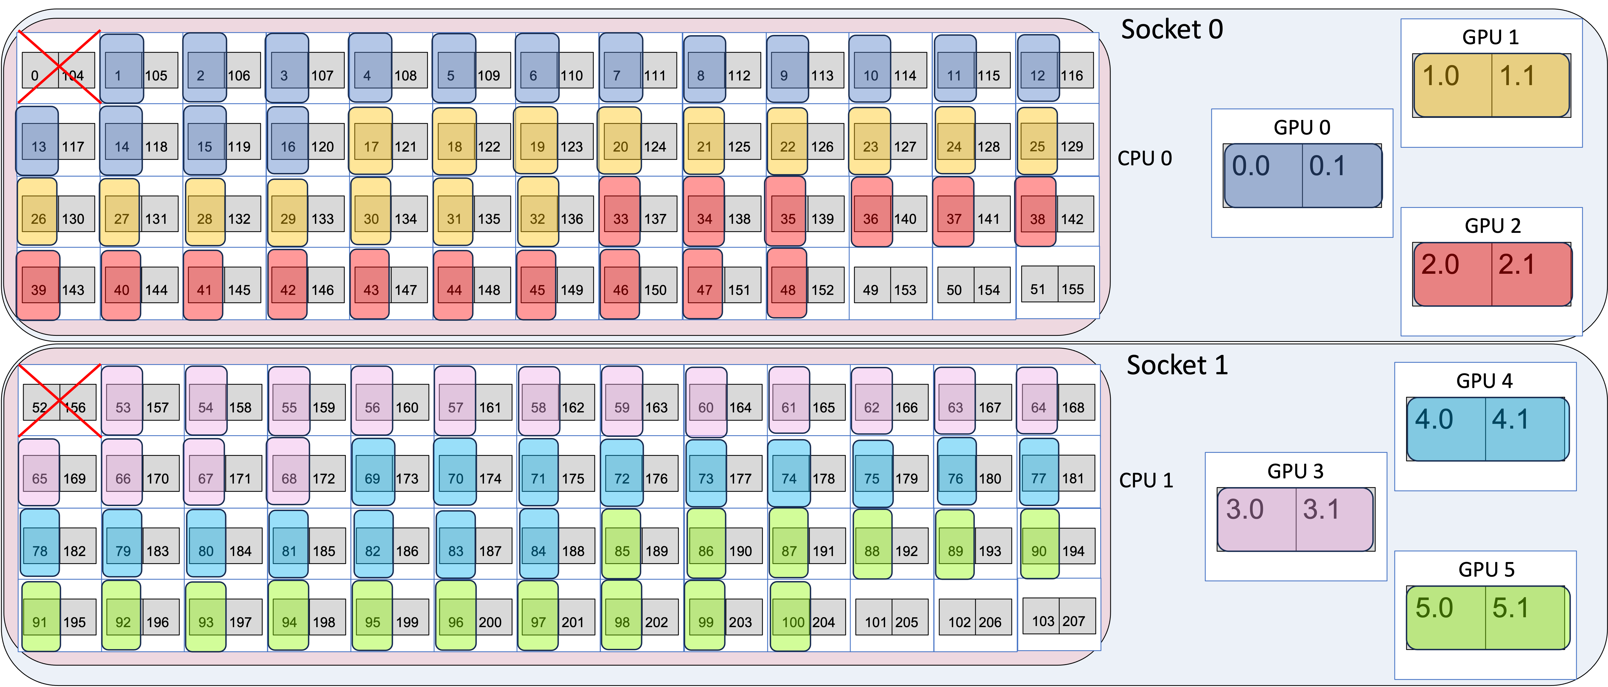
Using PVC as a Single Device – Implicit Scaling
If an application needs 128 Gb of continuous allocatable memory on GPU, PVC GPU can provide that in Implicit Scaling mode
Implicit Scaling turns GPU to a single device with 128 Gb; Explicit Scaling exposes 2 tiles with 64 Gb each
Explicit Scaling offers more flexibility for tuning and achieves better performance
Implicit Scaling is easier to use and provides more memory for the process running on GPU
6 MPI ranks per node
3 MPI ranks per socket
16 CPU cores per MPI rank
1 full GPU per MPI rank

Slide 13
Implicit Scaling by Using gpu_dev_compact.sh
ALCF has designed a wrapper script gpu_dev_compact.sh to bind 6 full GPUs to 6 MPI ranks.
Each MPI rank can access 128 Gb of continuous memory in GPU.
export CPU_BIND_SCHEME="--cpu-bind=list:1-16:17-32:33-48:53-68:69-84:85-100"
mpiexec -n 6 -ppn 6 ${CPU_BIND_SCHEME} gpu_dev_compact.sh ./EXE
The mapping of MPI ranks
to GPUs works as follows:
MPI (Rank 0) → GPU 0
MPI (Rank 1) → GPU 1
MPI (Rank 2) → GPU 2
MPI (Rank 3) → GPU 3
MPI (Rank 4) → GPU 4
MPI (Rank 5) → GPU 5

Slide 14
Final Thoughts
Aurora nodes provide outstanding compute capabilities:
  Peak double precision performance of 187 Tflops
  1 TB of RAM
  768 Gb of GPU memory
Application programmers need to make the application codes parallel to utilize these resources
Know the Aurora node architecture
Explicitly bind each MPI rank to specific physical cores to maximize the performance
Use ALCF-provided scripts for binding MPI ranks to GPUs
There are many other affinity options not covered in this presentation
Talk to your Point-of-Contact to discuss the optimal choices
For more information, see Aurora documentation: https://docs.alcf.anl.gov/aurora/running-jobs-aurora/

