Slide 1
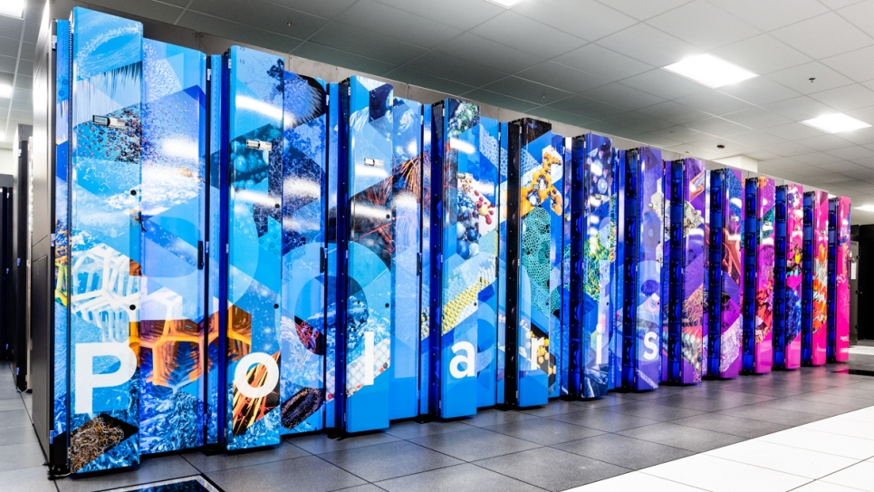

ALCF on-Demand
Integrated Research Infrastructure for Experiment-Time Computing with Globus Tools
October 15, 2025
ALCF Service-Enabled Science Series
Christine Simpson
Hannah Parraga
Argonne Leadership Computing Facility
Advanced Photon Source

Slide 2
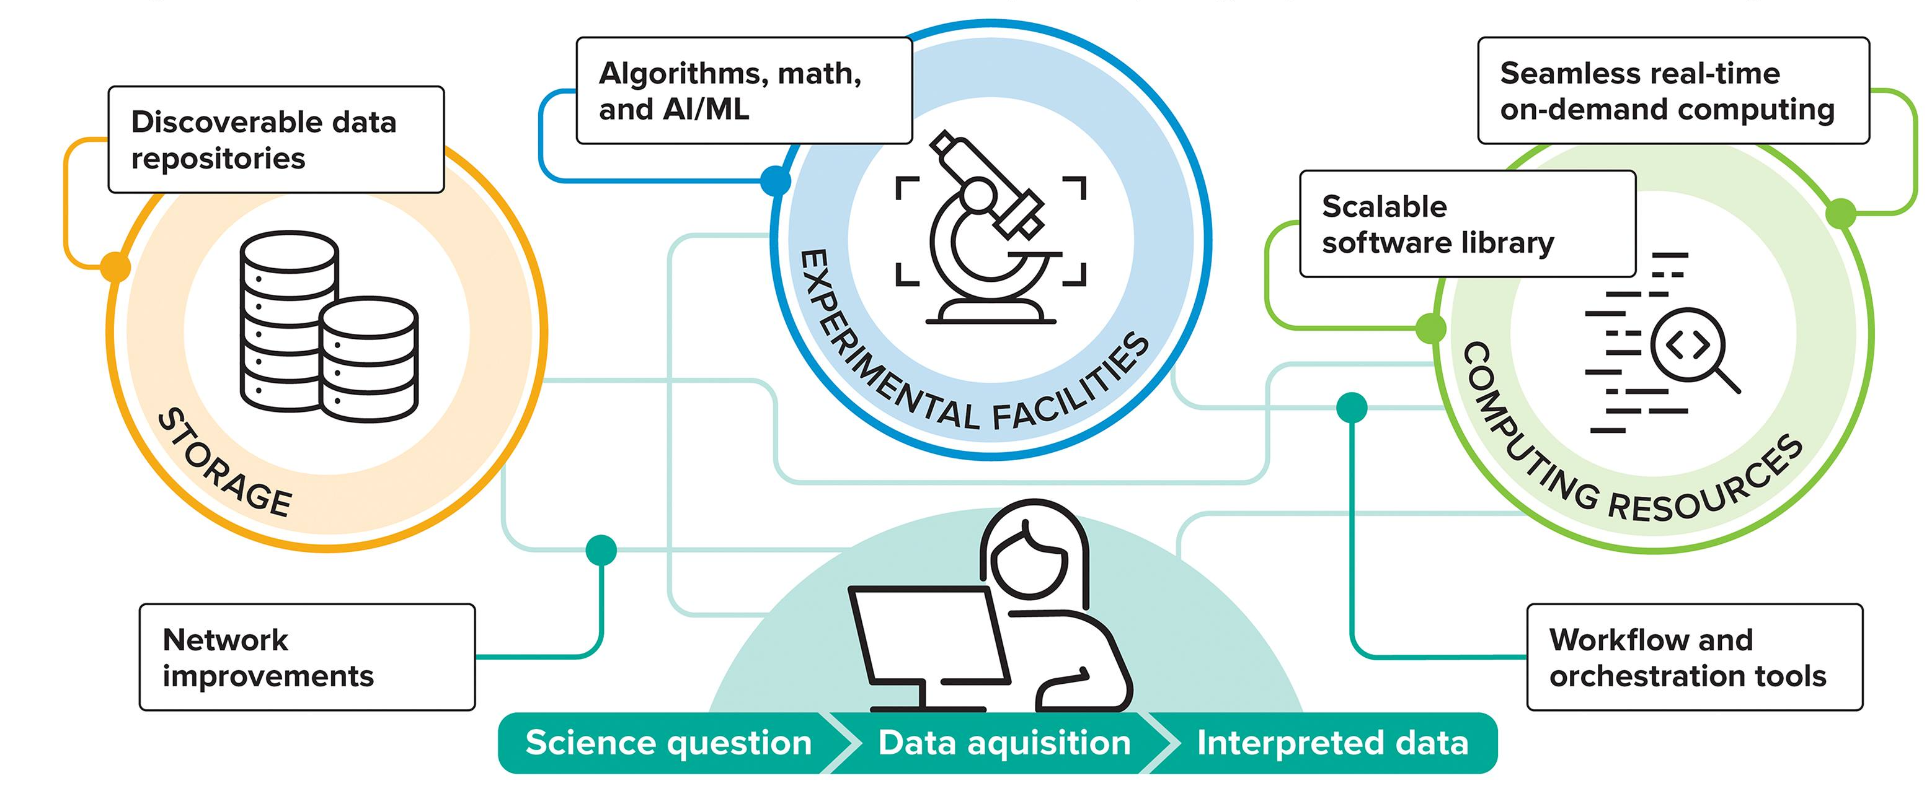
Outline
Today we will cover…
Introduction to Integrated Research Infrastructure at ALCF
An overview of services and tools for on-demand computing
  ALCF accounts and queues ideal for running experiments
  Globus Tools for triggering computational work
  Data management on ALCF resources with Globus Tools
An example use case from the Advanced Photon Source
Next steps and Future Programming

Slide 3
DOE Experimental User Facilities
DOE operates 24 Experimental User Facilities
Like computing facilities, some are undergoing upgrades
Many are also pivoting to make more use of AI tools
Their data rates and computing needs will increase accordingly

Slide 4
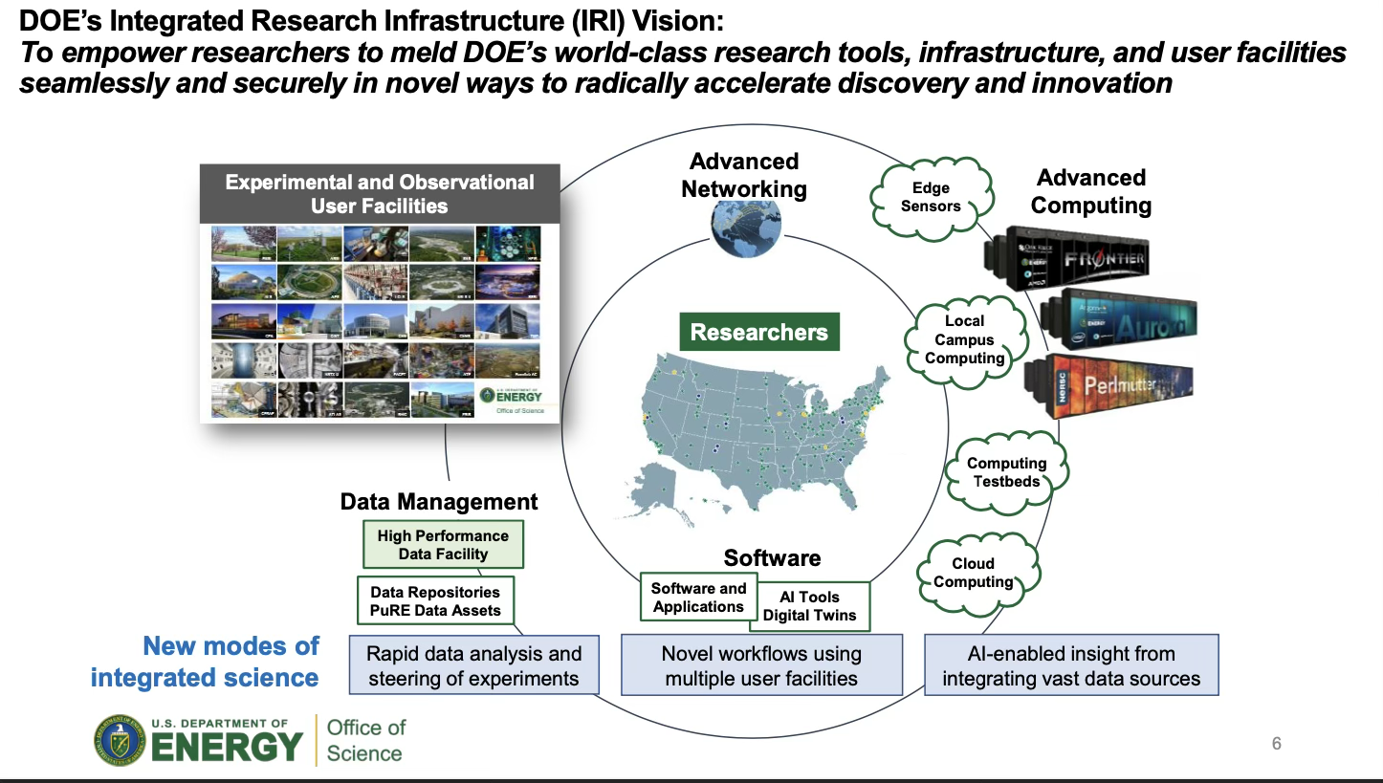
Need for Integrated Research Infrastructure (IRI)
Integrated (Research Infrastructure)
(Integrated Research) Infrastructure

Slide 5
ALCF Integrated Research Infrastructure
Demand Queues
  Enables experiment-time analysis jobs to run ~immediately; on-demand queue is backfilled by jobs in preemptable queue
Service Accounts
  Provide experiment-specific accounts for running analyses in a controlled environment
Eagle Data Publishing and Sharing (100PB filesystem)
  Allows users to define collections of data to share publicly or with designated Globus users
Globus Tools for Integration
  Supports distributed compute, transfer, and web-based monitoring
ALCF Community Data Cooperative (ACDC) Data Management
  Enables more sophisticated metadata-based navigation and search of data published directly from the Eagle filesystem
  Supports metadata extraction and capture services
Dedicated Web Applications
  Developing in collaborations with APS and Argonne Cosmology group for extension to other science areas
  Data catalogs resident on Eagle filesystem, searchable via user-provided metadata
  Community analysis of data supported via back-end integration of workflows on Polaris

Slide 6
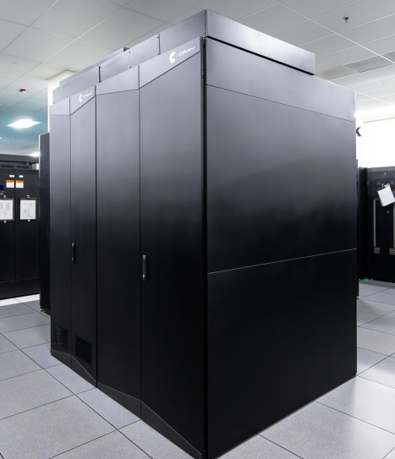
Demand Queues
Fast Access to Compute at Experiment Runtime
Demand Queues offer immediate access to nodes for approved projects
Two systems offer Demand Queues: Polaris and Crux
Demand queue jobs preempt jobs in the preemptable queue, giving fast access to nodes
Used by the APS, DIII-D, and other experiments for immediate access to compute resources during experiment runtime
Demand queue access available by request for teams with experiment-time compute needs
Polaris
Polaris Demand Queue:
56 available nodes with 224 GPUs
Job wall time limit of 60 minutes
Crux
Crux Demand Queue:
64 available nodes with 8192 CPU cores
Job wall time limit of 60 minutes

Slide 7
Service Accounts
Accounts for experiments or services
Service accounts are special accounts tied to a project experiment or service workload rather than an individual
Suitable for computational work done on behalf of an experiment (such as a light source beamline)
Service account approval requires a security review of all related components of the service applications
Service accounts are accessible from dedicated service nodes
Currently available on Polaris and Crux
Globus compute has passed the security review and is therefore a fast-track to functionality
Polaris
Crux

Slide 8
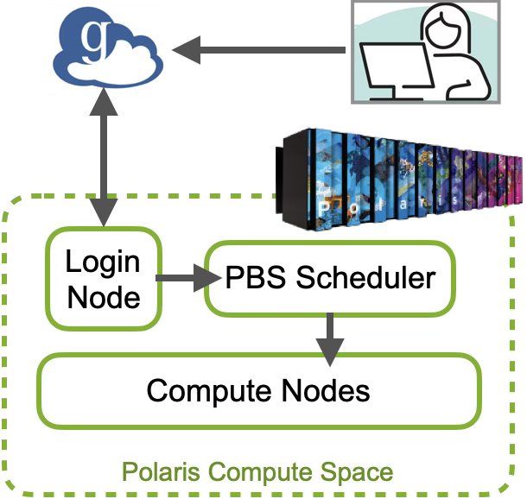
Remote Triggering of Jobs with Globus Compute
Globus Compute (GC) can be used to trigger jobs on ALCF machines from a remote location, e.g. a machine connected to an experiment
Setup entirely by user, no intervention by ALCF staff needed
Automated authentication available
Requirements:
  python environment at remote site with globus-compute-sdk
  environment on ALCF target system with the required application software (e.g. python/conda environment, paths to compiled executables, containers, etc.)
GC sends work in the form of python functions, but any type of application can be executed with subprocess.run()
Results returned through function return (for lightweight results) or moved separately with a Globus Transfer

Slide 9
Globus Compute Endpoints
Globus Compute (GC) requires prestaging a GC Endpoint process on a login/service node
GC endpoints managed with the python tool globus-compute-endpoint
Endpoint configuration specifies
  PBS job information
  Task resources and execution (e.g. number of CPUs or GPUs per task, retry conditions, etc.)
Teams maintain their own endpoints
See recent ALCF workshop materials for detailed tutorial

Slide 10
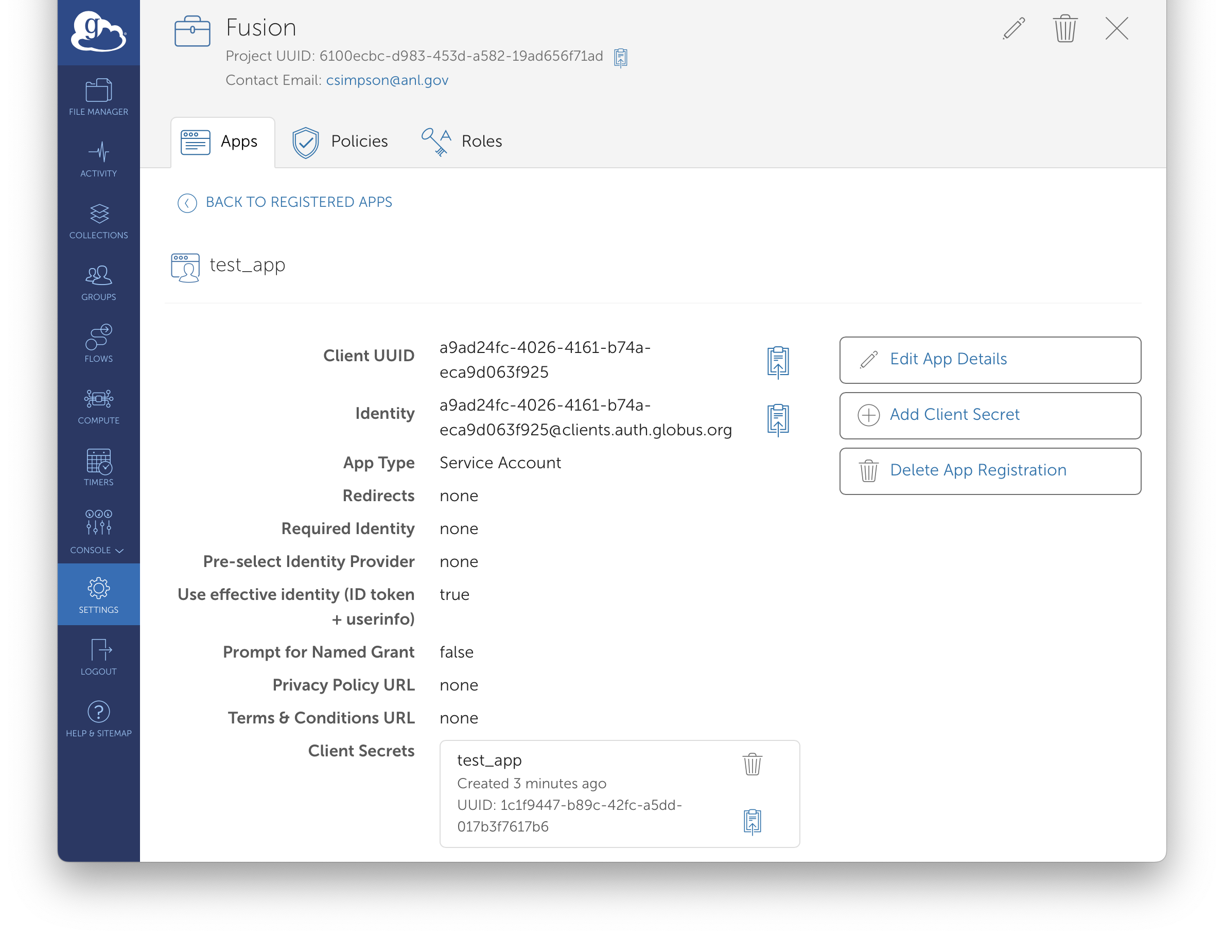
Automated Globus Auth
Authentication for Automated Services
Globus Auth allows for Automated Authentication using a Client ID and Client Secret
Useful for enabling persistent automated access between an experimental facility and ALCF
The Client Secret is a token generated by Globus that should be kept secure by the user
Policies and roles can be specified for the Client
Tools and software can access the Client and Secret from env variables set by the user in a secure manner

Slide 11
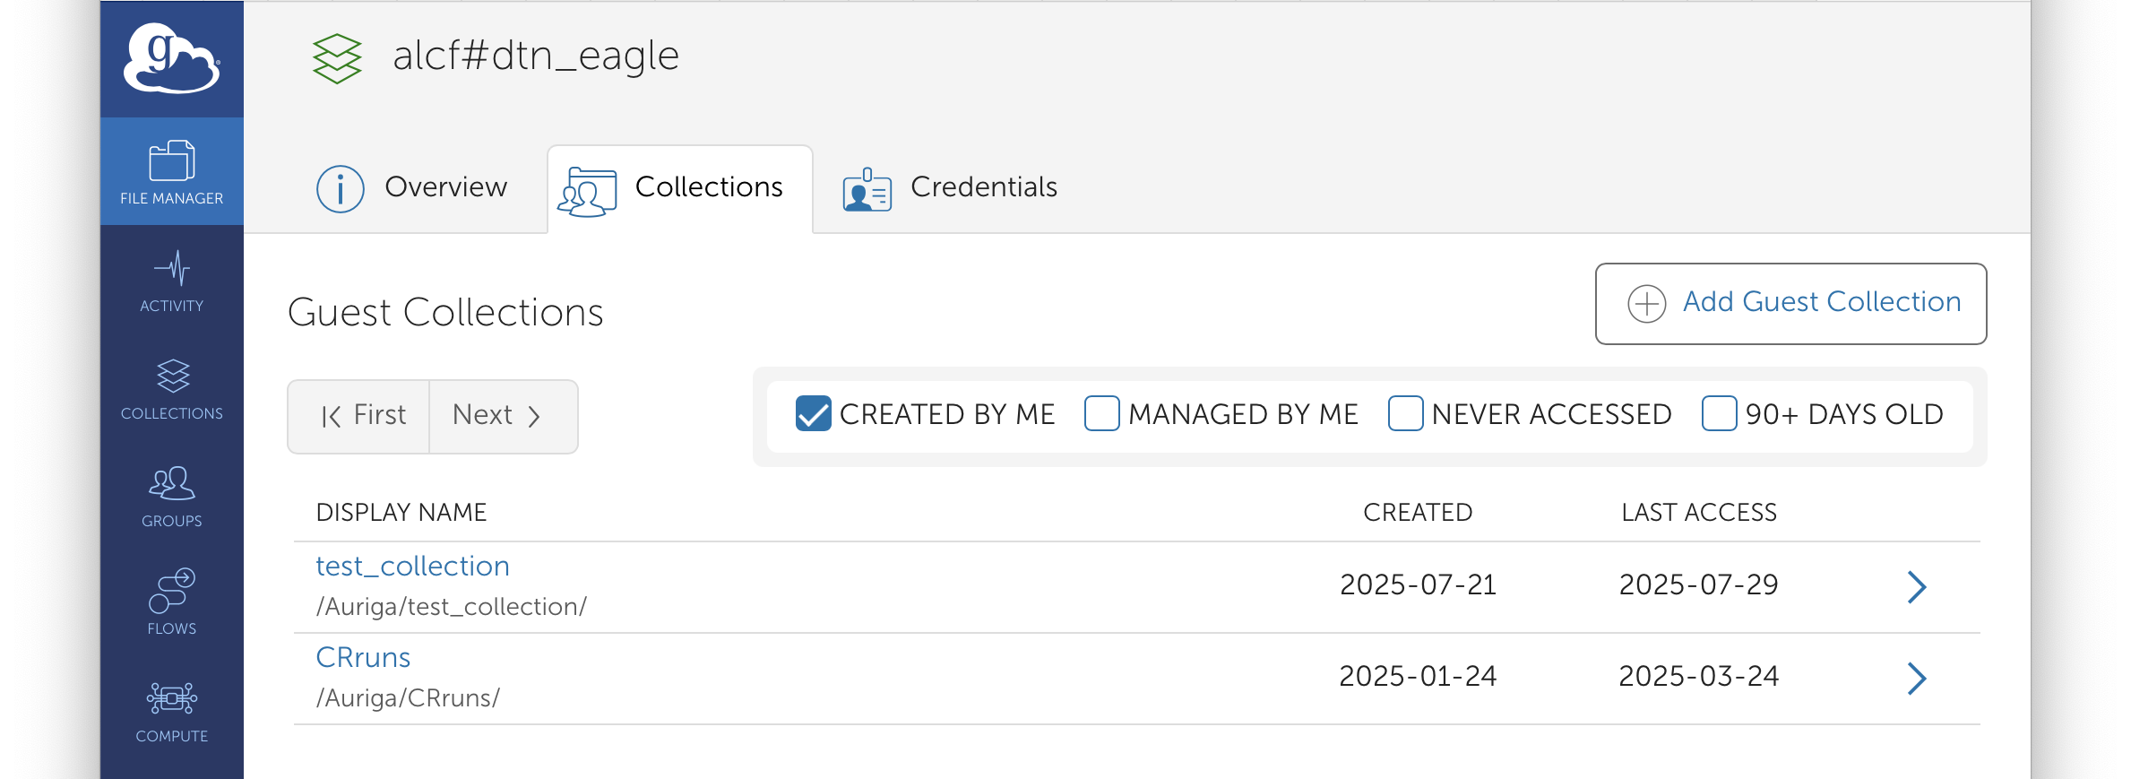
Eagle File System and Globus Guest Collections
Flexible and Performant Data Management
100 PB Lustre Parallel File System mounted on Polaris, Crux, Sophia, and Edith
Facility-maintained Globus Collection available for Globus file transfers
Project PIs can create Globus Guest Collections that allow teams to share data via Globus or https, even to unauthenticated users
Transfers can be initiated with Globus' Web UI, globus-sdk python package, or command line tool
Globus Transfers can be coordinated with Compute tasks using Globus Flows

Slide 12
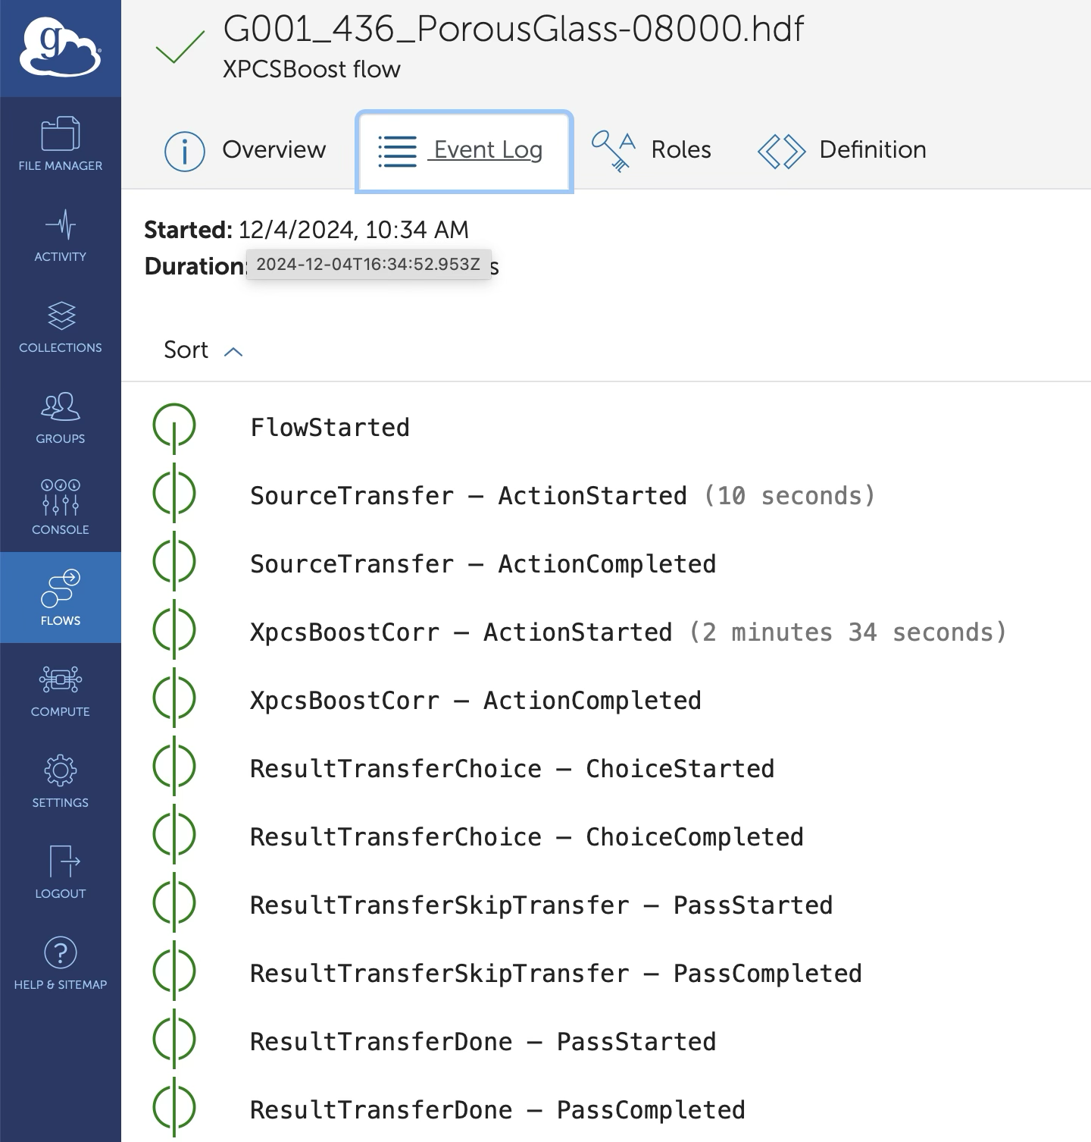
Globus Flows
Creating Workflows with Globus Compute Tasks and File Transfers
Globus Flows is an automated and managed workflow service hosted by Globus
Built on top of AWS step functions
Hosted in the cloud in the Globus Service
A ‘flow’ can couple actions of different types, e.g. a file transfer and a compute task
Other types of actions: e.g. choice actions, data cleanup actions, etc.

Slide 13
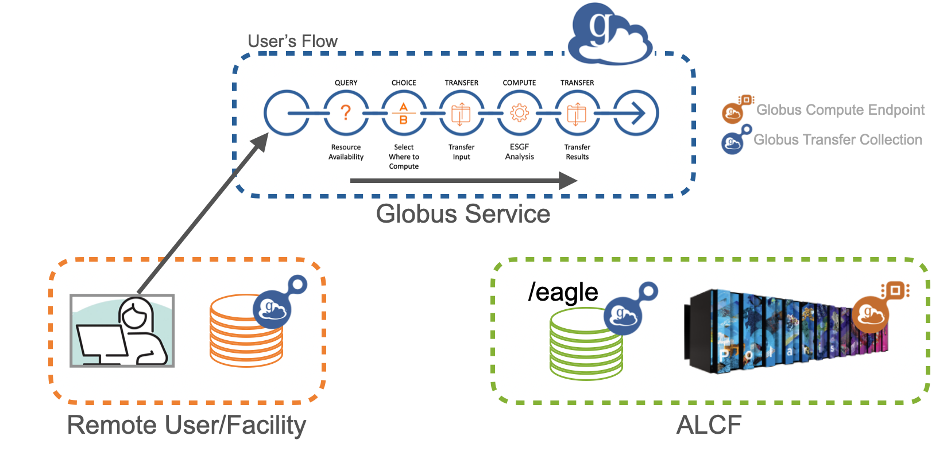
Globus Flows
Remote user/software sends Flow to Globus Service in the Cloud
Globus Service communicates with endpoints and collections to execute steps within the flow, e.g. compute endpoints to run compute actions and collections for file transfers
*More details on running flows at ALCF from recent webinar

Slide 14
Example Case from the
Advanced Photon Source

Slide 15
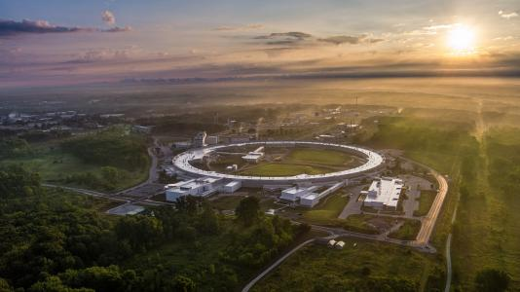
X-Ray Light Sources
Indispensable tools in the exploration of matter
Wavelengths of the emitted photons span a range of dimensions from the atom to biological cells
Scientific user facilities (5 funded by the US Department of Energy)
Serves thousands of users per year from academia, government, and industry
Diverse communities: materials research, biology, geosciences, life sciences, security, and many more
Advanced Photon Source (APS) at Argonne National Laboratory

Slide 16
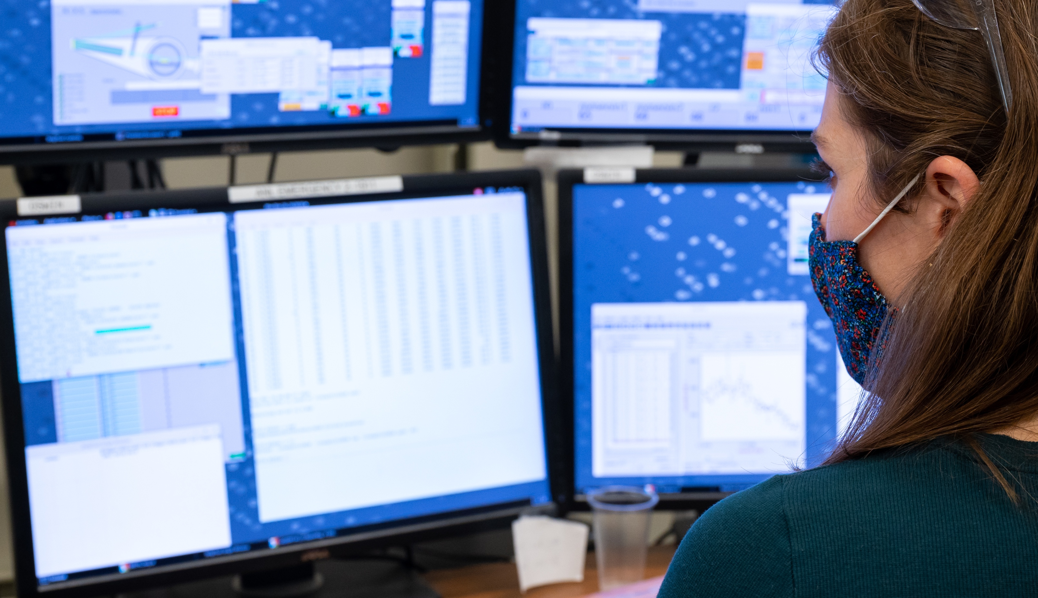
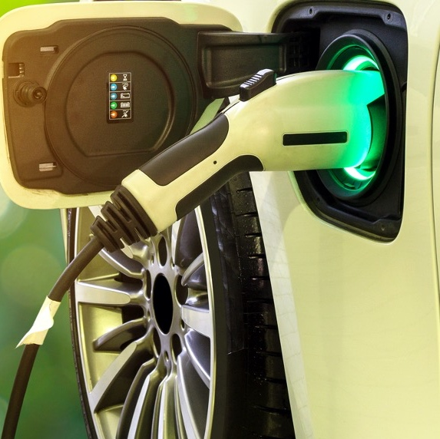
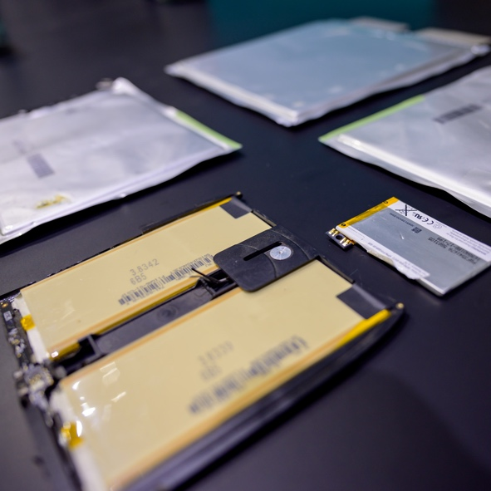
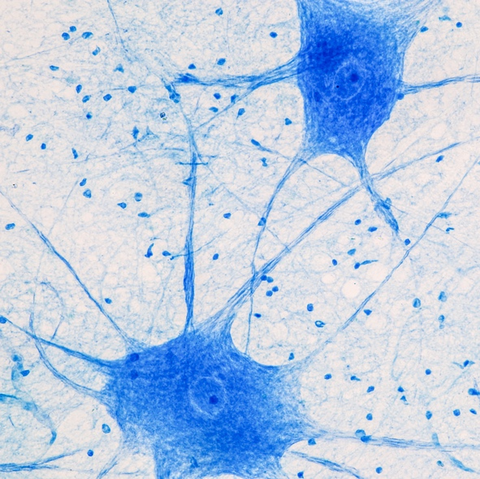
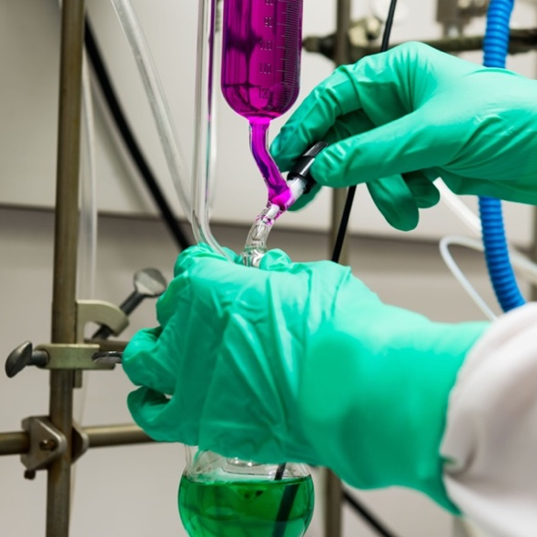


Transformational Science
Advances across research areas
CLEAN
ENERGY
BATTERY LONGEVITY
BRAIN MAPPING
CUSTOM MATERIALS

Slide 17
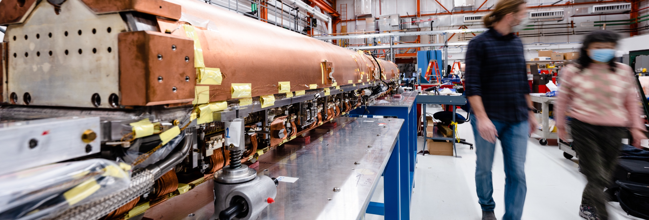
The Upgraded Advanced Photon Source
Illuminating our world
Intense
X-ray beams
Penetrates deep inside materials for atom-scale views of our world
Upgraded
light source
Up to 500x brighter than previous APS for
higher resolution
Rapid-speed captures of nature
Can image materials in less than a billionth of a second

Slide 18
Scale of the Problem
Data
Archiving
APS-U Shutdown
Multiple order-of-magnitude increase in demand for computing resources
Over the past decade the APS has
Created over 9000 experiments in the Data Management database
Used 4.9PB of storage space
Over the next decade the APS will
Generate 100s of petabytes (PBs) of raw data per year
Require 10s of petaflop/s of on-demand computing power

Slide 19
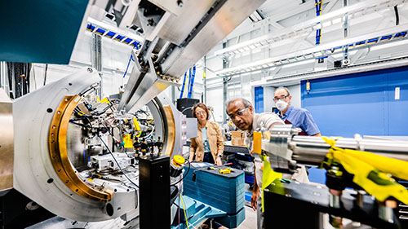
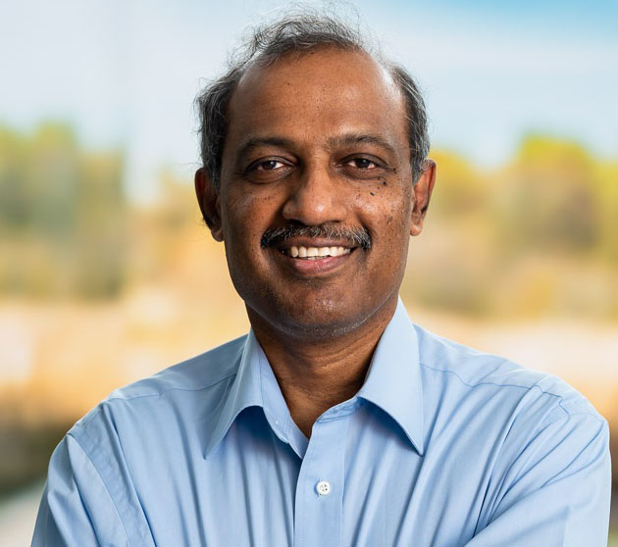

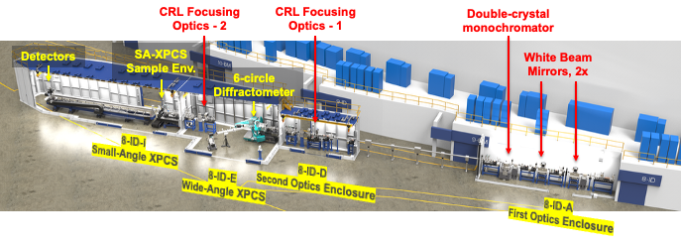
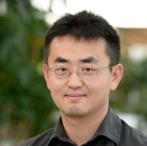
X-ray Photon Correlation Spectroscopy Beamline 8-ID
One of 8 feature beamlines reconstructed during the APS upgrade
8-ID-E for atomic scale dynamics in hard condensed matters
8-ID-I for mesoscale dynamics in soft condensed matters
Suresh Narayanan (group leader), Eric Dufrense, Qingteng Zhang

Slide 20
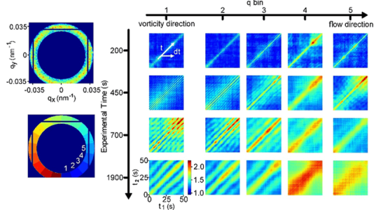
Impact of XPCS Experiments at Beamline 8-ID
Research outcomes include study of cartilage and joints, solar cells, flexible electronics, plastics, batteries, glass, effect of stress on the body, viruses, and more
255 publications attributed to research at 8-ID in the past 5 years
https://www.aps.anl.gov/Sector-8/8-ID/Science-and-Research/Research-Highlights-and-News
https://beam.aps.anl.gov/pls/apsweb/pub_v2_0009.publication_stats_detail
Research Highlight: Understanding the microscopic origin of shear thickening and how friction can affect particle motions. Shear thickening occurs in many industrial mixing processes and directly impacts energy consumption.
J. P. Horwath et al., Physical Review Letters (2025)
https://doi.org/10.1103/PhysRevLett.134.178202

Slide 21
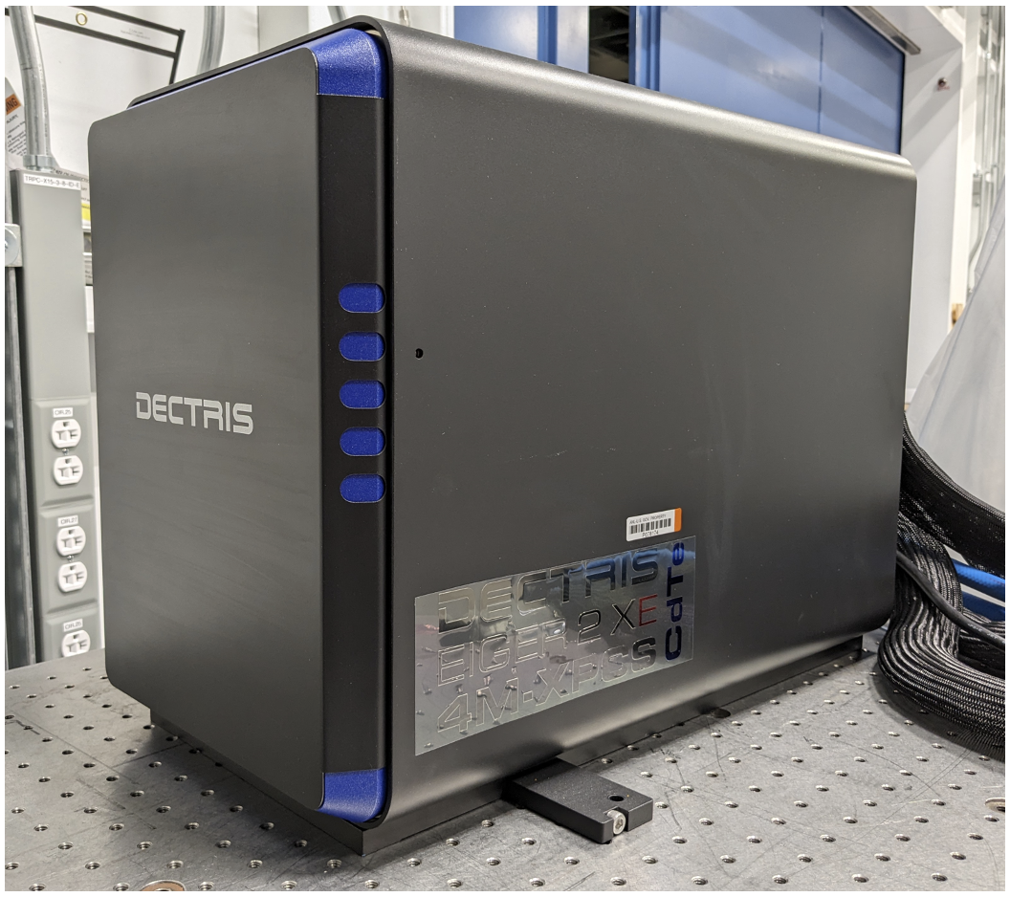
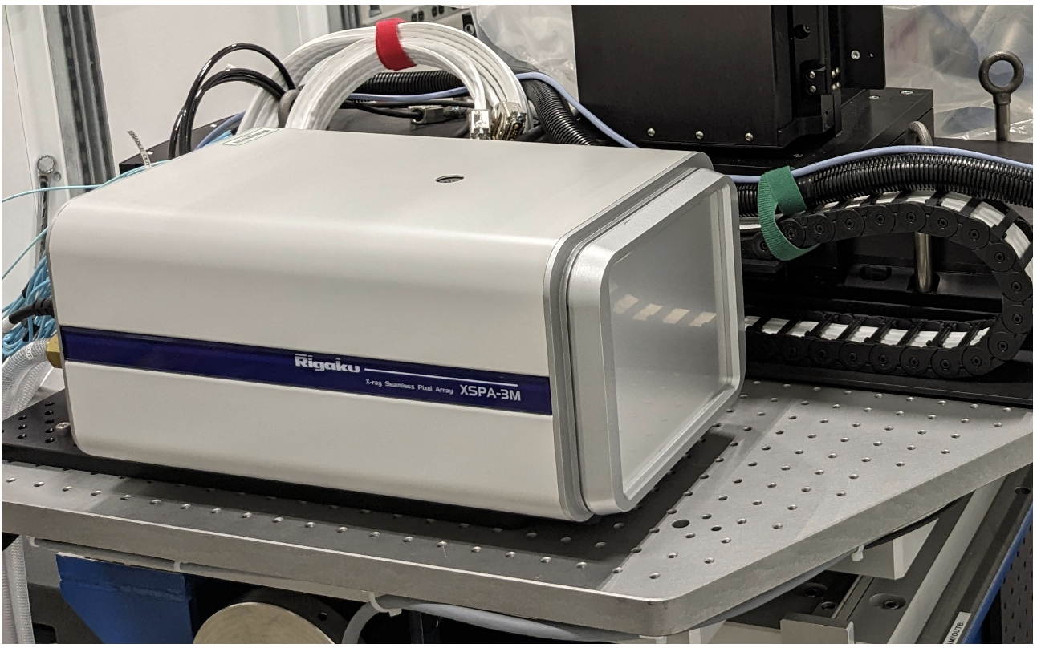
8-ID Pushes the Limits of Data Generation
Over 450 experiments in APS Data Management database
About 400 TB storage space used
About 9 million cataloged files
A recent experiment collected 69810 datasets with 8000 frames each @ 4 kHz (2 sec per dataset). 1 job was submitted to the Polaris supercomputer every 2-3 sec. The total data was 61 TB (compressed)
Typical experiments are expected to generate about 900-720 files an hour for several hours nonstop
Dectris Eiger 4M CdTe sensor
Rigaku XSPA 3M Si sensor

Slide 22
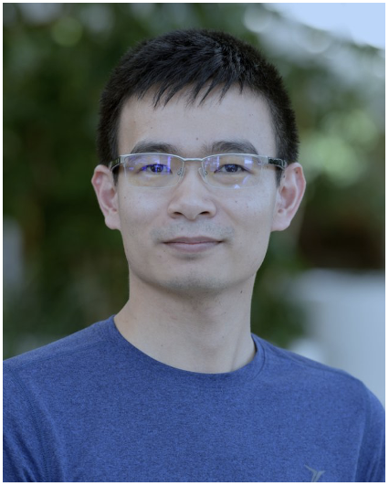
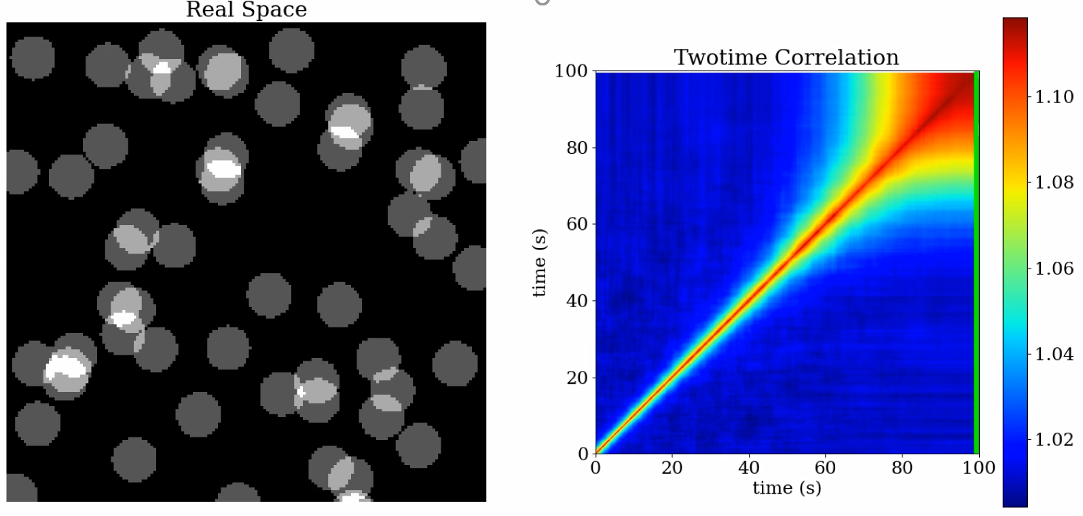
Boost Corr for Efficient XPCS Data Processing
Twotime correlation captures non-equilibrium dynamics by calculating pair-wise correlation from every frame in a continuous acquisition
MultiTau is an average of the two-time correlation in the diagonal direction to produce a 1D correlation as a function of delay time
g₂ (MultiTau Correlation)
Stage 2
Stage 2
Stage 1
Stage 1
Delay Time
|t₁-t₂|
Miaoqi Chu
https://github.com/AZjk/boost_corr
Notes:
For these non-equilibrium systems, we will have to bin C2 into g2 to sample dynamics at different stages of the non-equilibrium process. Apparently, the stronger the scattering, the smaller our binning window, and the more accurately our g2 plots depict the non-equilibrium dynamics. However, there are also situations where g2 does not represent the non-equilibrium dynamics at all and we absolutely have to use C2, and we’ll see an example later in this talk.

Slide 23
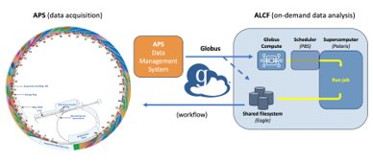
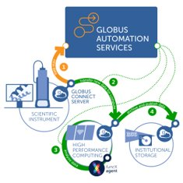
Bridging Large-scale Facilities
Partnerships with ALCF and Globus Accelerate Scientific Discovery
Facility (ALCF/NERSC) collaboration means APS users do not need to navigate HPC
  Priority “on-demand” queue for real time processing at ALCF
  Service/collaboration accounts for beamlines
  Computing allocations for APS
Globus Compute
  Function-as-a-service platform for remote job execution
  Endpoints deployed at ALCF/NERSC
  Secure access to data and compute resources

Slide 24

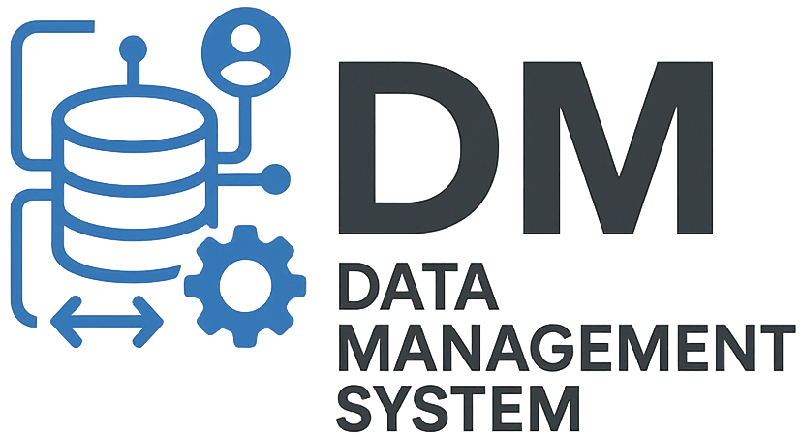
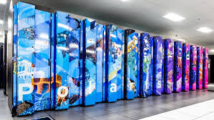
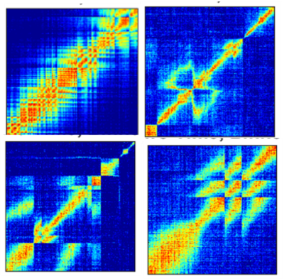
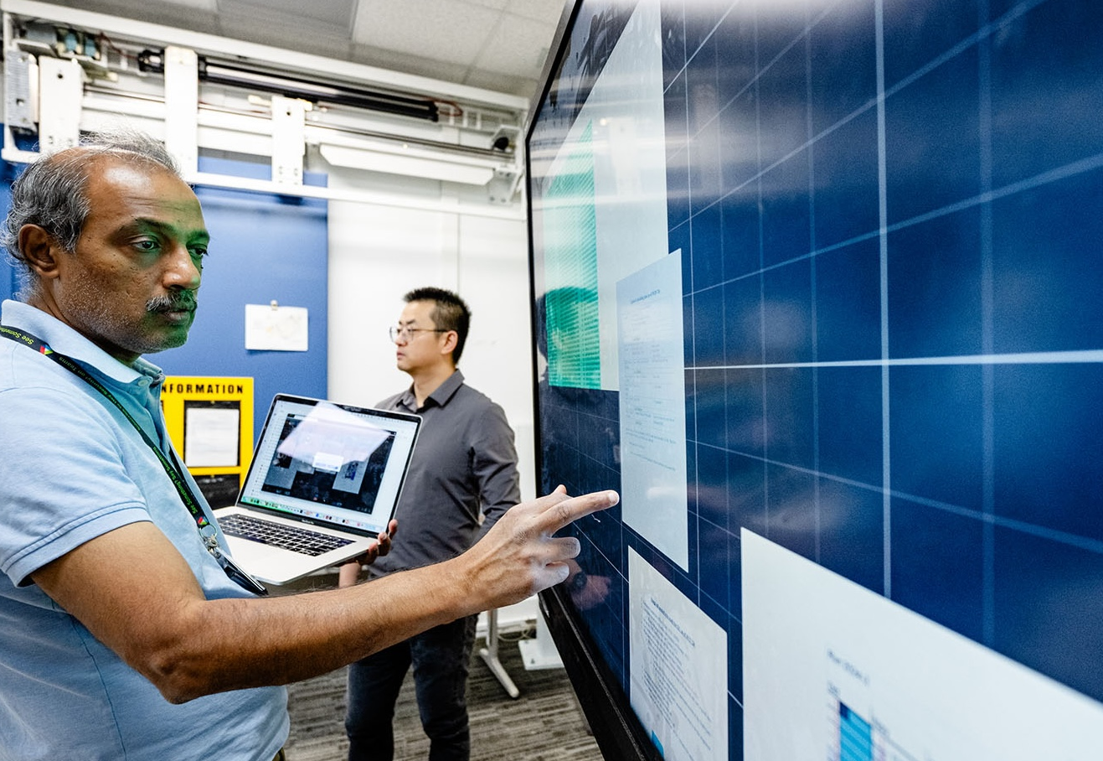

An End-to-End Pipeline for XPCS Data
A comprehensive and unified approach to manage data at every stage of the experiment data life cycle
Bluesky runs plans to control experiment
3. APS Data Management
sets user access and
launches workflow
5. Boost Corr processes data
7. Scientists interpret data
and make decisions
about the experiment
4. Globus moves data to
ALCF and submits to
Polaris job queue
6. Globus moves analysis
result back to APS
2. Detectors generate data

Slide 25
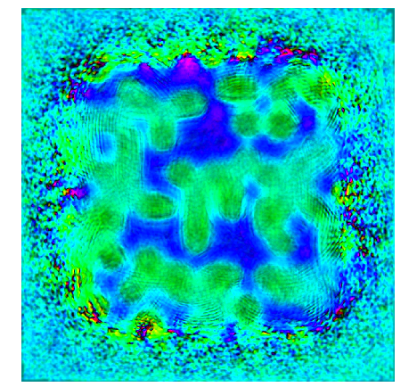
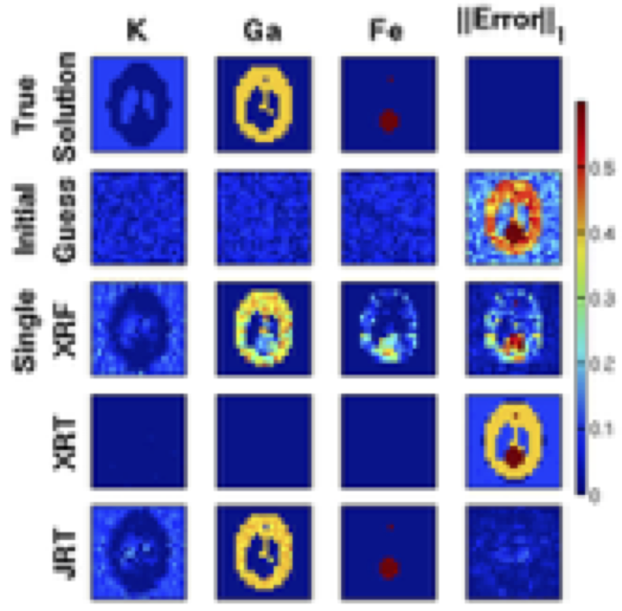
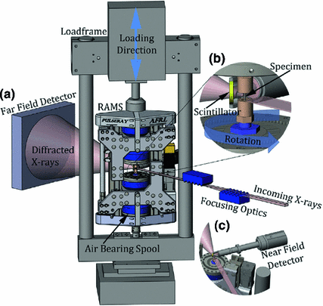
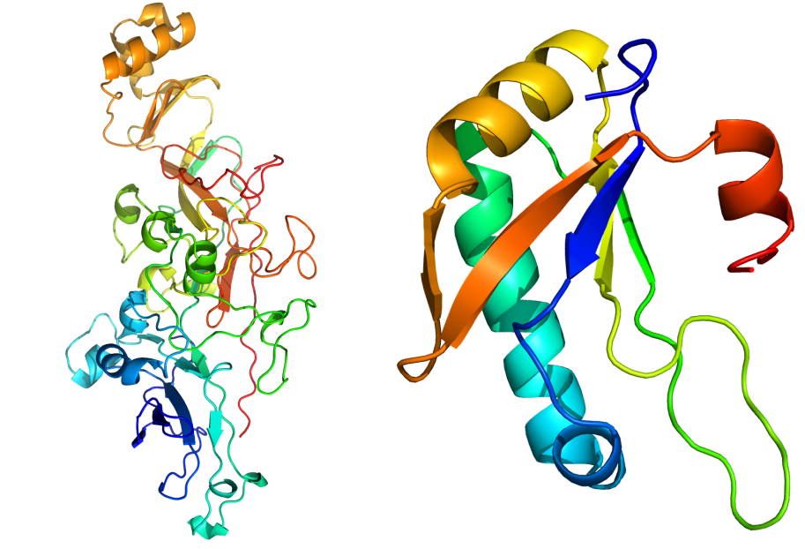
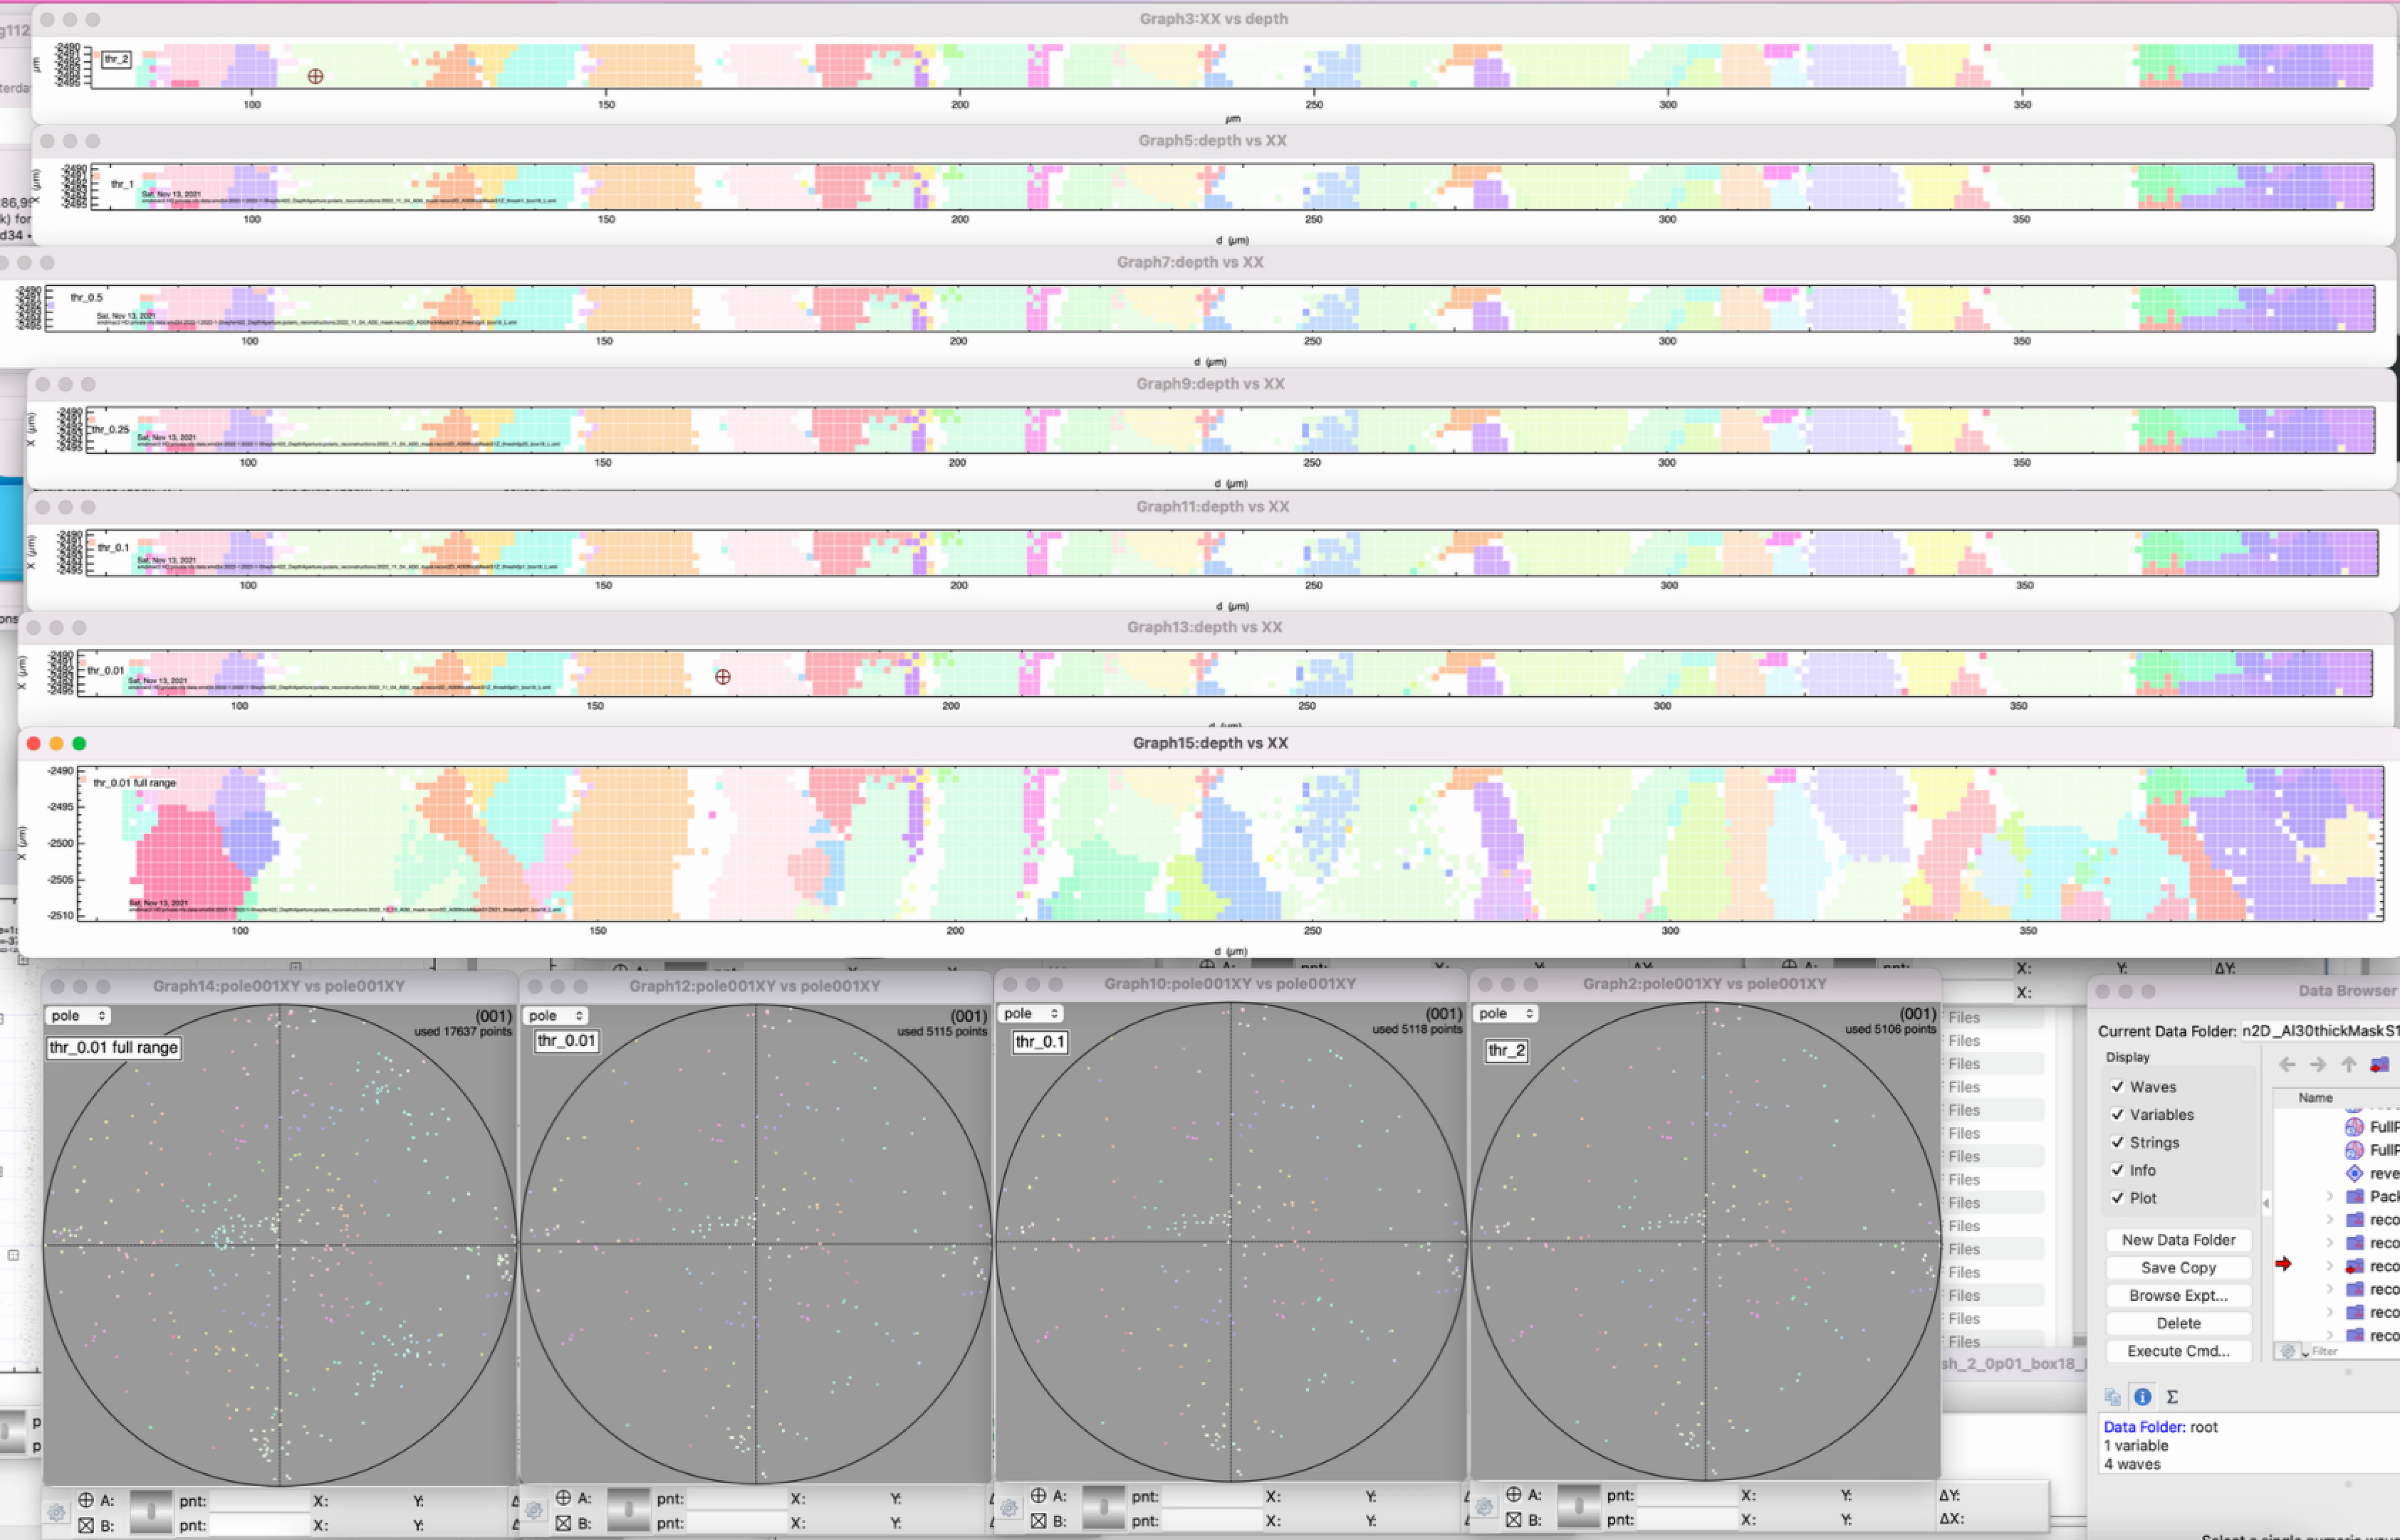
Data Processing
Standardized processing for common x-ray techniques
High-energy Diffraction Microscopy
1ID, 20ID
https://github.com/marinerhemant/MIDAS
Wide Angle and Small Angle X-ray Scattering
1ID, 20ID, 12ID
https://github.com/marinerhemant/MIDAS
X-ray Photon Correlation Spectroscopy
8ID, 9ID, 28ID
https://github.com/AdvancedPhotonSource/boost_corr
Crystallography
21ID, 23ID, 24ID
https://www.gmca.aps.anl.gov/
Laue Micro-diffraction
34ID
Prince et al., 2023
Ptychography
2ID, 4ID, 9ID, 12ID,19ID, 26ID, 28ID, 31ID, 33ID
https://github.com/AdvancedPhotonSource/ptychodus
Grazing Incidence X-ray Scattering
9ID
Werzer et al., 2024
Tomography/Laminography
1ID, 2ID, 2BM, 7BM, 19ID, 20ID, 31ID, 32ID
https://github.com/tomography/tomocupy/
X-ray Fluorescence Microscopy
2ID, 4ID, 12ID, 19ID, 33ID
https://github.com/AdvancedPhotonSource/XRF-Maps

Slide 26
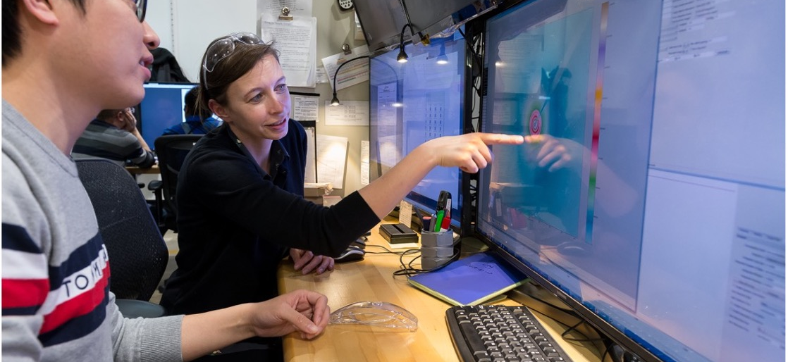
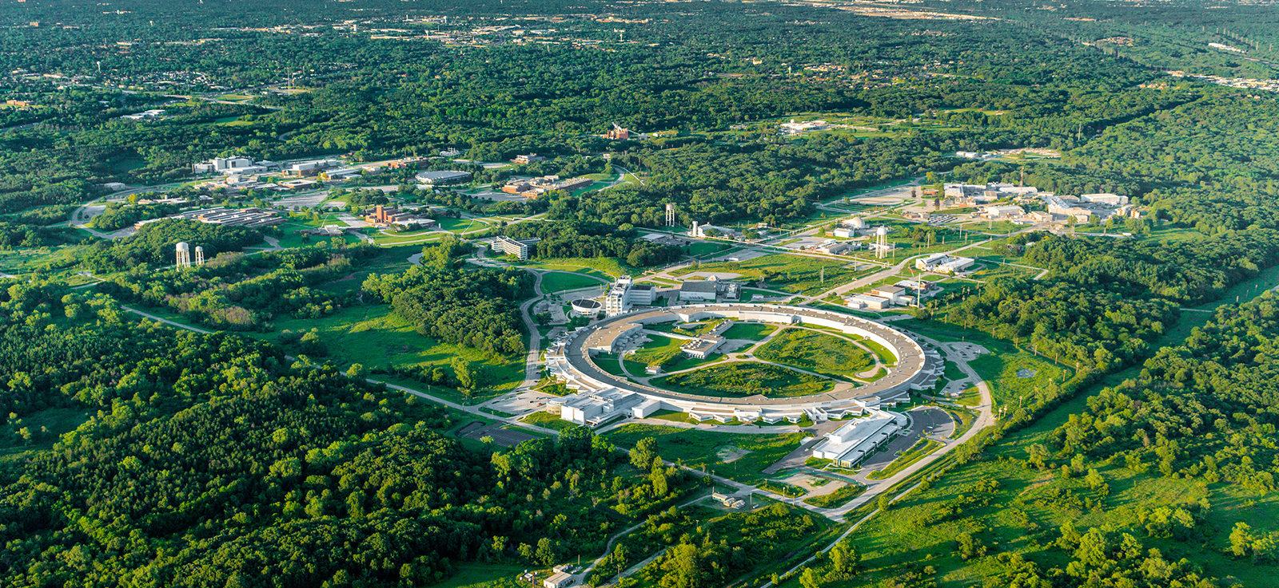
Impact
Partnerships with Globus and ALCF enable scientists to streamline data management and access high-performance computing resources, enhancing research capabilities and accelerating discovery.

Slide 27
Conclusion

Slide 28
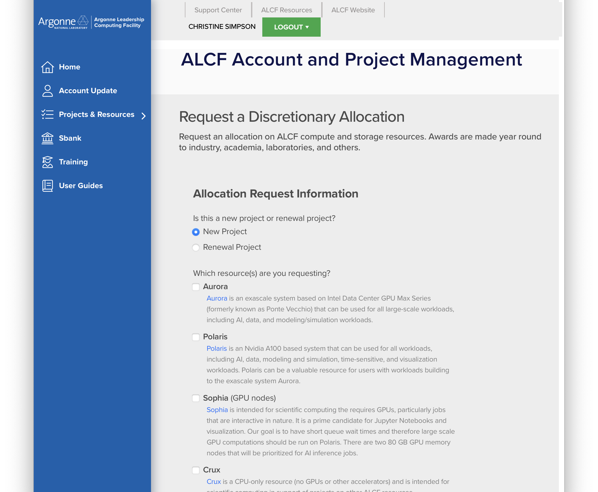
How can you experiment with these tools at ALCF?
Request a Director’s Discretionary allocation, a brief project summary is all that is required
  Go to our Get Started page: https://www.alcf.anl.gov/get-started
  Requests up to 5k node hours for Crux and Polaris can usually be accommodated
  Space on Eagle can also be requested here
Access to a service account and demand queues requires special permission, email support@alcf.anl.gov and we will work with you
Globus tools are available to any ALCF user and to users of many other facilities and institutions
Have a special need not addressed by any of the tools or techniques in this talk? We’re happy to discuss your needs, please reach out

Slide 29
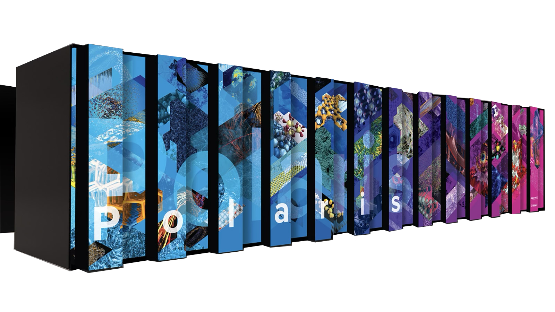
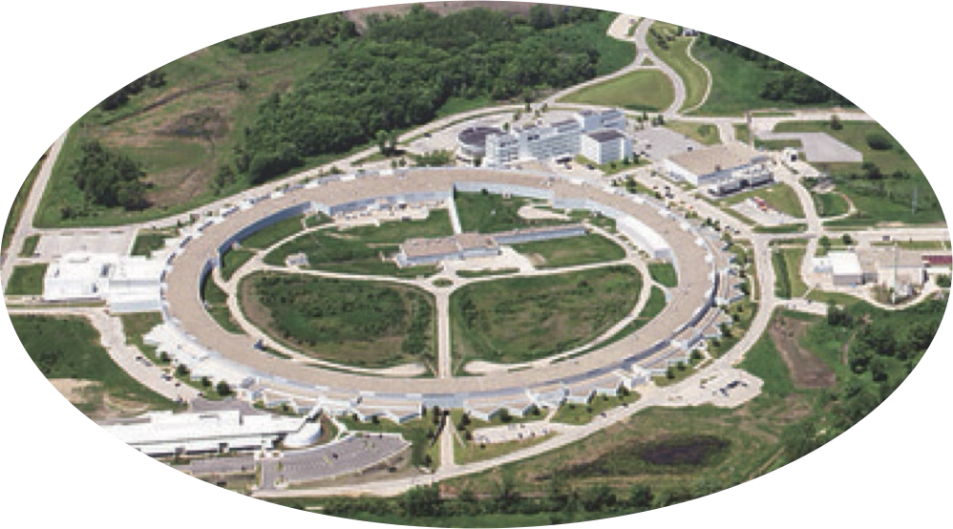
ALCF Service-Enabled Science Series
Thank you for your attention!
This is the first in a series of webinars and training events focused on Service-Enabled Science at ALCF
Stay tuned for our next webinar
We expect to begin training events in early 2026
Future topics that we will explore:
  Services for multi-facility workflows
  Data portals
  Inference services
  More example applications from tokamak experiments and earth science experiments
  Training events with hands on examples for some of what we covered today

