Slide 1
DAOS – Distributed Asynchronous Object Storage
Paul Coffman (pcoffman@anl.gov) ALCF Performance Engineering Team

Slide 2
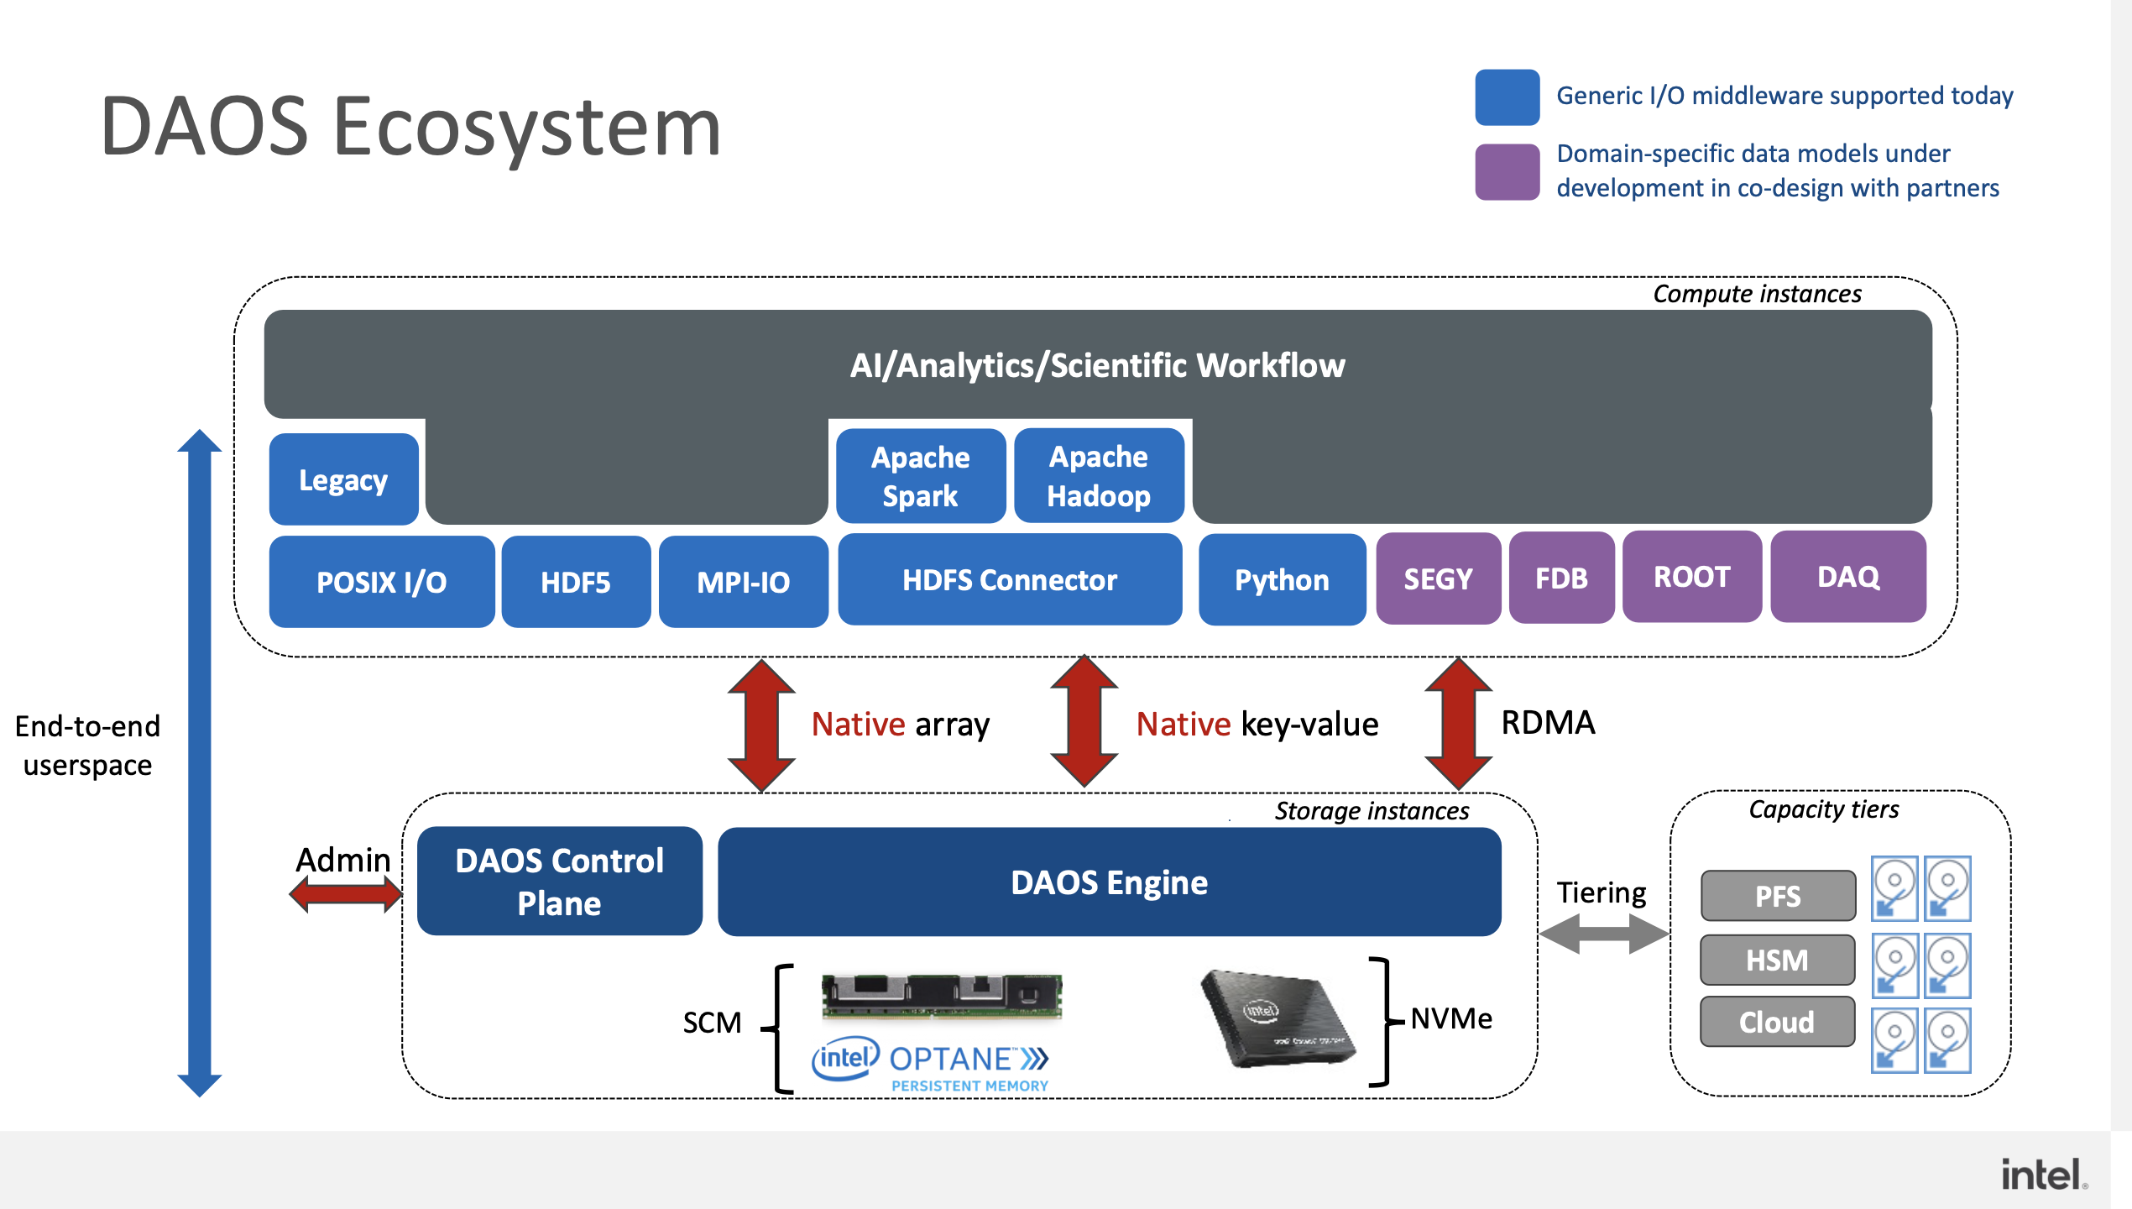
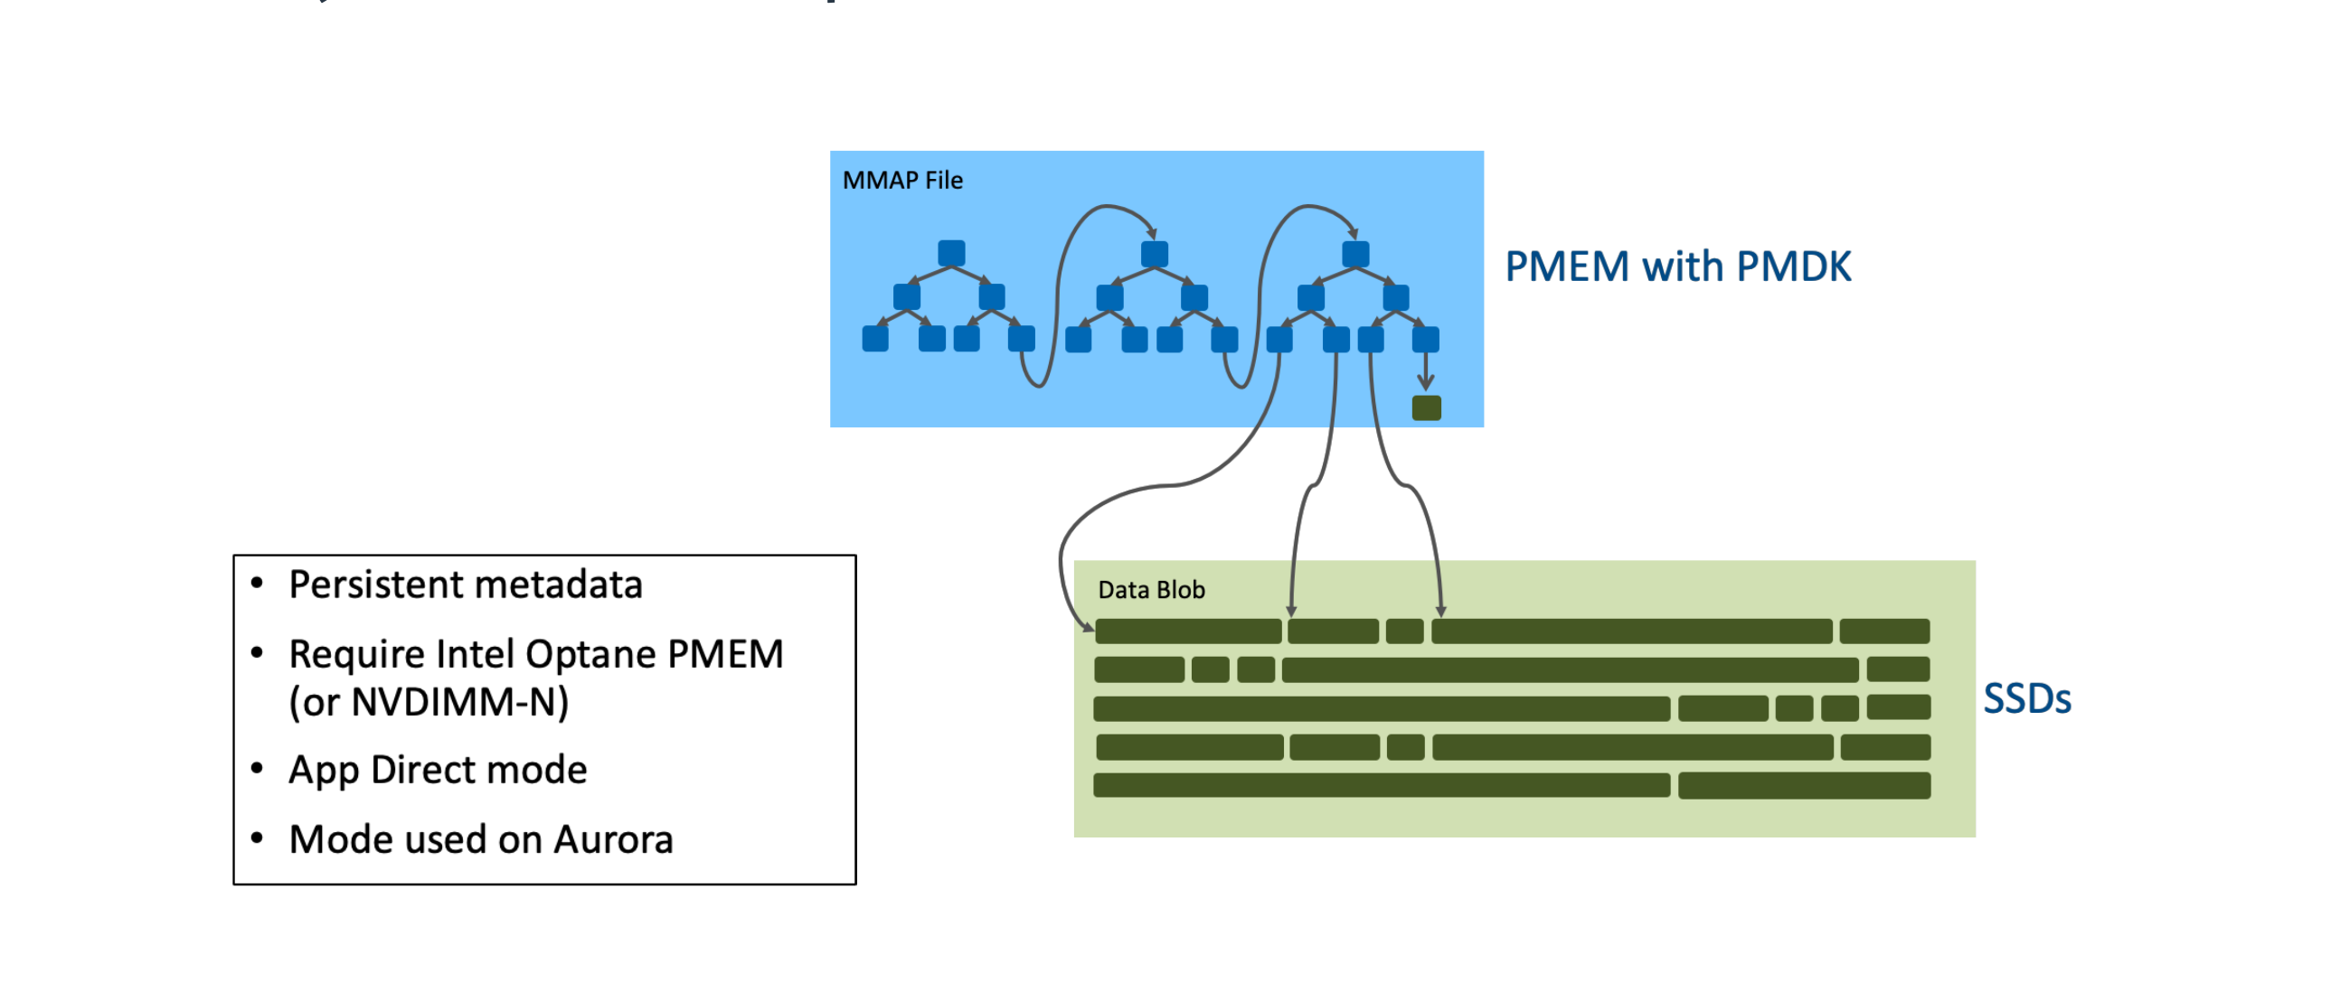
DAOS Ecosystem and Design Fundamentals
Distributed Key-Value Object Store with several interfaces
Full end-to-end userspace – avoid kernel space overhead
Efficient for unstructured data
Efficient for accessing small data.
High bandwidth, low latency, and IOPS
No read-modify-write on I/O path (use versioning)
No locking
No centralized (meta)data server
Self-healing data protection

Slide 3
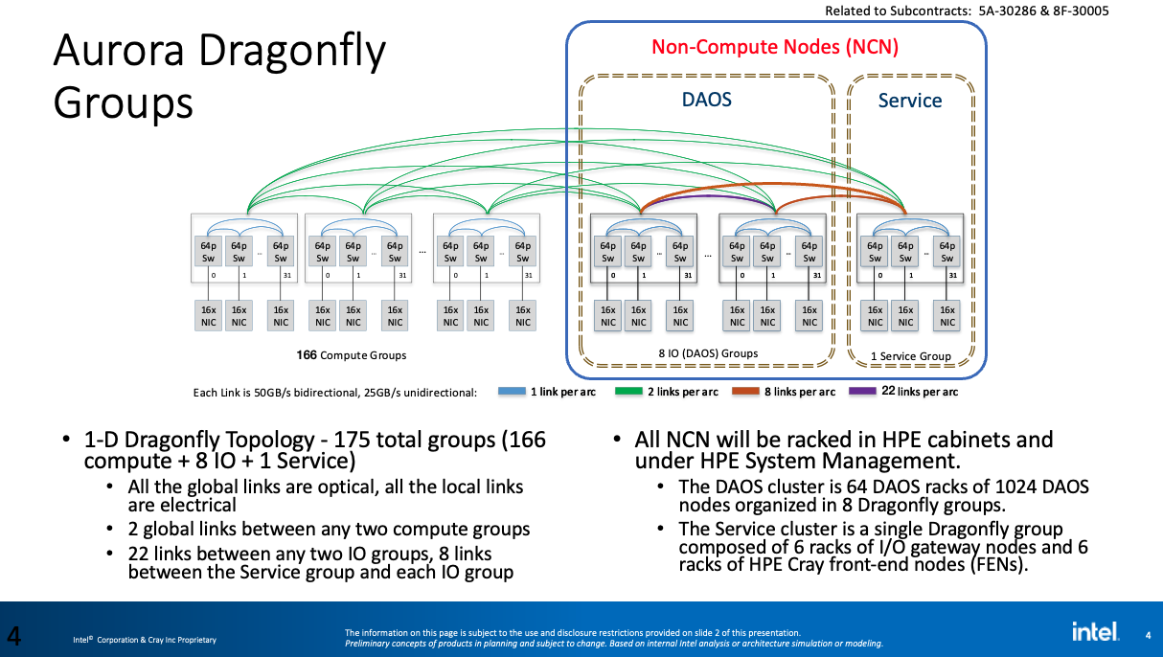
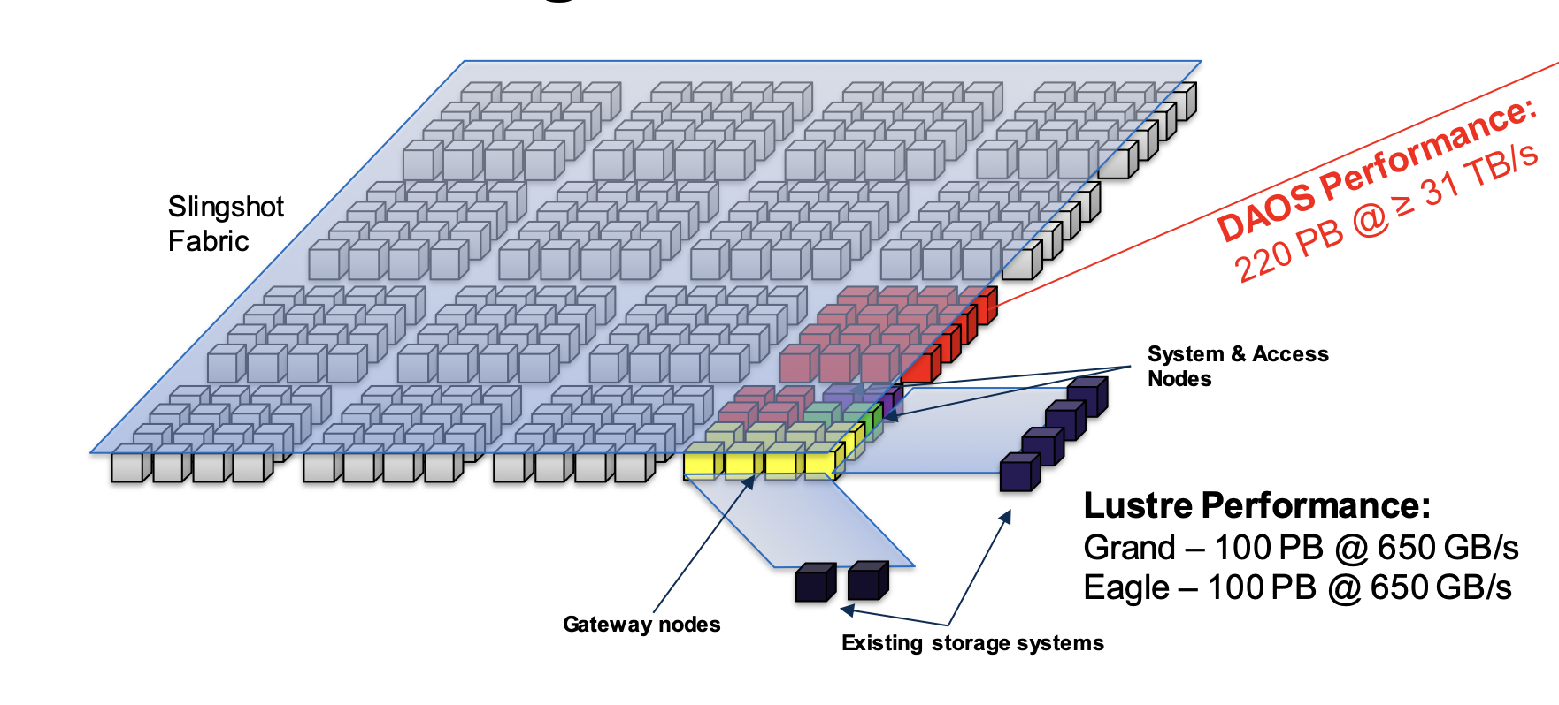
Network Architecture – slingshot fabric - Dragonfly

Slide 4
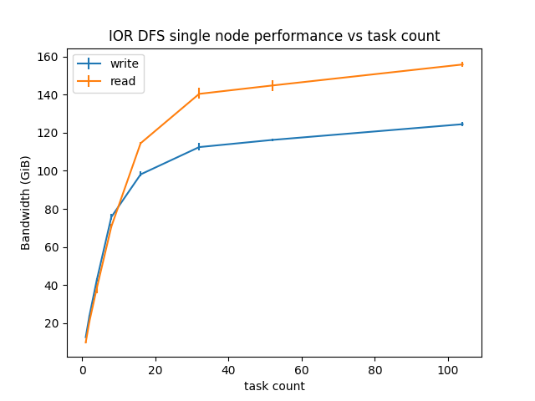
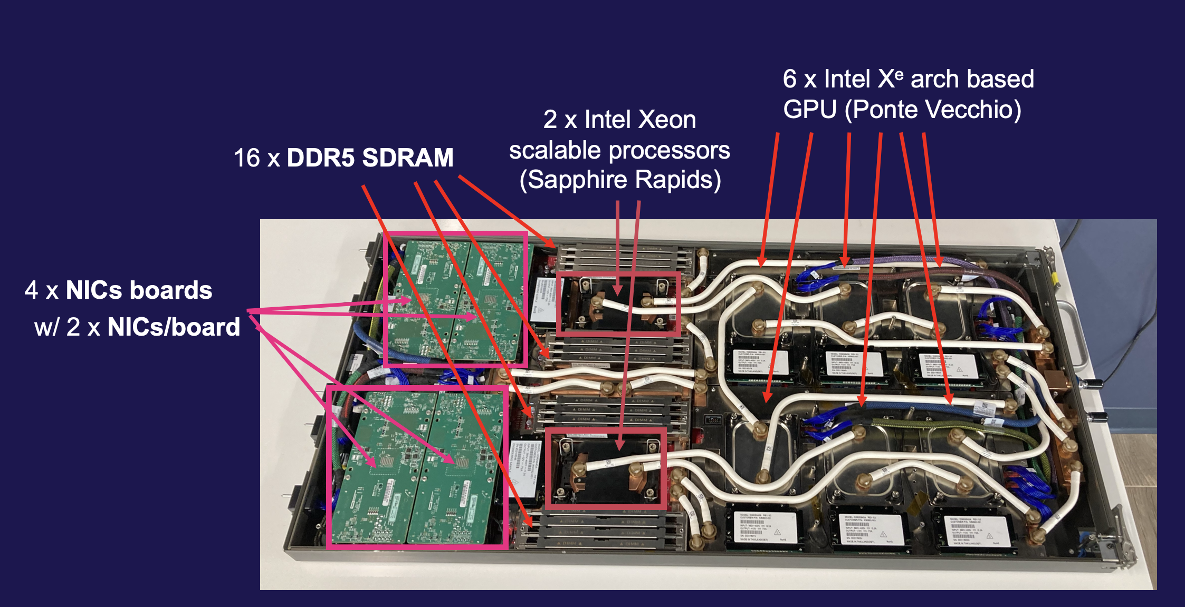
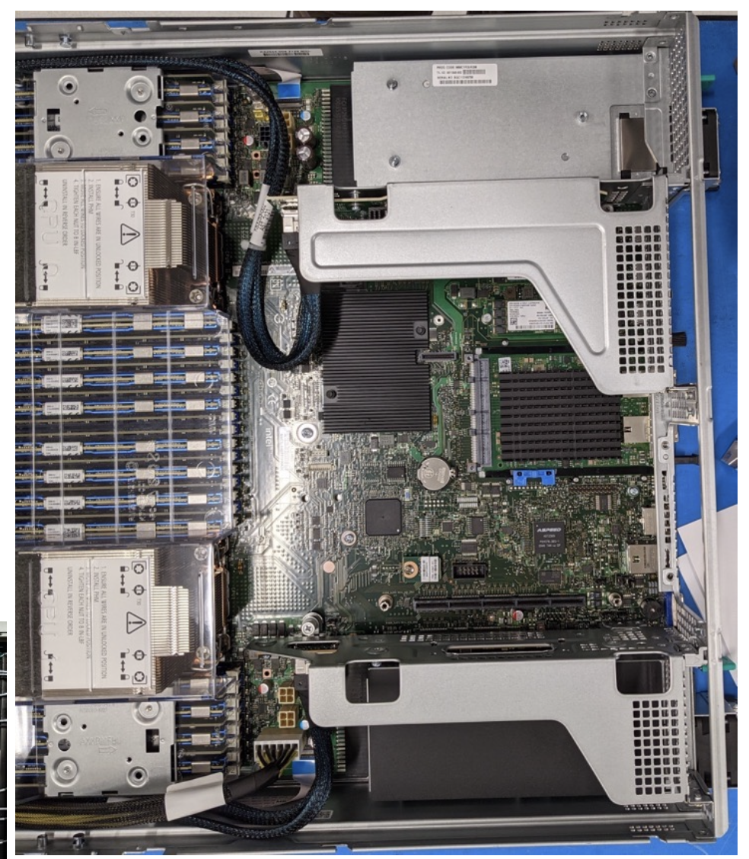
A single Aurora compute node
A single DAOS storage node
8 NICs, 52 cores per socket, 2 sockets
25GB/s X 8 NICs = 200 GB/s
1024 Total DAOS Servers
Each node will run 2 DAOS engines
2048 DAOS engines, 16 targets per engine on 8 SSDs
Servers currently partitioned into several clusters
Intel Coyote Pass System
(2) Xeon 5320 CPU (Ice Lake)
(16) 32GB DDR4 DIMMs
(16) 512GB Intel Optane Persistent Memory 200
(16) 15.3TB Samsung PM1733
HPE Slingshot NICs
(25 ~ 20) GB/s X 2 NICs = 40GB/s

Slide 5
Most common data access modalities
POSIX via DFUSE
MPI-IO
Data libraries (HDF5, PNetCDF) mainly via MPI-IO
DFS
Python via PyDAOS python module (experimental)

Slide 6
daos_user
377 server cluster for users, ~90 PB
2 logical partitions:
  127 'old' ~4 TB/sec max bandwidth with redundancy factor 3
  250 'new' ~8 TB/sec max bandwidth with redundancy factor 3
  Which your pool gets depends on data requirements
  Compare bandwidth to lustre flare ~650 GB/sec unreliably
Availability ~90% - not a production resource
  Very susceptible to network issues
  SSD and PMEM failures
  Current rebuild time and performance impact
Data loss possibility
  Back up your data periodically (VAST,flare)
    Data-mover utilities

Slide 7
User Guides
https://docs.alcf.anl.gov/aurora/data-management/daos/daos-overview/
https://docs.alcf.anl.gov/aurora/data-management/moving_data_to_aurora/datamover

Slide 8
Acknowledgements
Alex Kulyavtsev, Kevin Harms, Kaushik Velusamy, Paul Coffman, Huihuo Zheng, Venkatram Vishwanath
HPE DAOS team: Mohamad Chaarawi, Johann Lombardi, John Carrier, Sylvia Chan
MCS team: Rob Latham
This research used resources of the Argonne Leadership Computing Facility, which is a DOE Office of Science User Facility supported under Contract DE-AC02-06CH11357.
This research was supported by the Exascale Computing Project (17-SC-20-SC), a joint project of the U.S. Department of Energy’s Office of Science and National Nuclear Security Administration, responsible for delivering a capable exascale ecosystem, including software, applications, and hardware technology, to support the nation’s exascale computing imperative.

